Slide 1
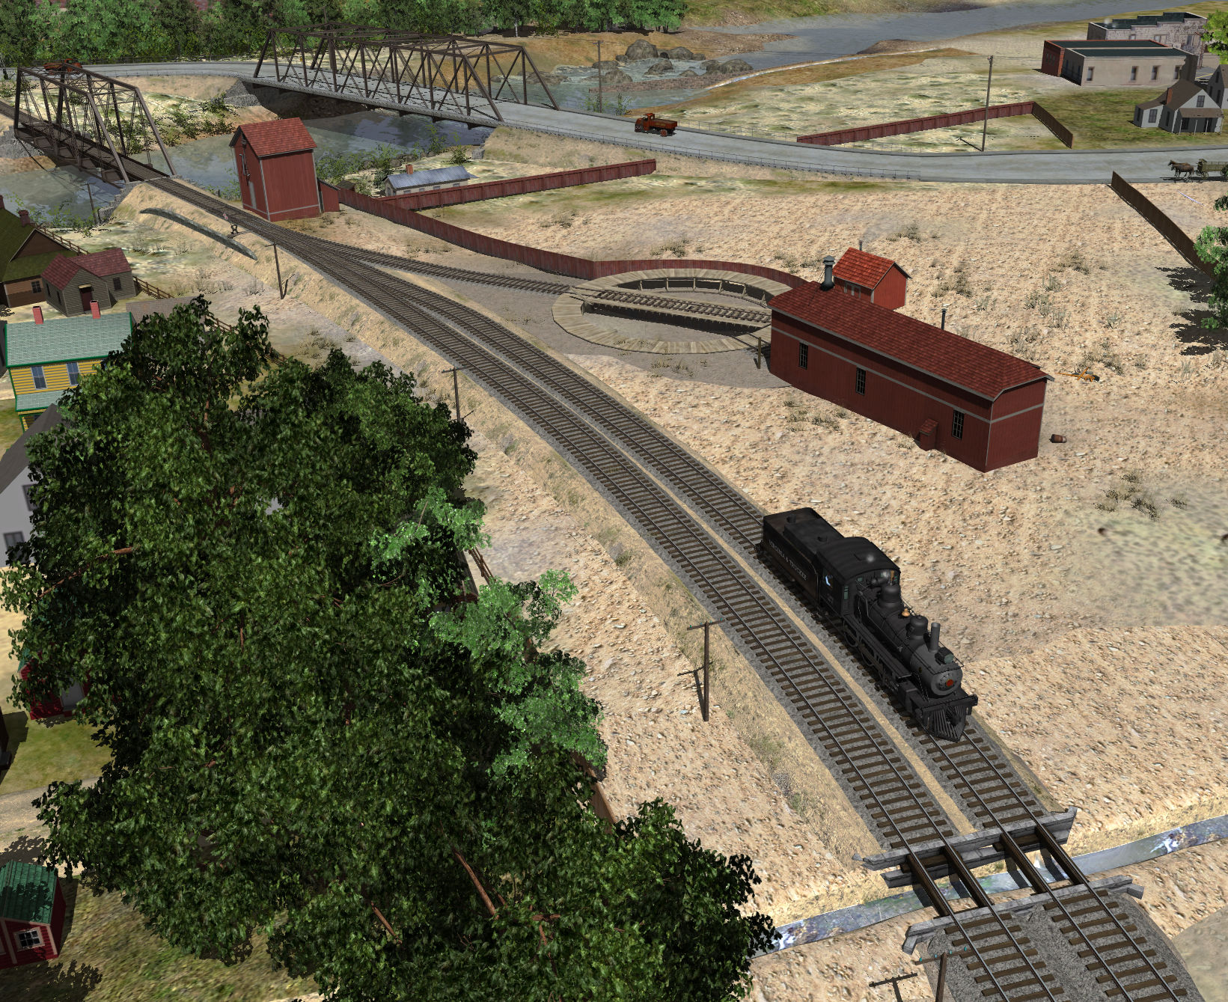
An Illustrated History of the V&T’s Reno Yard
2017 Virginia and Truckee Railroad History Conference
By Curtis Reid

Slide 2
Special thanks to:
Mike Collins
Stephen Drew
The University of Nevada Special Collections

Slide 3
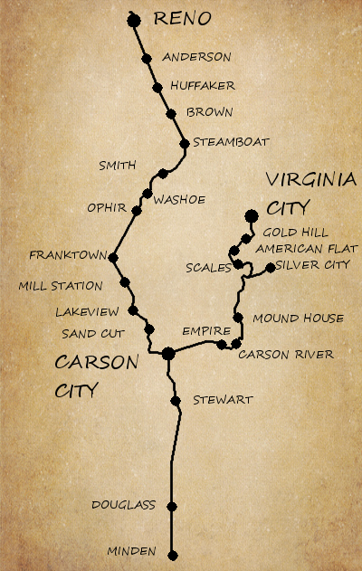
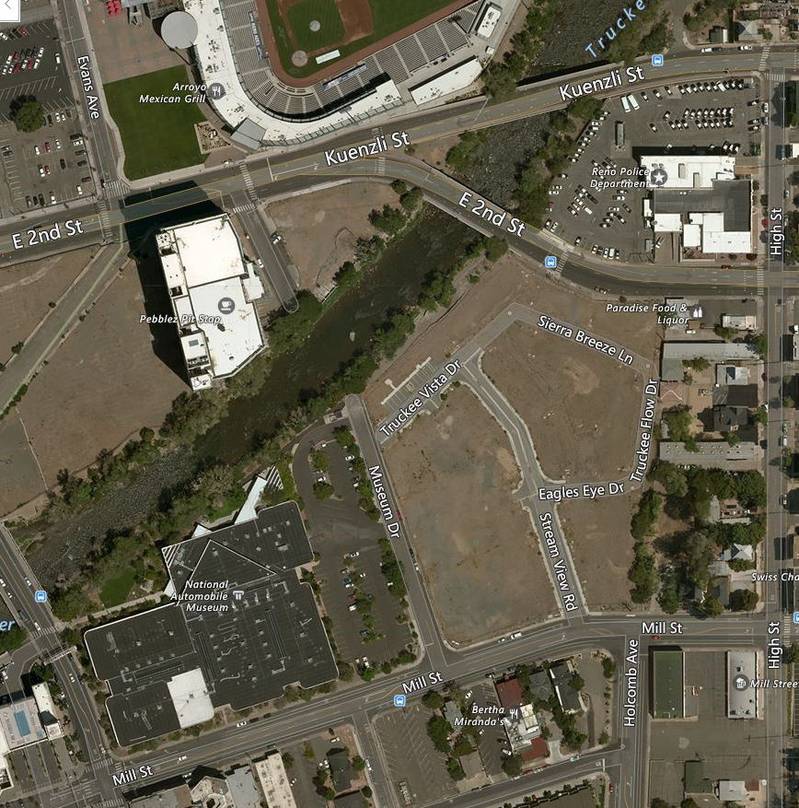
Location:
Downtown Reno; just South of the Truckee River:
Image courtesy Bing Maps

Slide 4
Reno Background
1850s: Pioneers begin to settle the Truckee Meadows
1859: Charles Fuller builds a bridge across the Truckee River
1861: Fuller sells the bridge to Myron Lake; who develops 'Lake's Crossing'
1868: Reno founded by the Central Pacific
1871: Reno becomes the Washoe County seat
1871: The V&T starts building from Reno

Slide 5
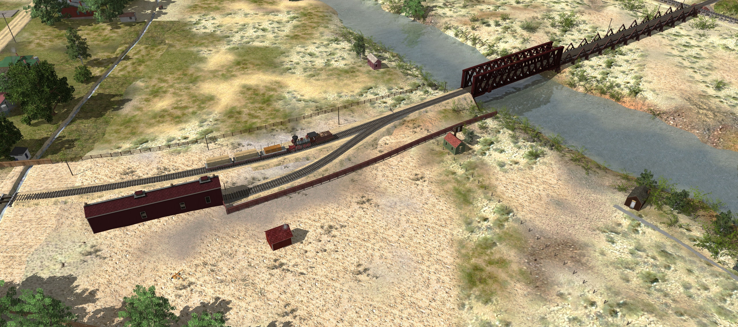
1871
Construction started
Bridge; engine house; blacksmith shop built

Slide 6
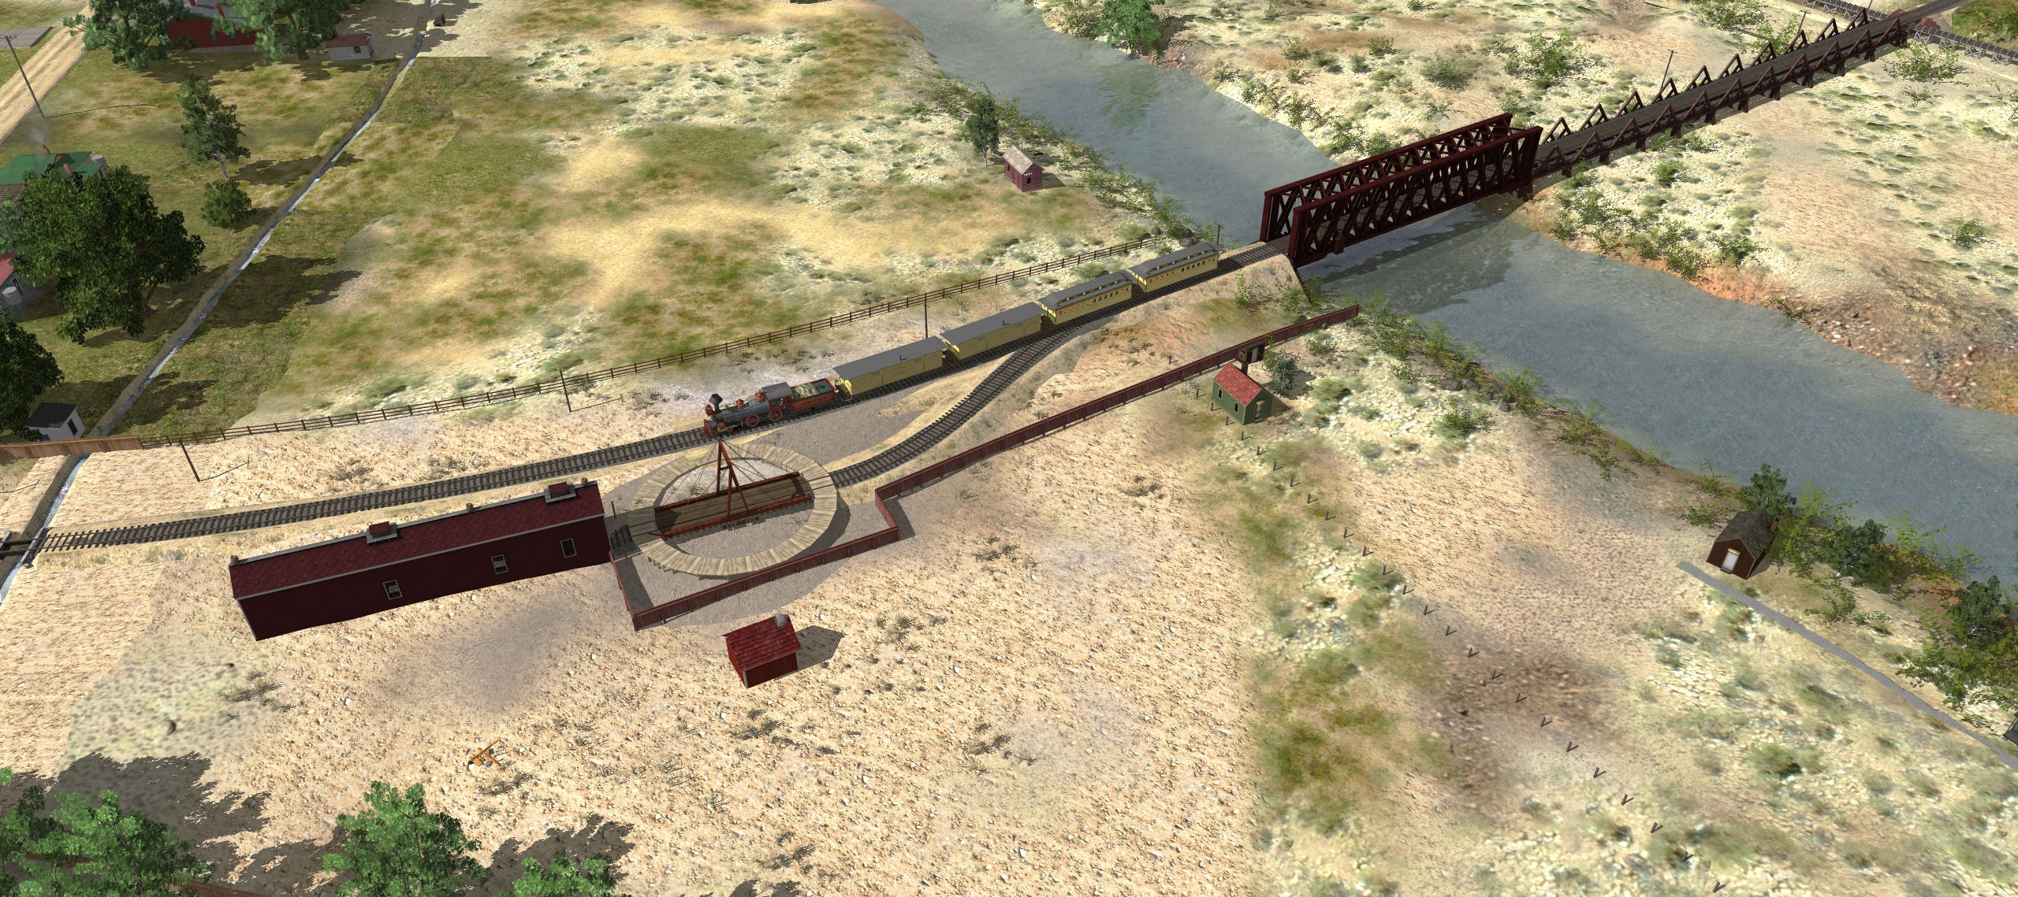
1872
50’ diameter gallows A-frame turntable built
Tracks completed to Carson

Slide 7
1873
Water tank built
Also the pump house
Wood siding built

Slide 8
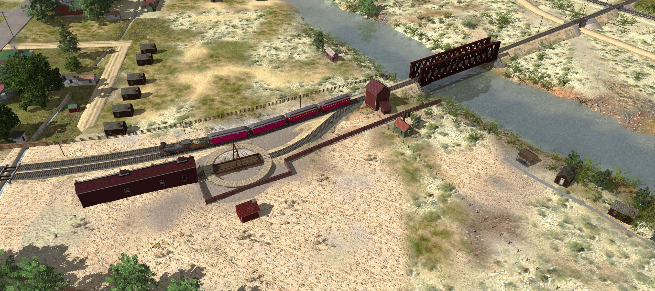
1880
Trestle is filled in
Bridges get stone abutments

Slide 9
1890
Engine house has bracing by now

Slide 10
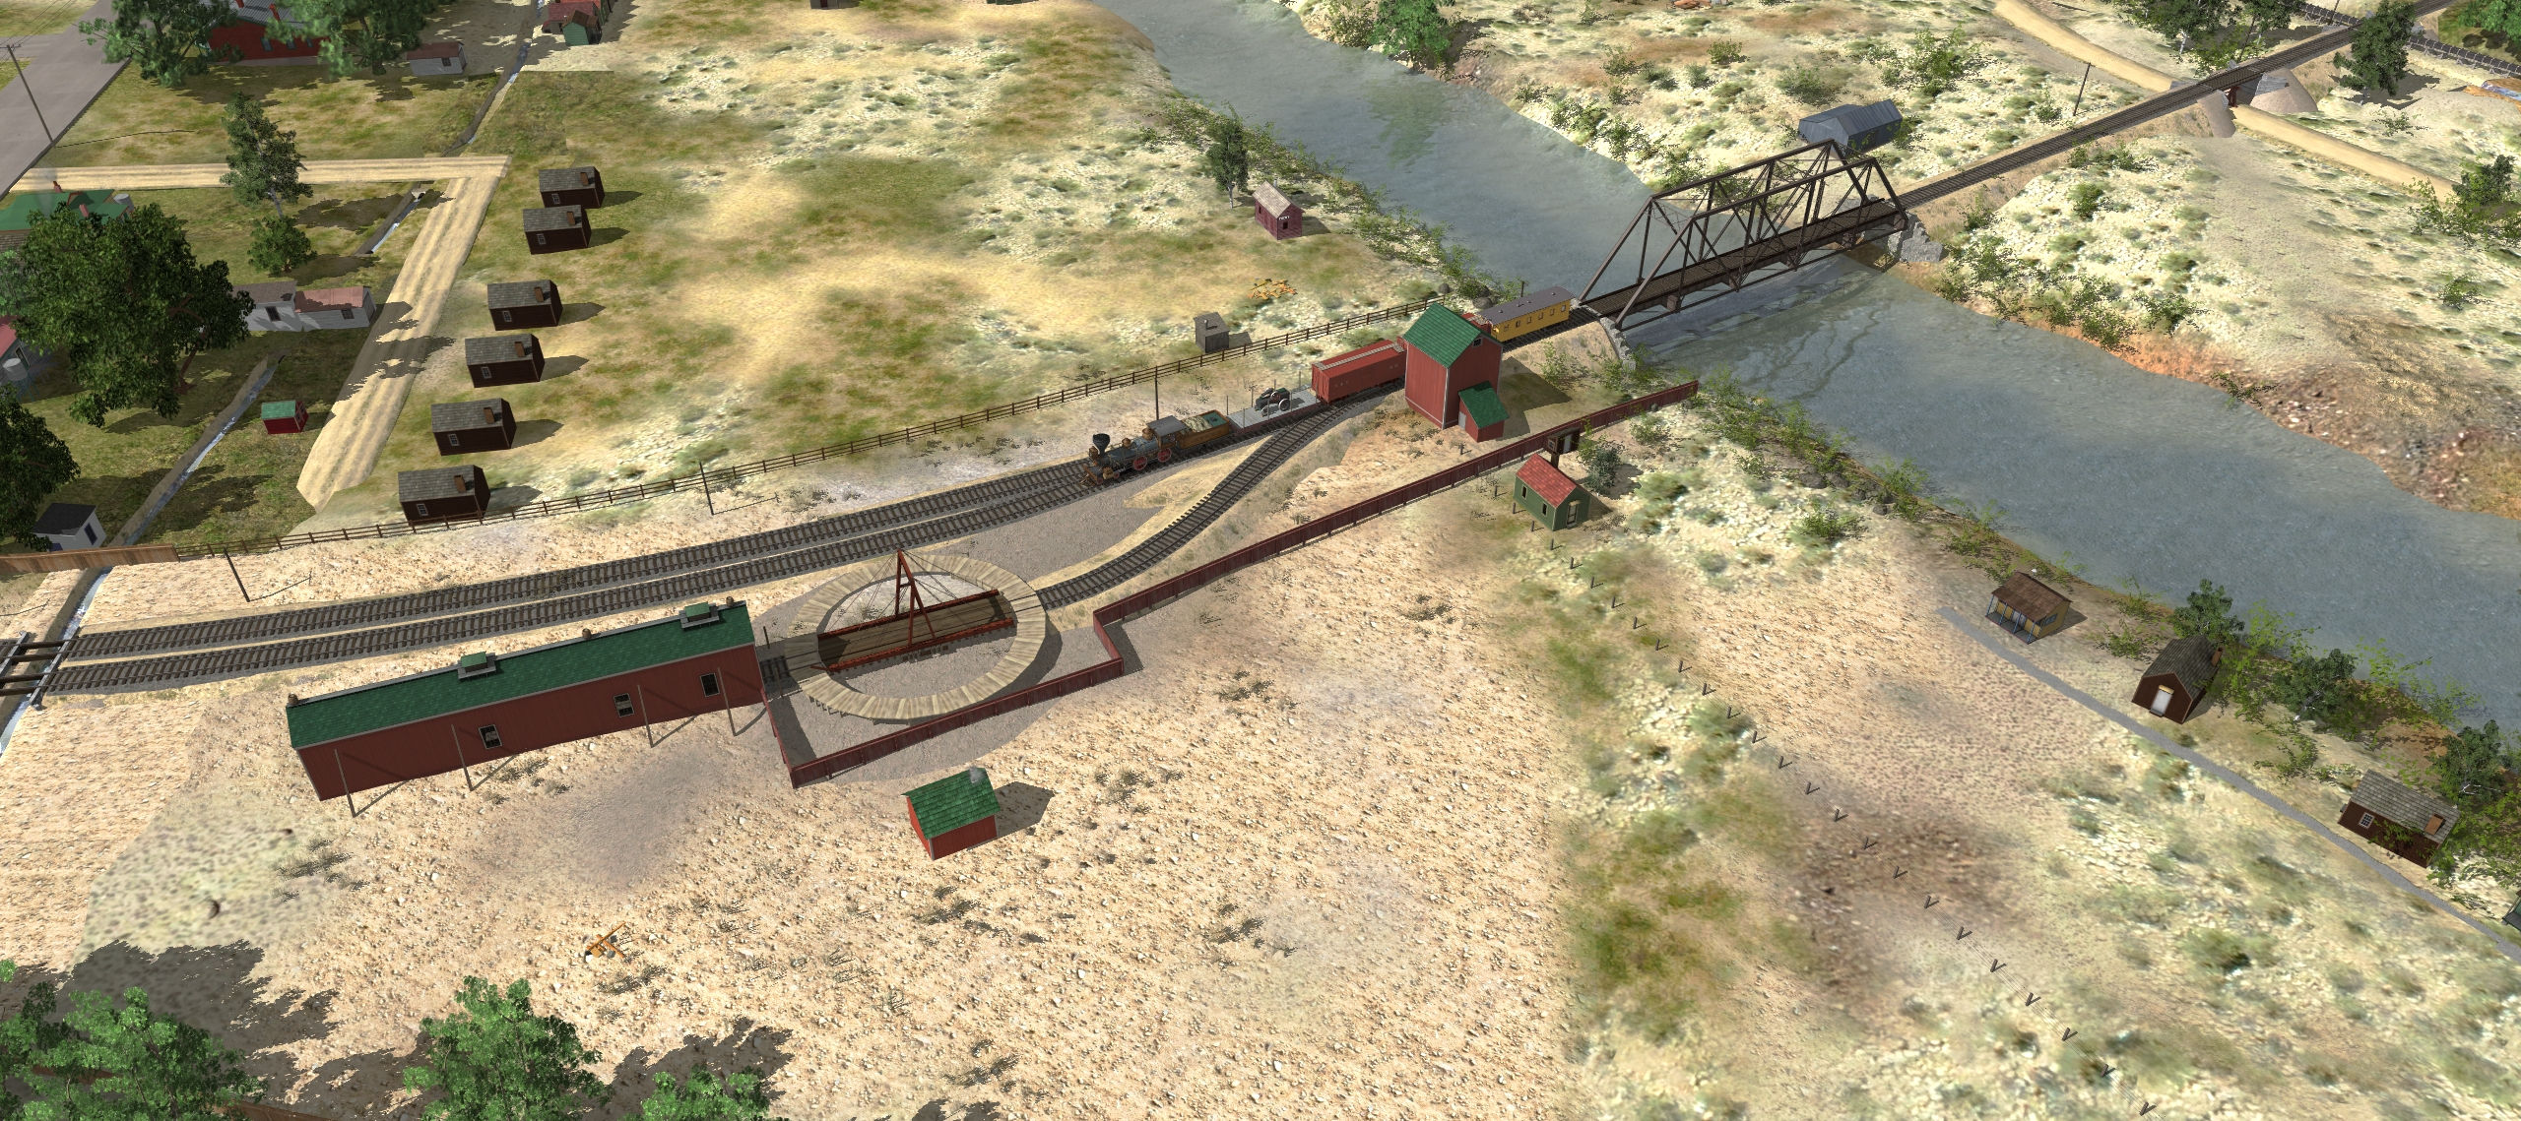
1894
138’ Steel bridge replaces the older Howe truss
Buildings are likely caboose red with green roofs by now

Slide 11
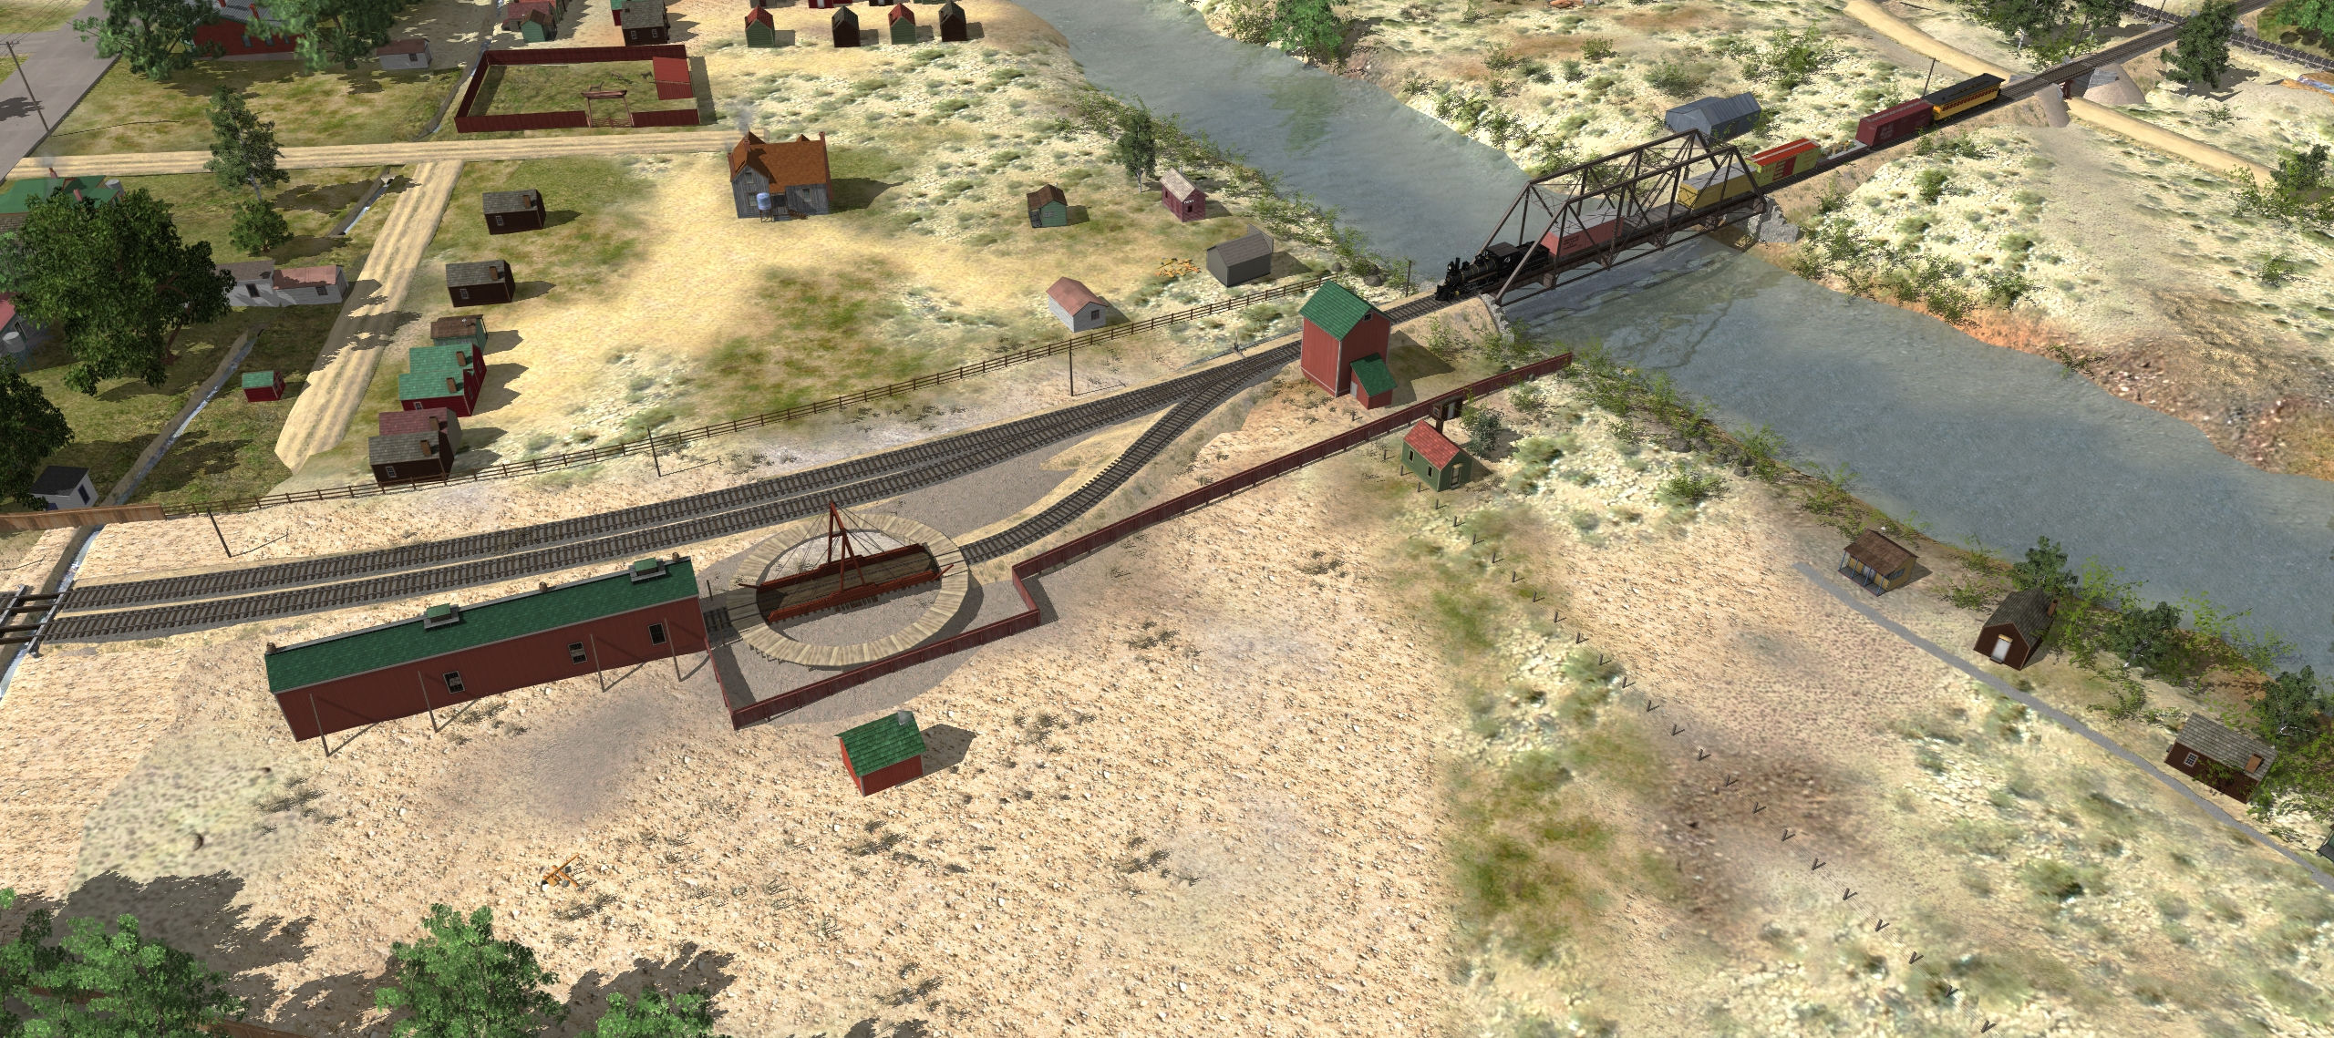
1901
Turntable reinforced for first No. 25

Slide 12
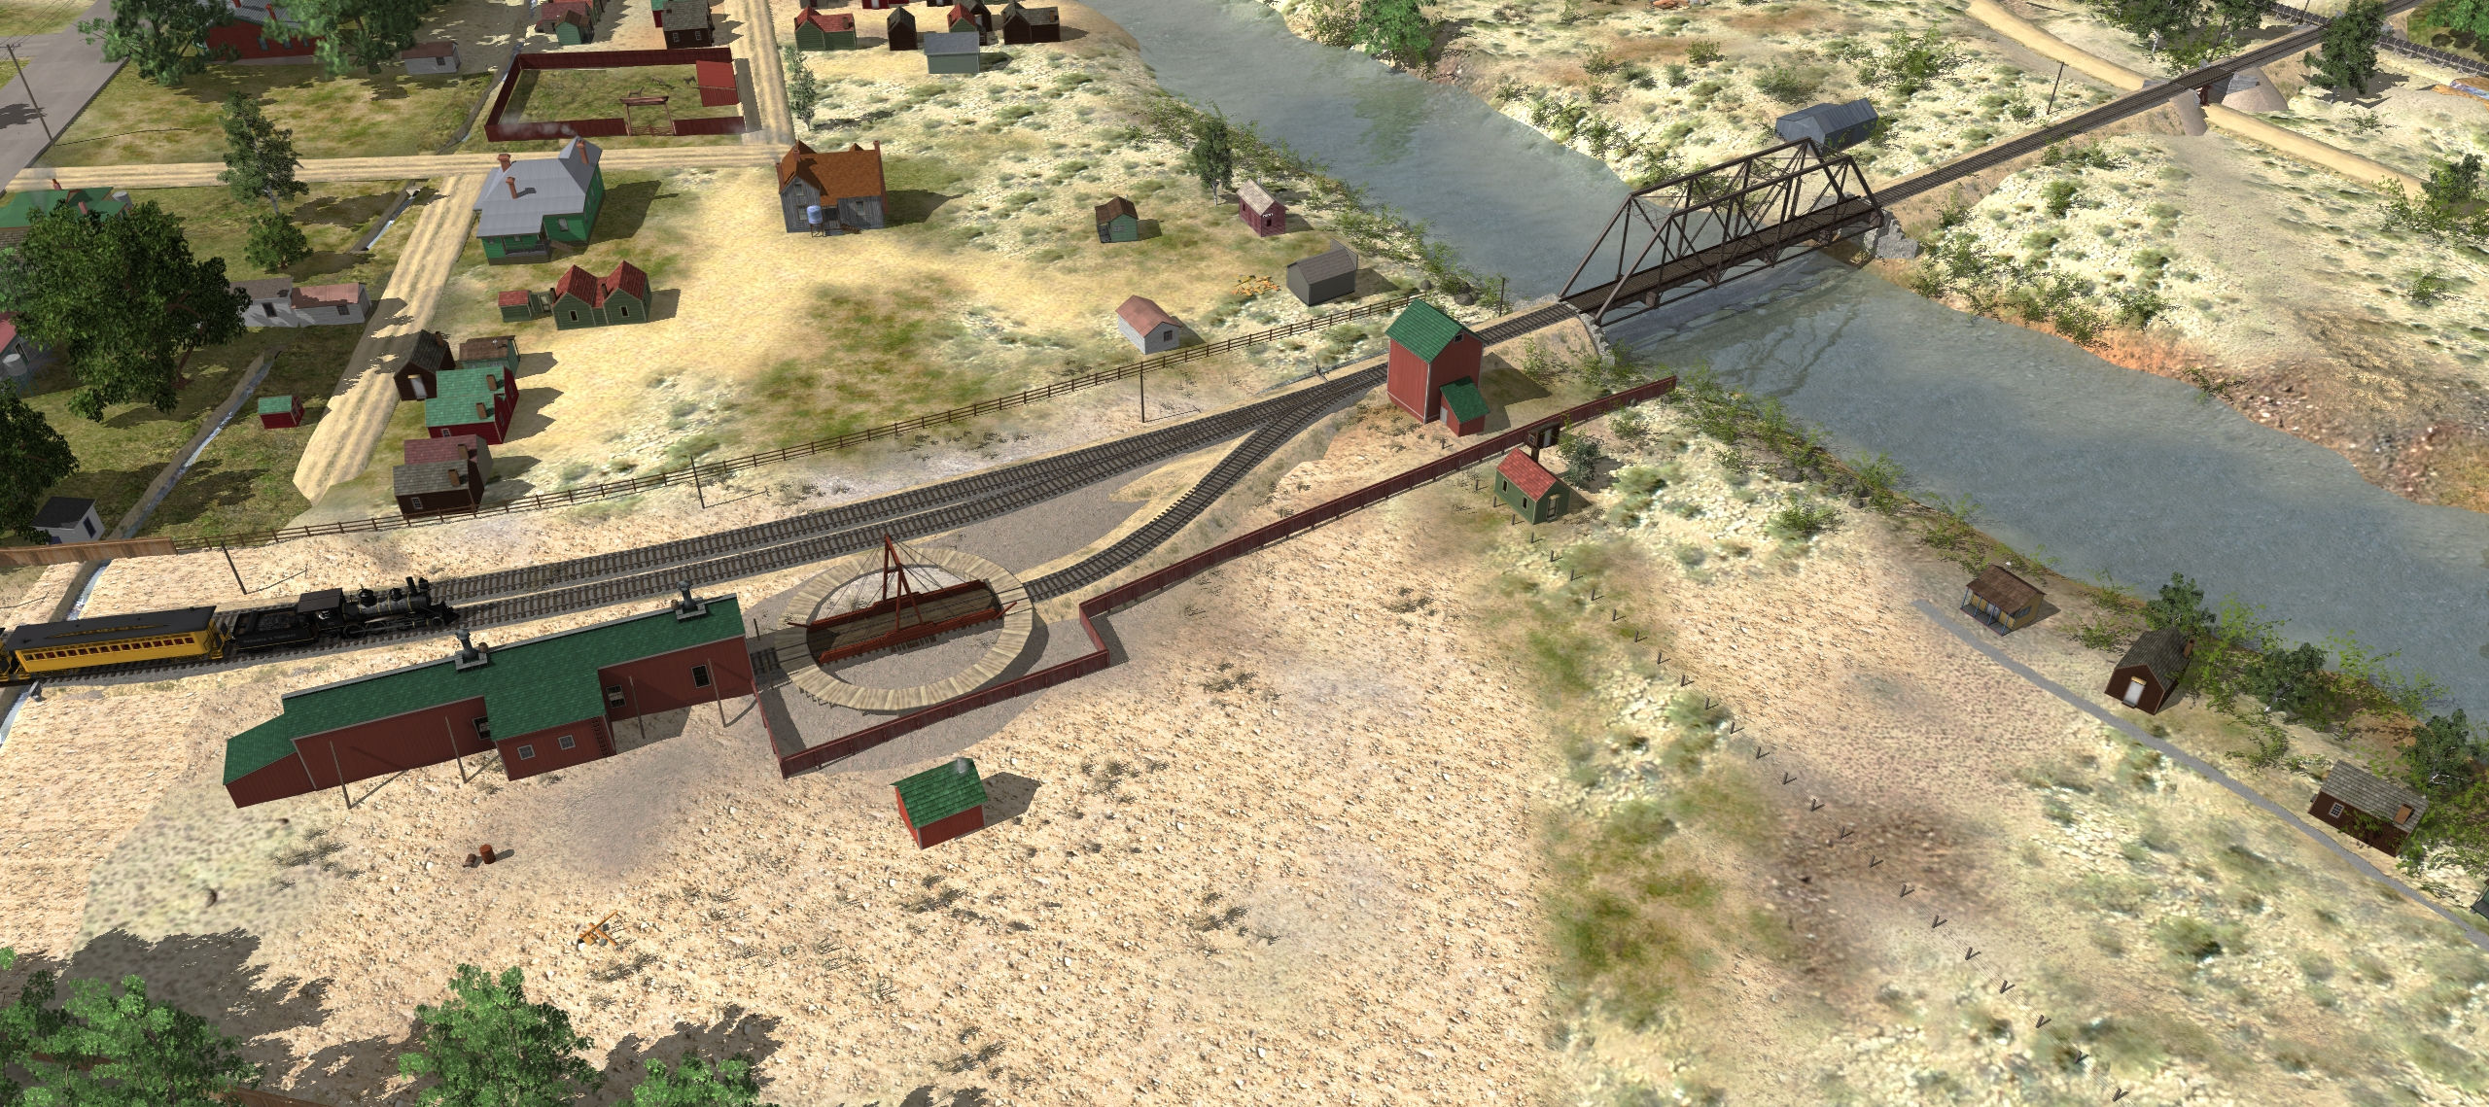
1904
Bunkhouse, rear shed added by now
Likely some time between 1890 and now

Slide 13
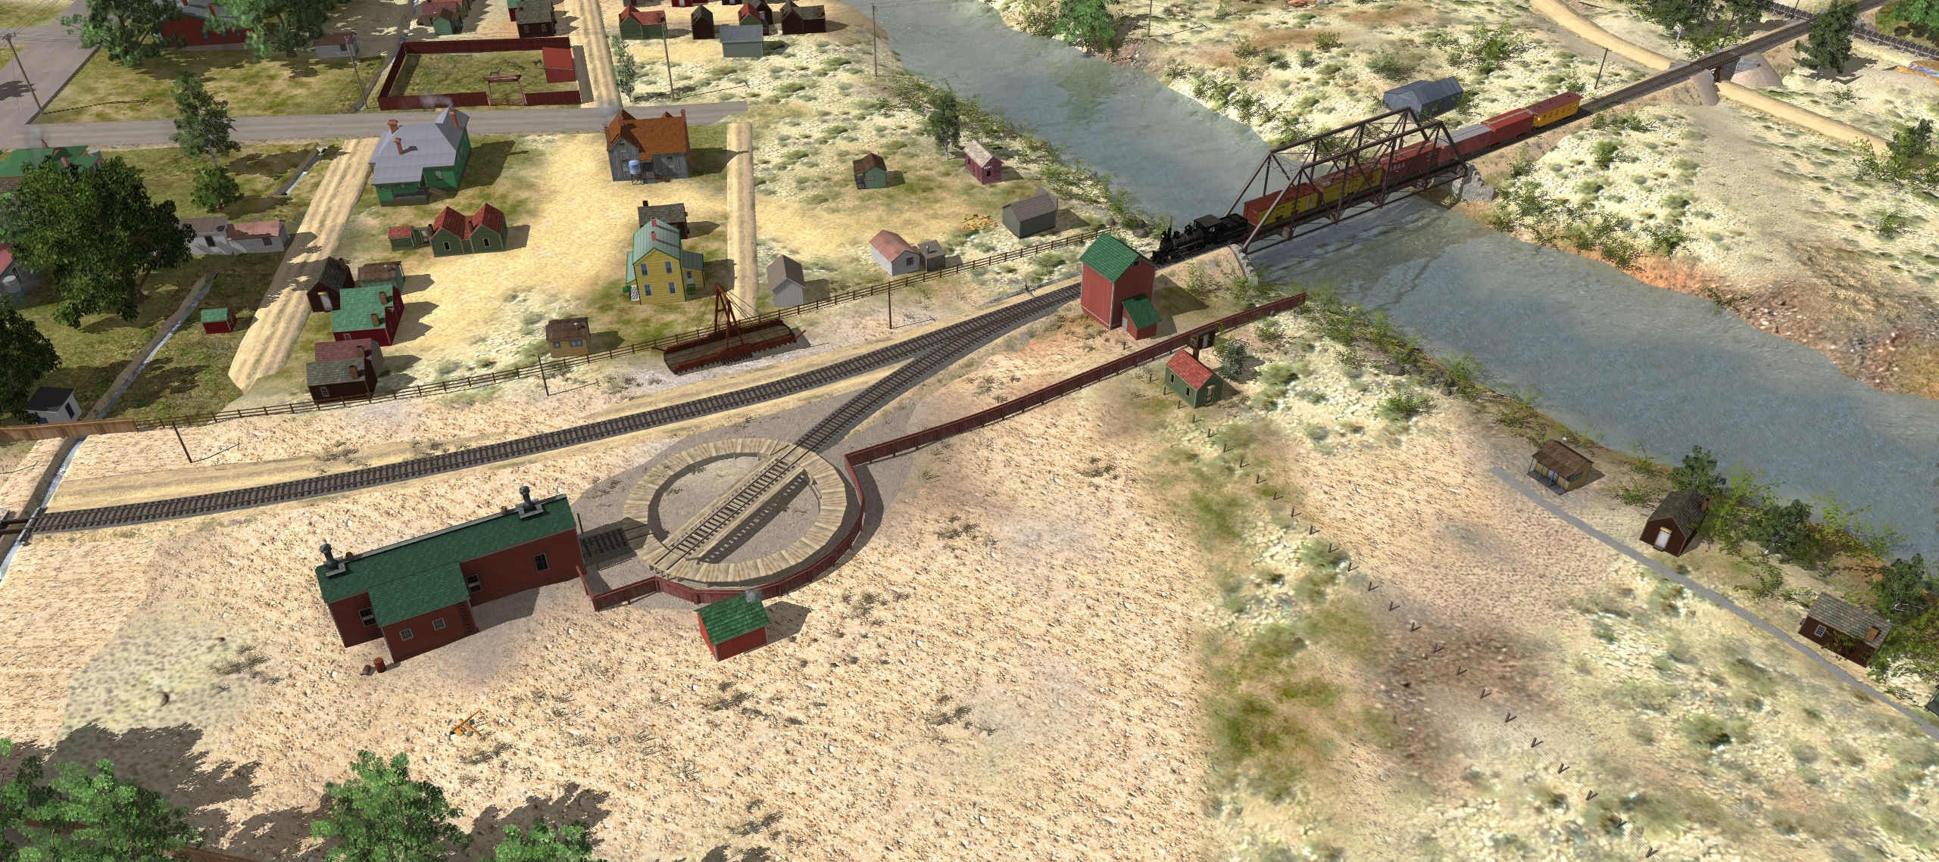
1905
Engine house shortened
Turntable replaced with 57’ iron table
Wood track siding is removed around now

Slide 14
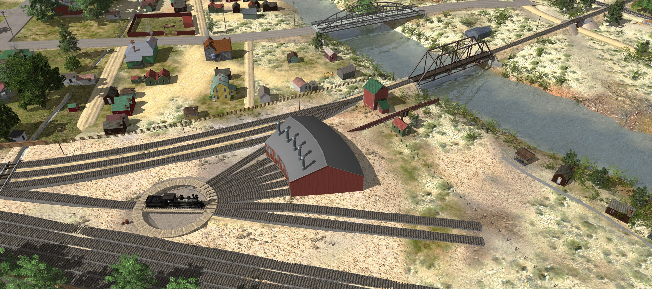
1909 (proposed)
New roundhouse; larger yards
Likely this proposal was in support of a lawsuit against the city of Reno around the connection of 2nd and Scott Streets.

Slide 15
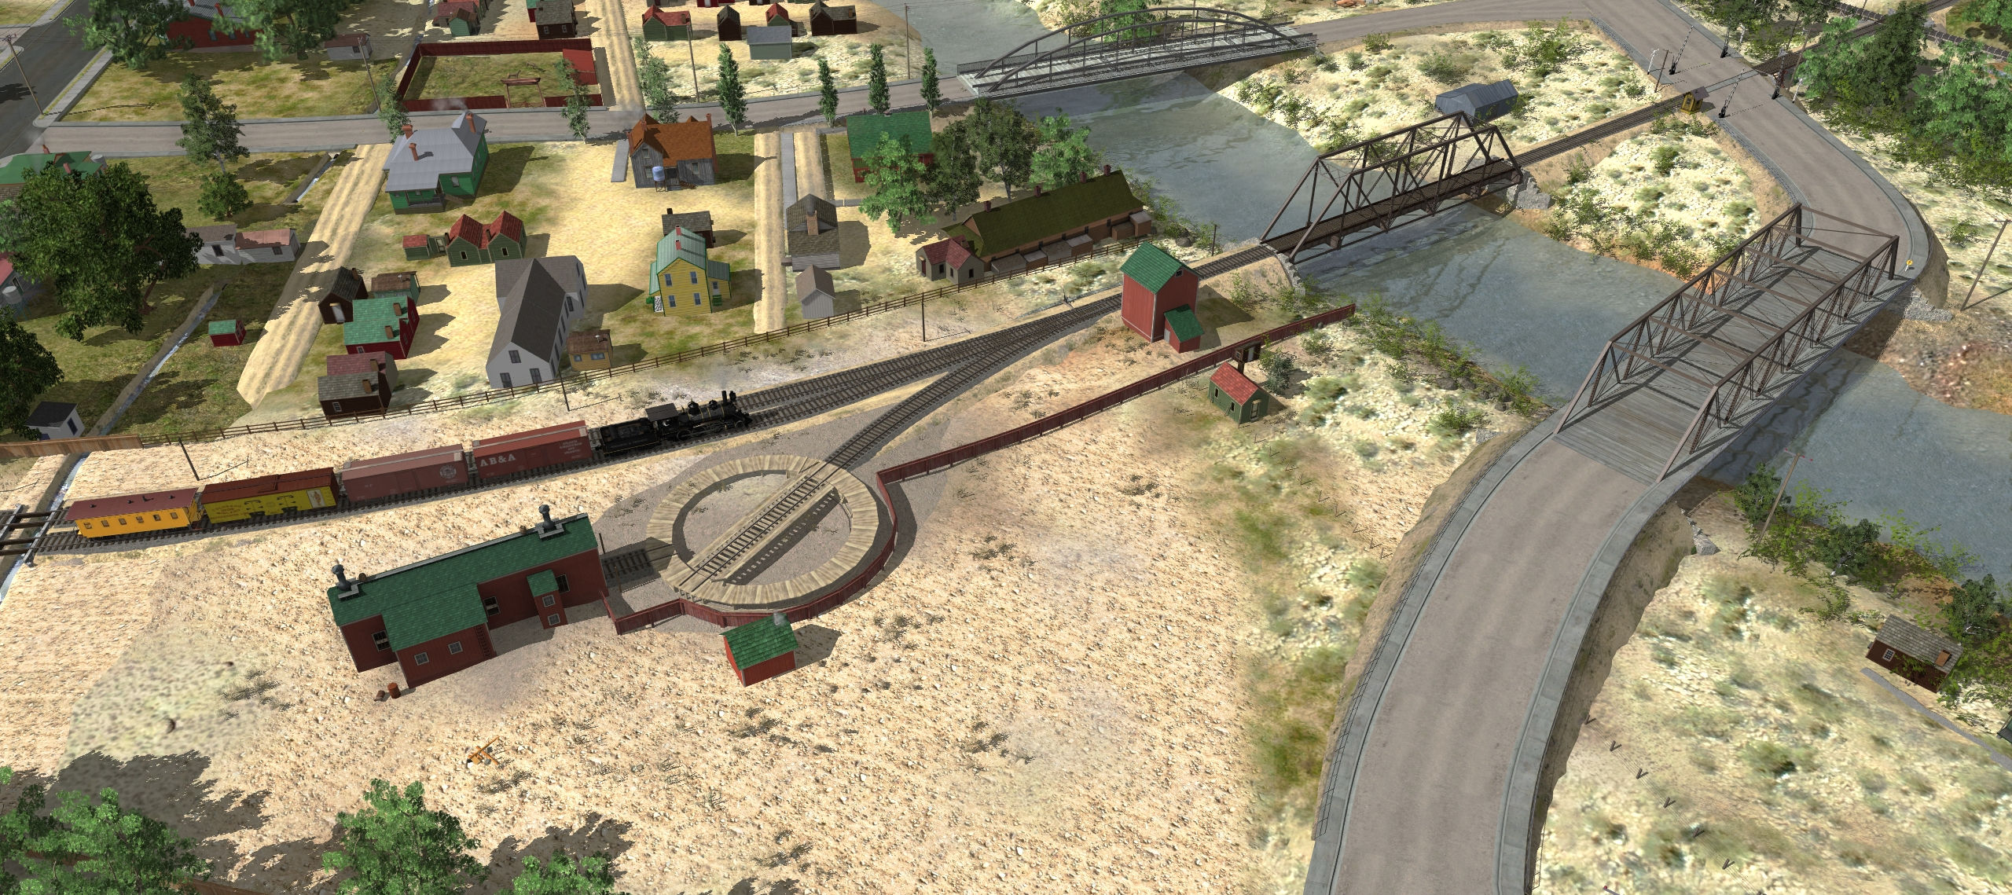
1909 (actual)
2nd street crossing and bridge built
Coach siding likely built by now
Oil shed is now present on the east wall

Slide 16
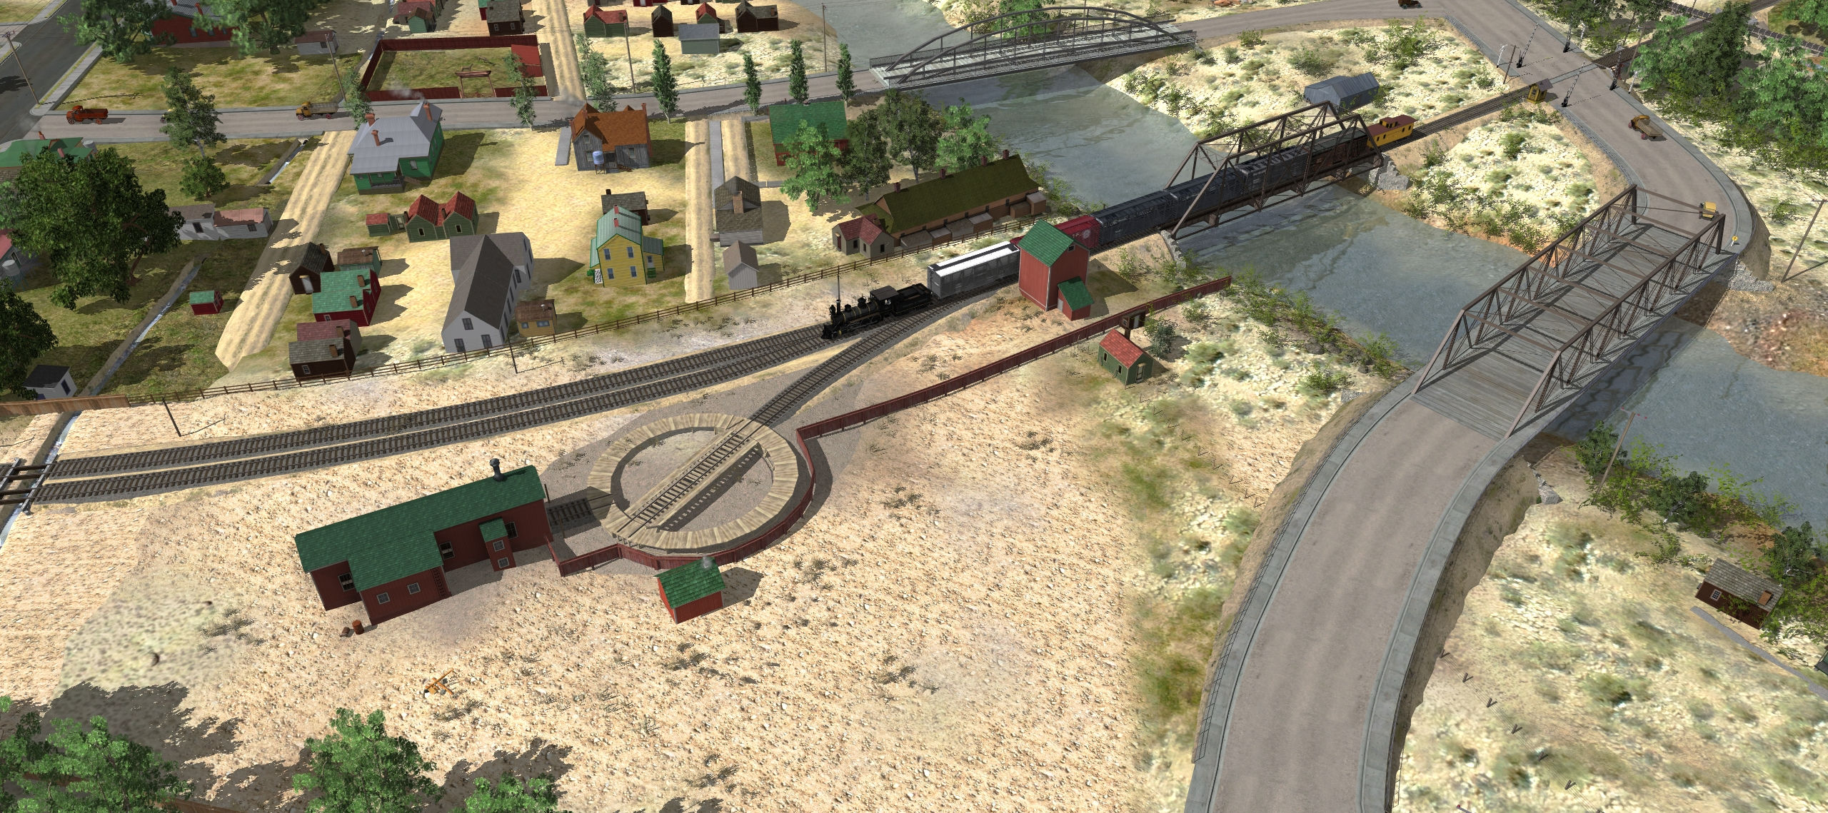
By 1916
Coach siding shortened; 685’ long
2nd smoke jack and roof walks gone
Engine house appears to have larger eaves

Slide 17
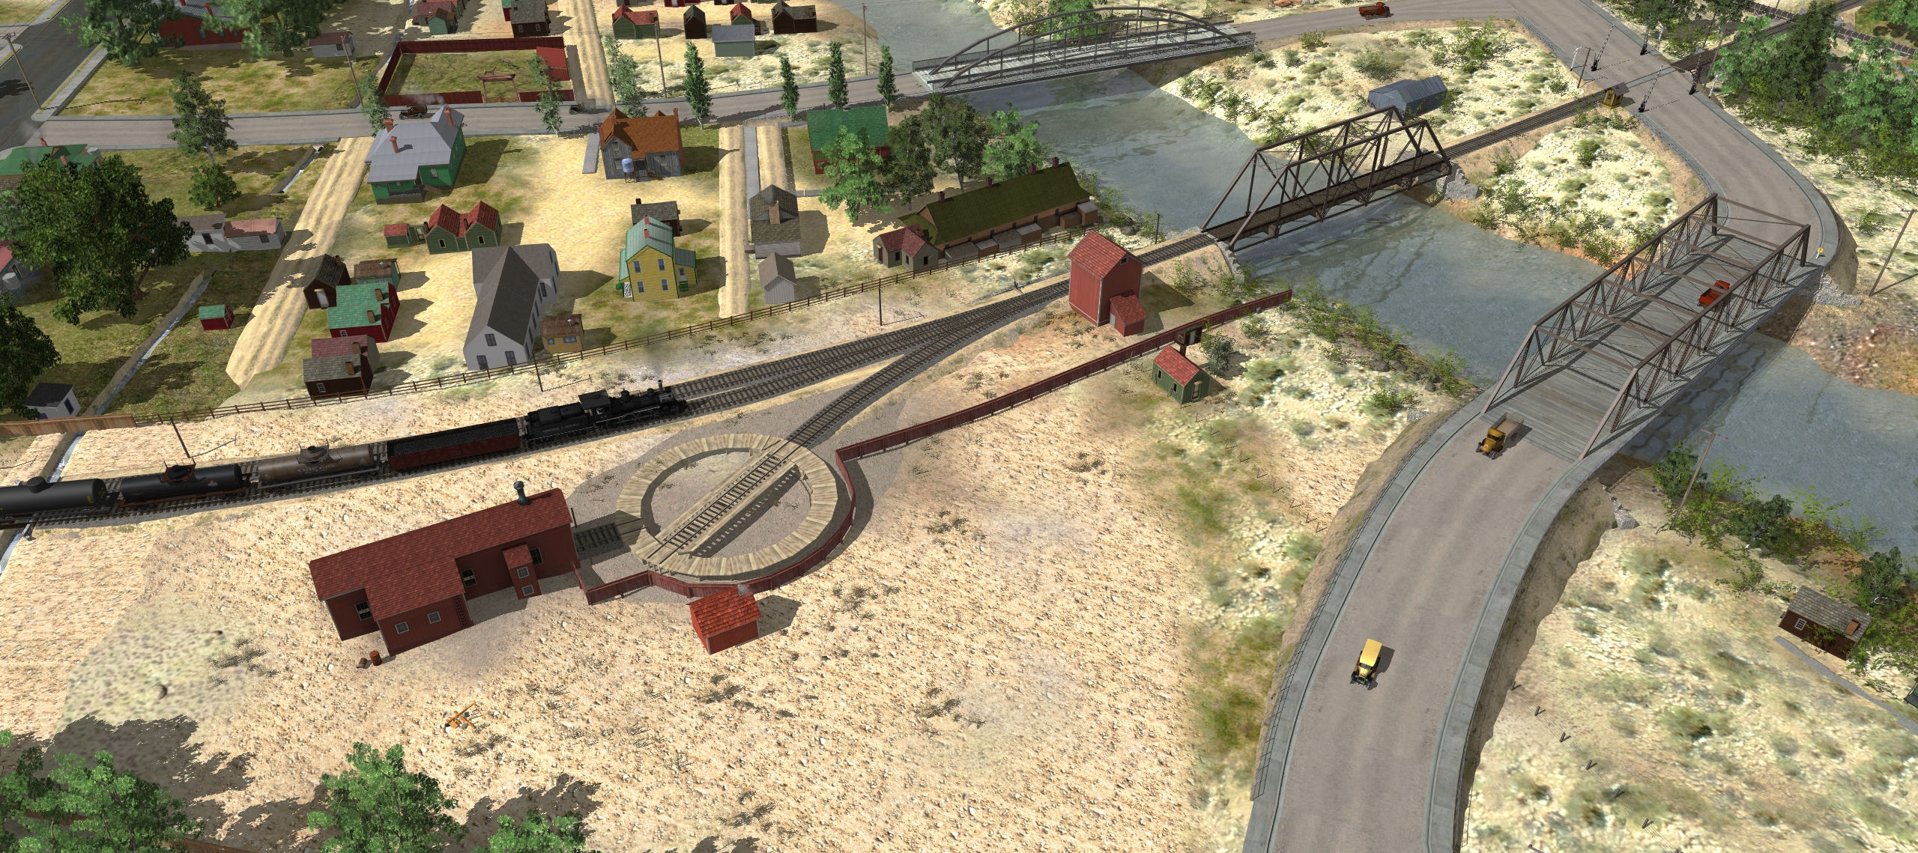
1920
Yard buildings painted; probably with red roofs now

Slide 18
1921
Engine house roof is hipped
- Also some trim added above the windows?
Engine house and water tank are painted (again!)

Slide 19
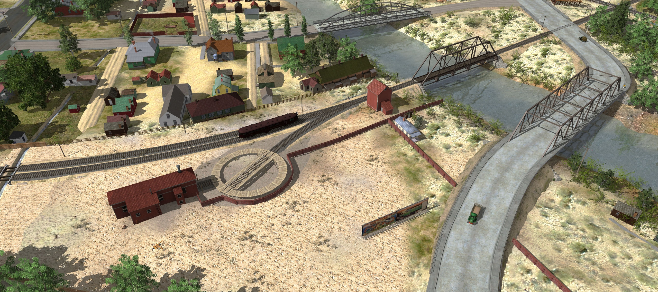
By 1928
2nd Street crossing gates are gone
Bridge 1b is gone
Blacksmith shop is gone (retired 1924)

Slide 20
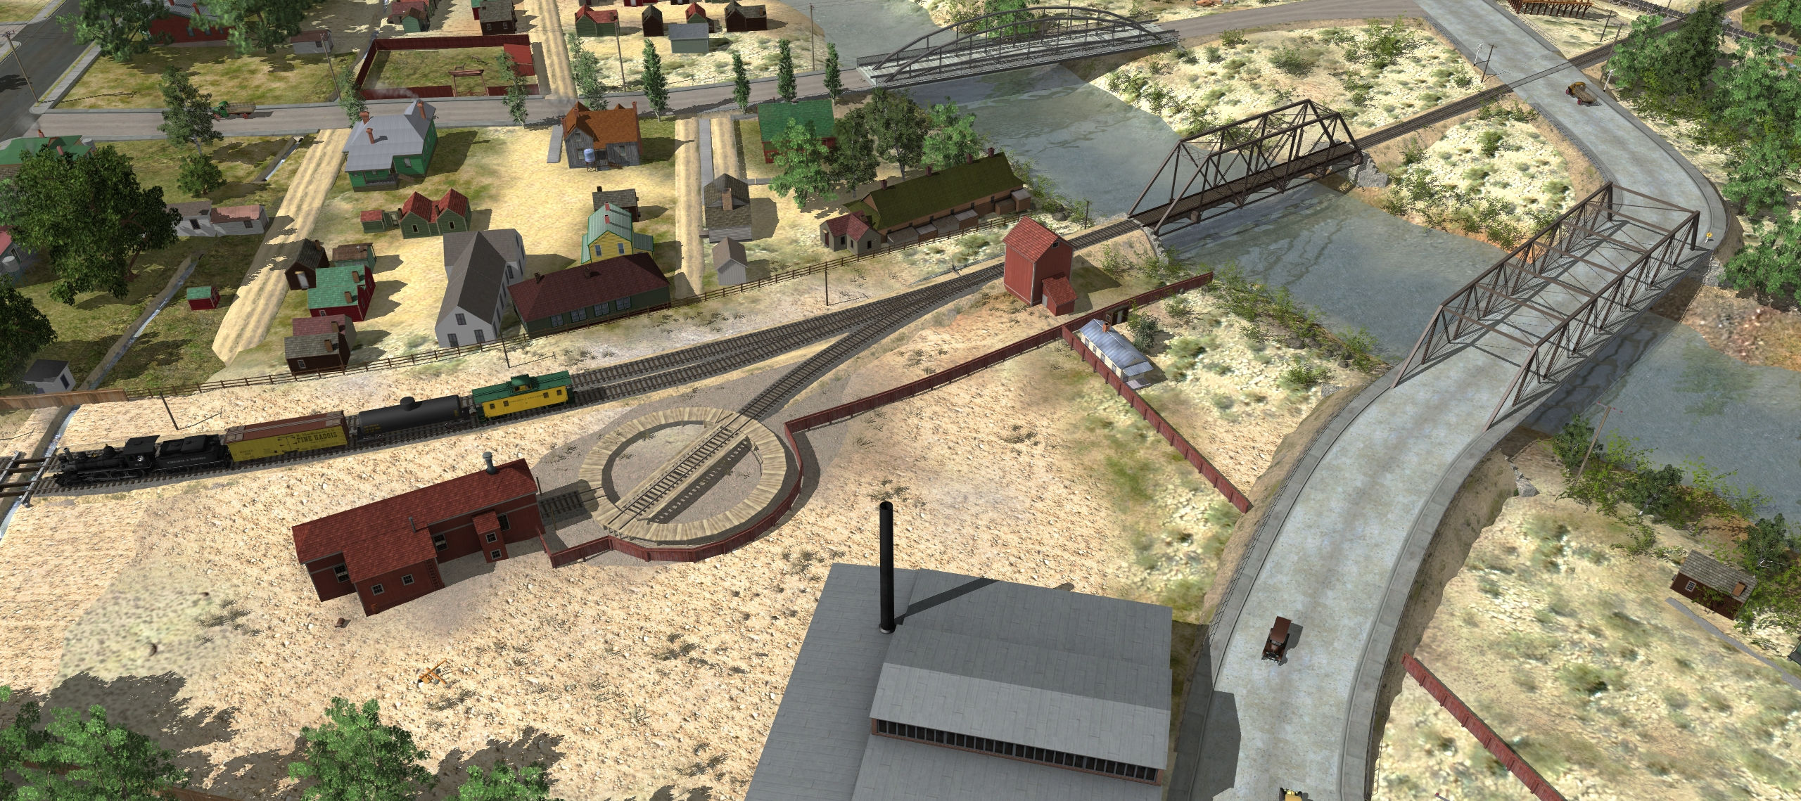
1930
Sunshine Laundry opens (land sold in 1929)

Slide 21
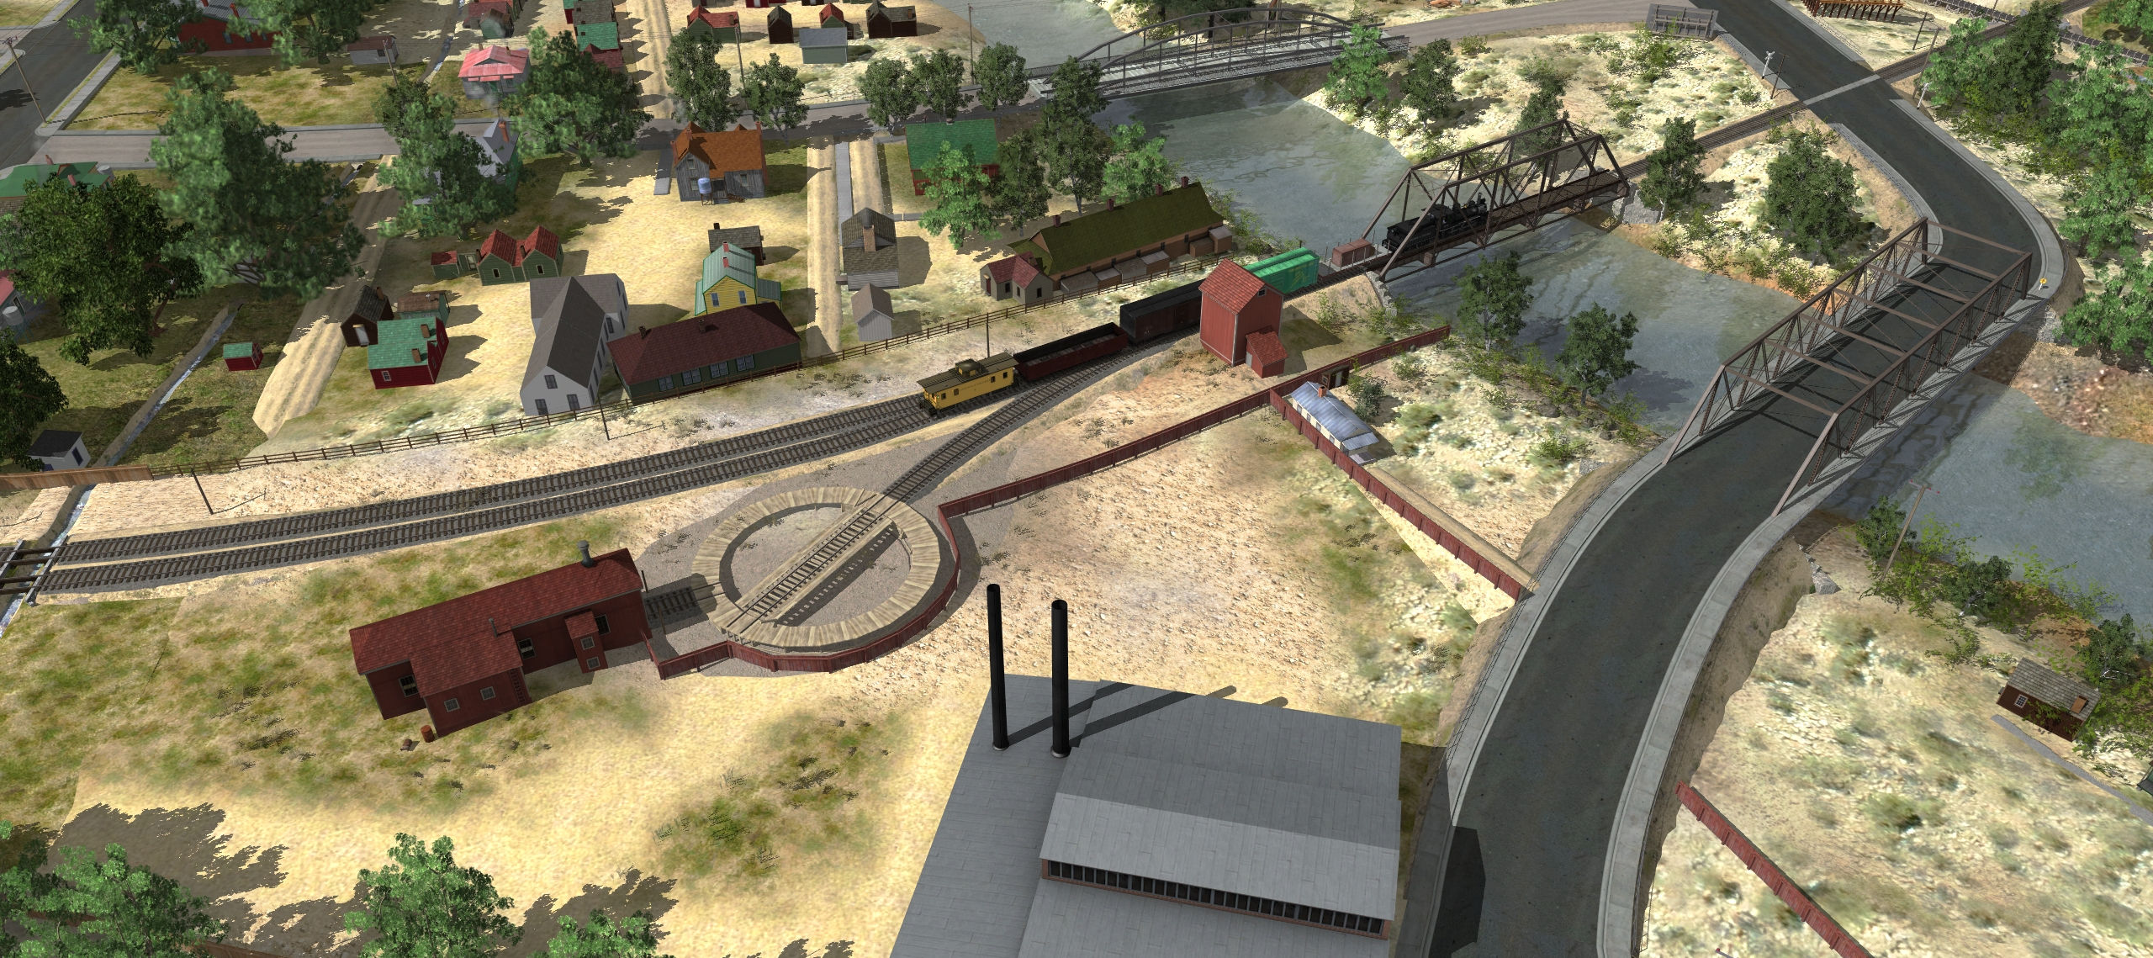
1937
Wall trim on engine house is red by now

Slide 22
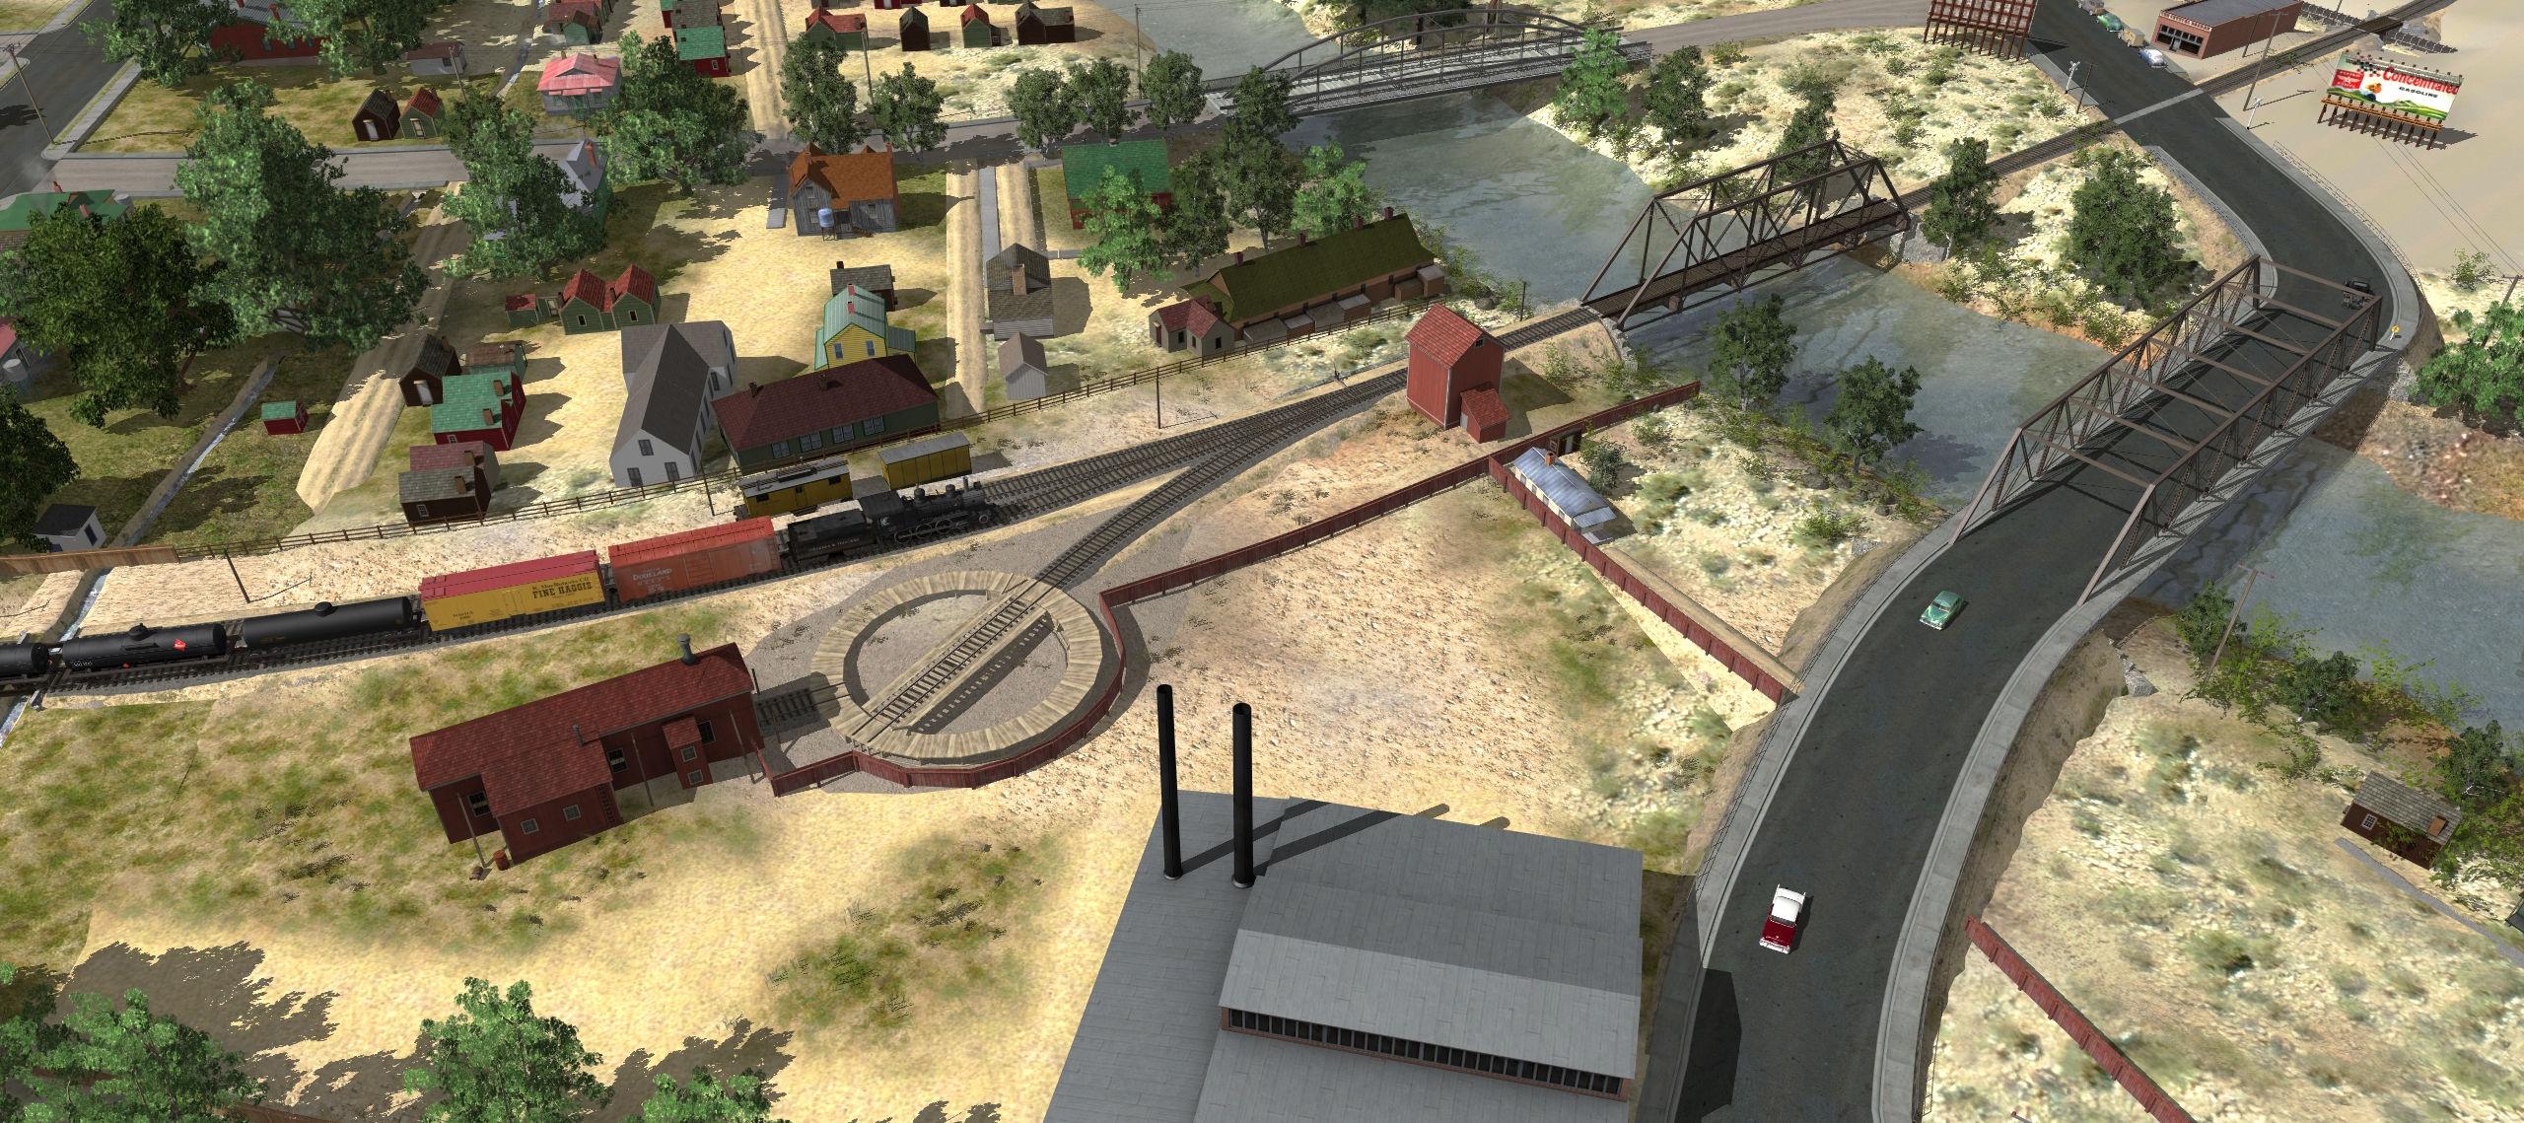
By 1948
Construction Car No. 6 (2nd) is on the ground
Taken out of service 1942
Rear door on engine house

Slide 23
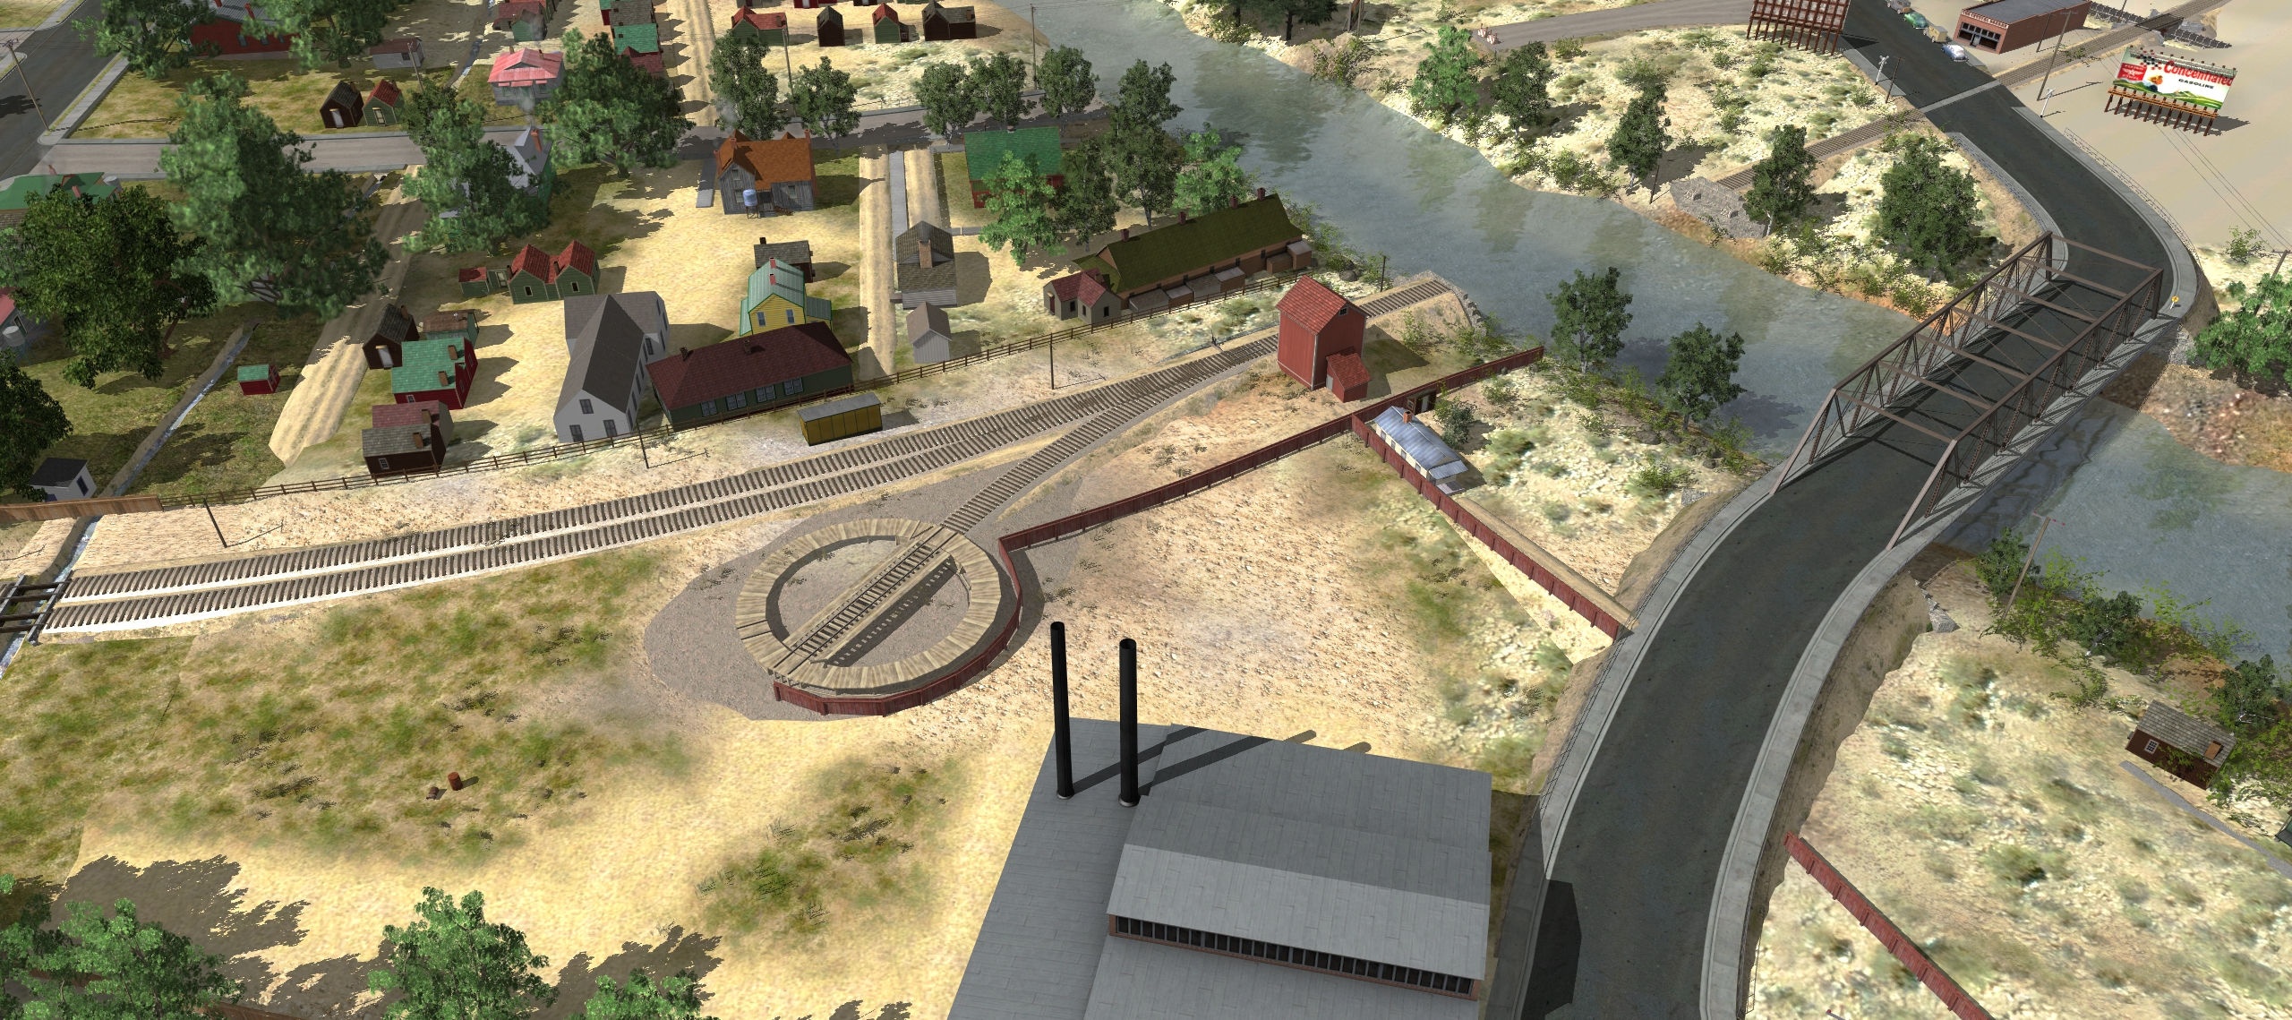
1950
Engine house burns down
Railroad is abandoned
While being dismantled, the bridge washes away in Thanksgiving flood

