Slide 1
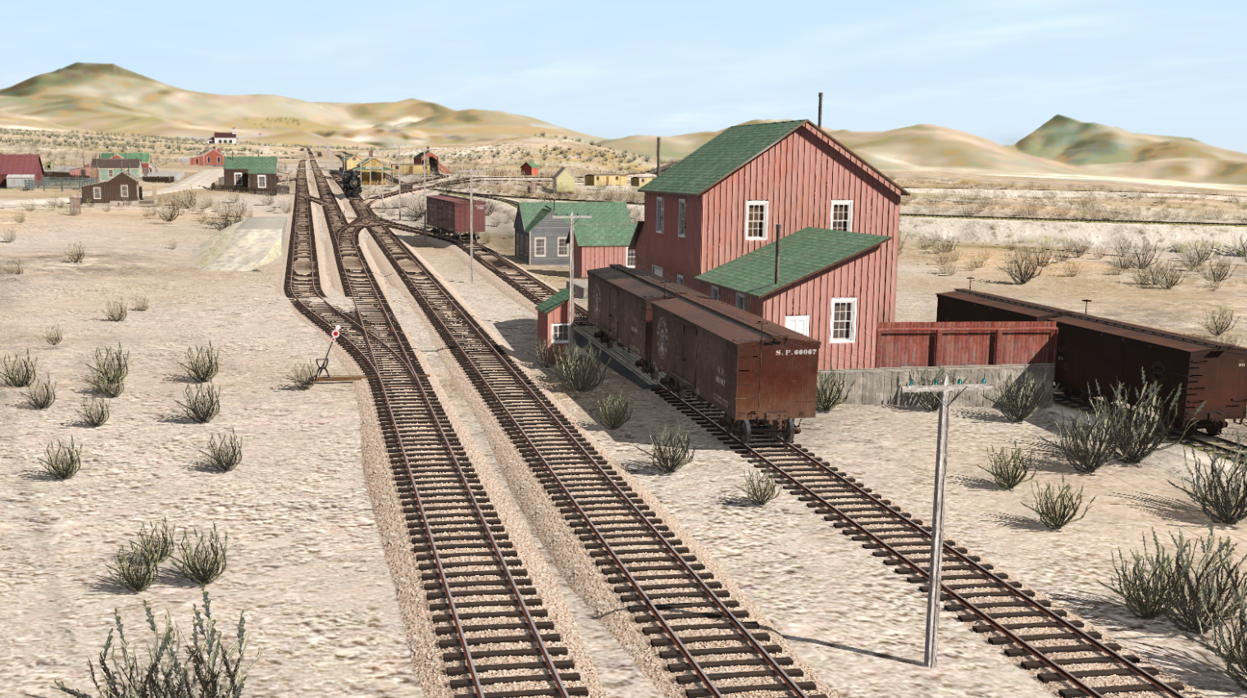
History of Mound House 1869-1941
2023 Virginia and Truckee Railroad History Conference
By Curtis Reid

Slide 2
Before the railroad:
1841: First to pass through the “Carson Pass Route” - Bidwell-Bartleson party.
1861: James Fair builds “Halfway House”
1862: Toll road opens from Eagle Valley
Mid-1860s: Mound House toll station opens.

Slide 3
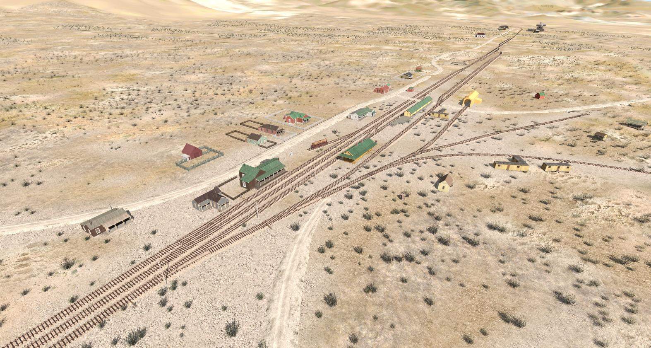
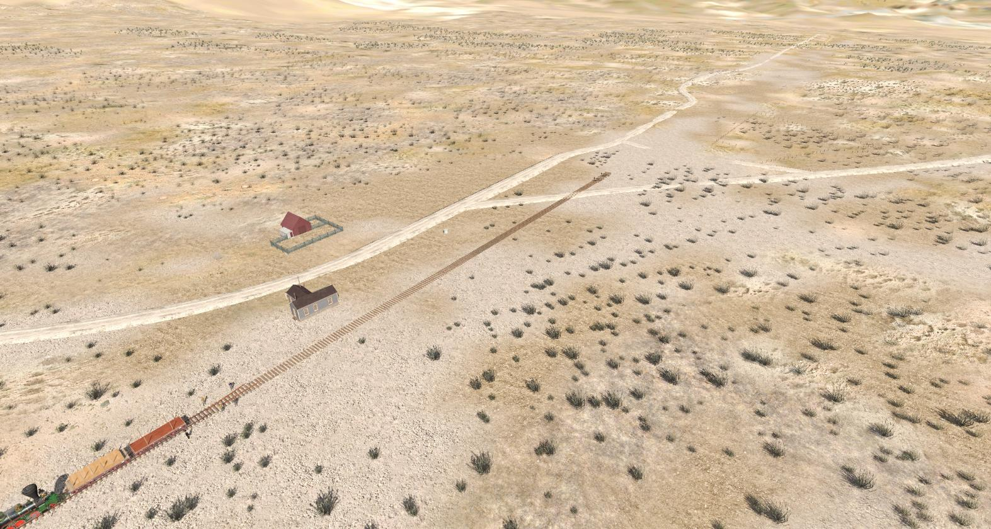
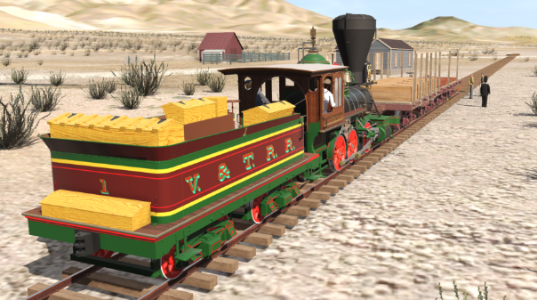
1869 (Late October)
Rails reach Mound House

Slide 4
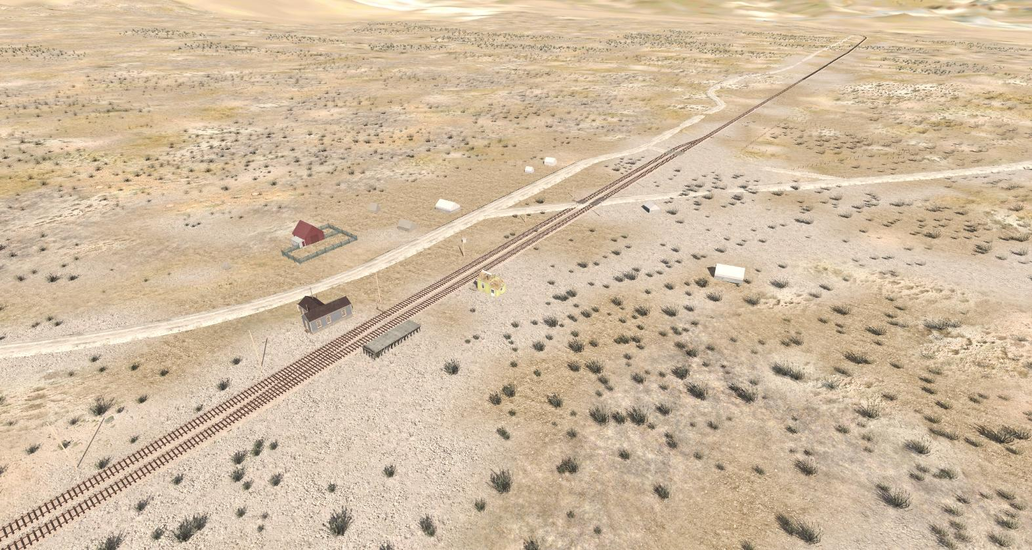
1869 (November)
Nov 19: Rails reach Virginia City (shop building)
Passing siding built
Telegraph office in place now

Slide 5
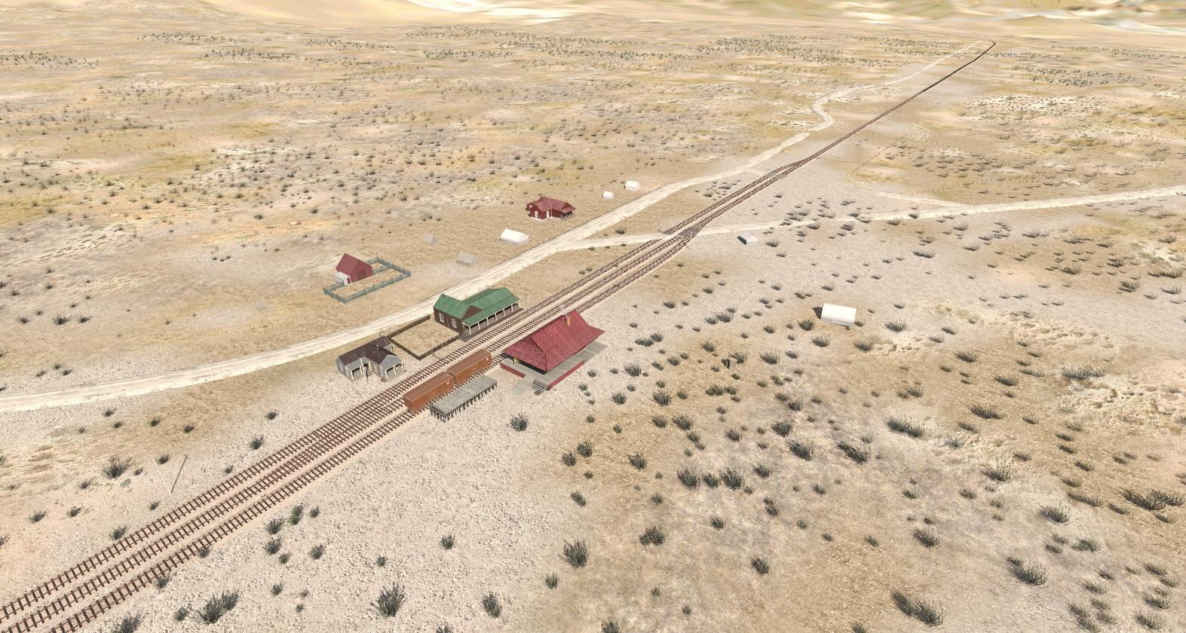
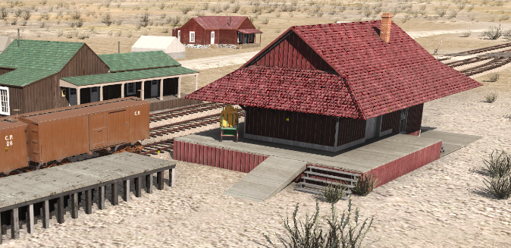
1872
October 3: Combination depot built
October: Section crew stationed here by now
November 4: McLean’s saloon open by now

Slide 6
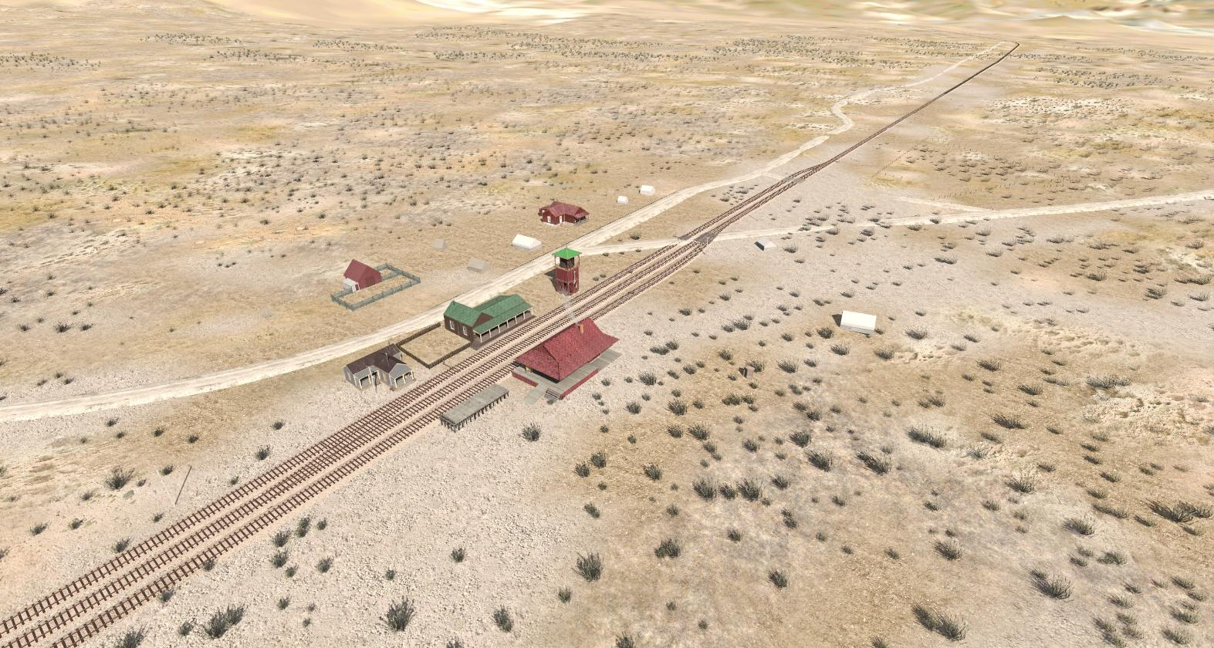
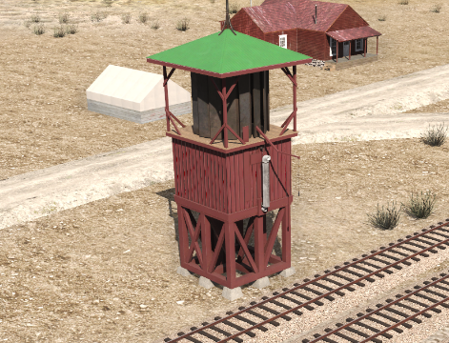
1874?
Dexter windmill built by V&T?

Slide 7
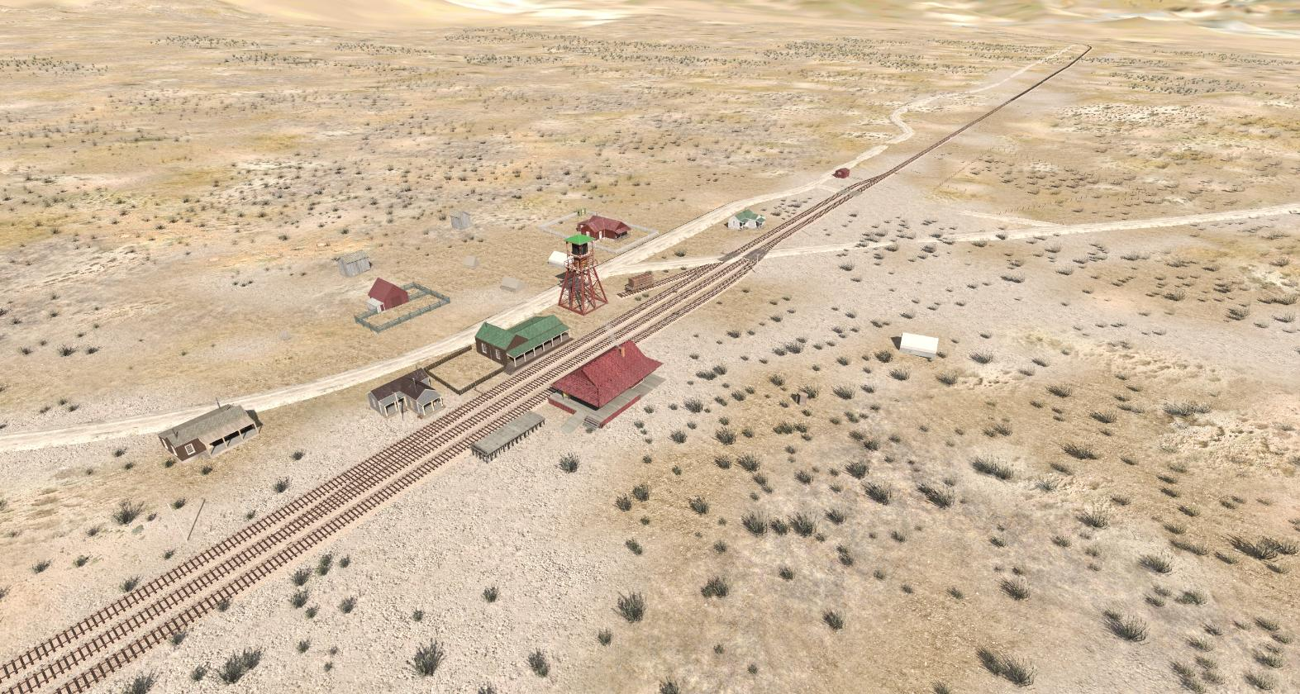
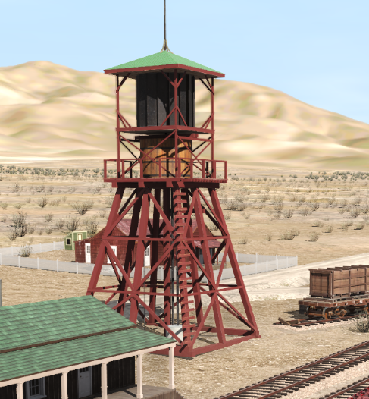
1876
Feb 10: Windmill blows down
Rebuilt by McLain by April; used for irrigation

Slide 8
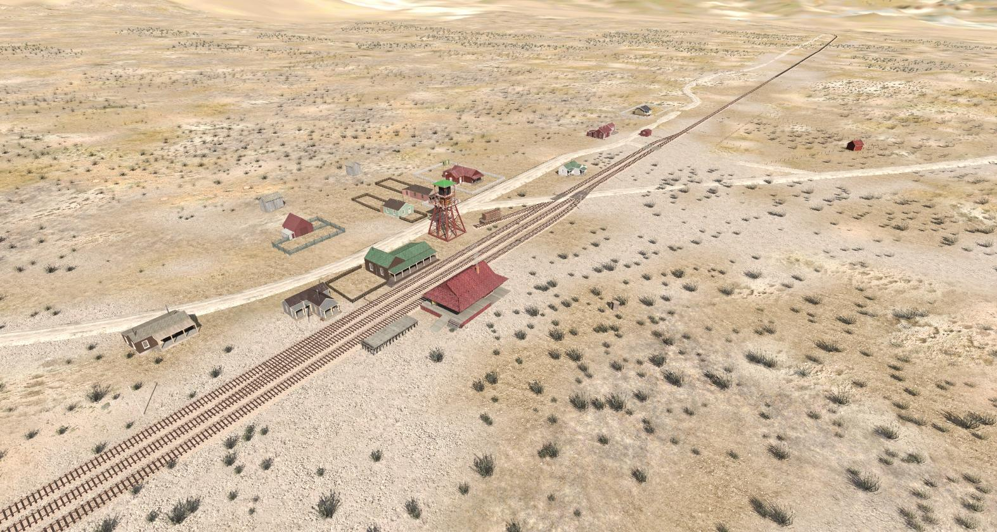
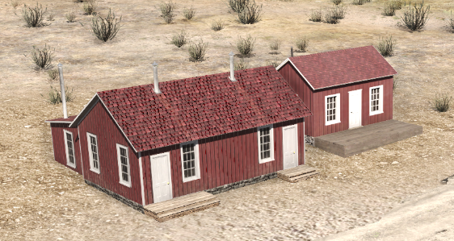
1877
Section crew bunk house and foreman’s house built. Living in tents until now? Boxcars?

Slide 9
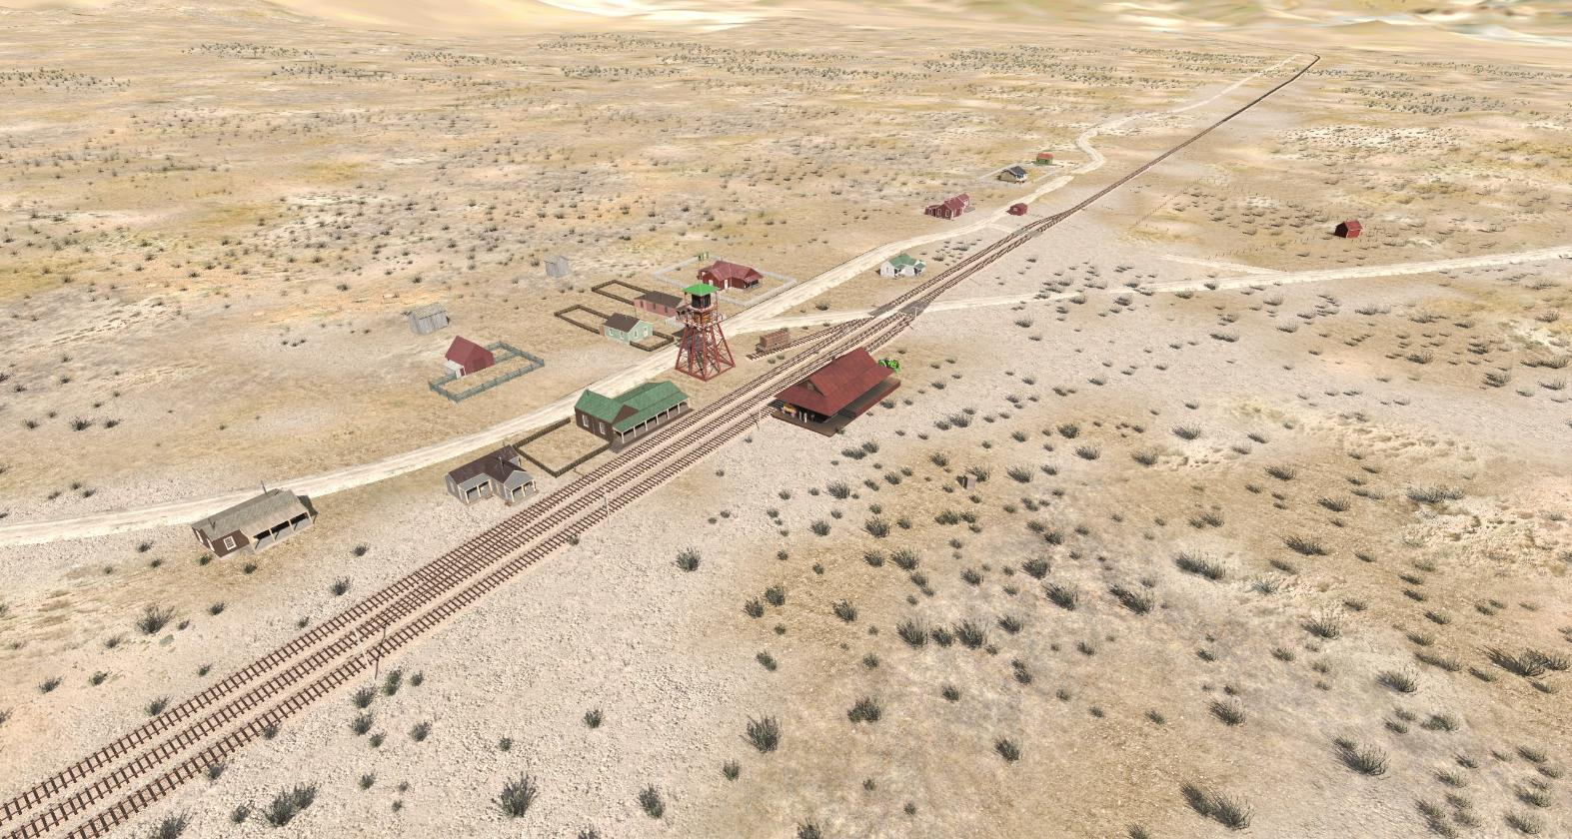
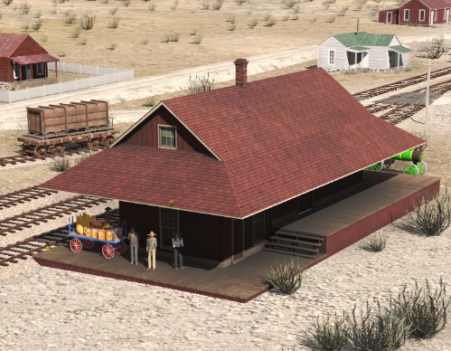
1879
Sept. 13 – Original 20’ x 40’ depot burns down
October – new, larger (20’ x 50’) depot built

Slide 10
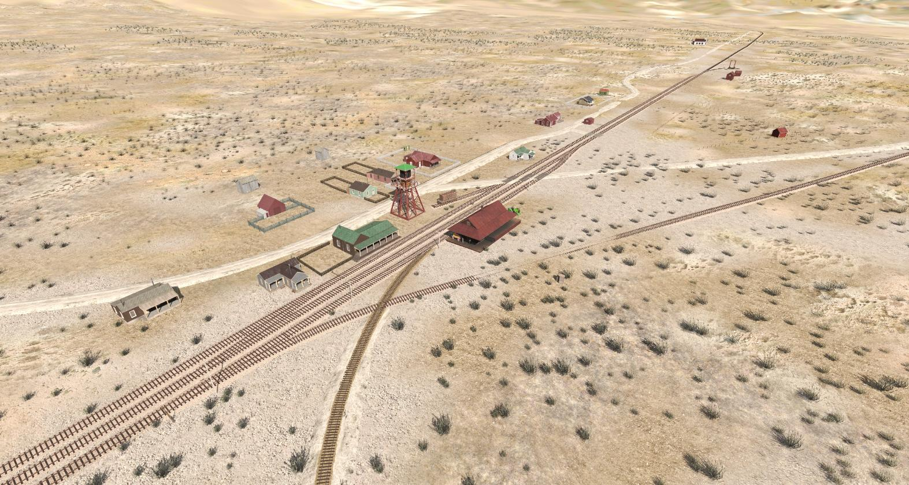
1880
Construction started on C&C
Dual-gauged most of the Mound House trackage
Dual-gauge turntable built

Slide 11
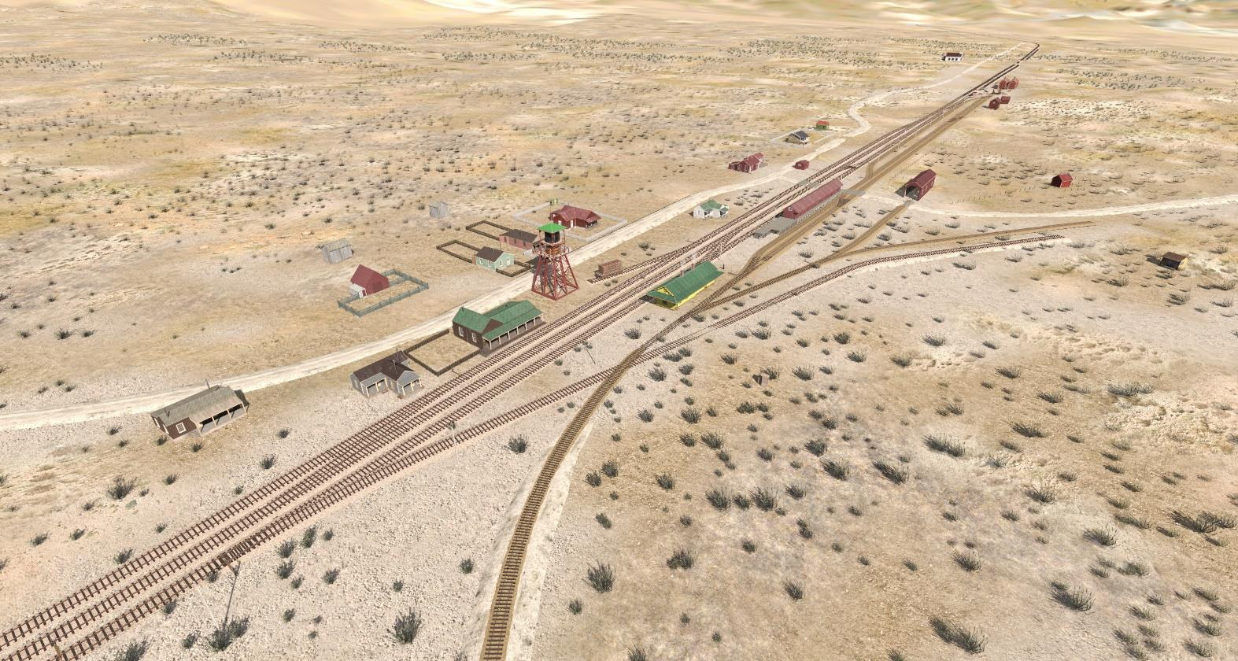
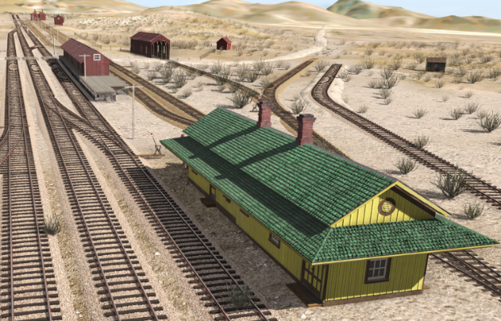
1881
Depot moved to Dayton
New passenger and freight depots built
April / May: Track scales moved from Scales

Slide 12
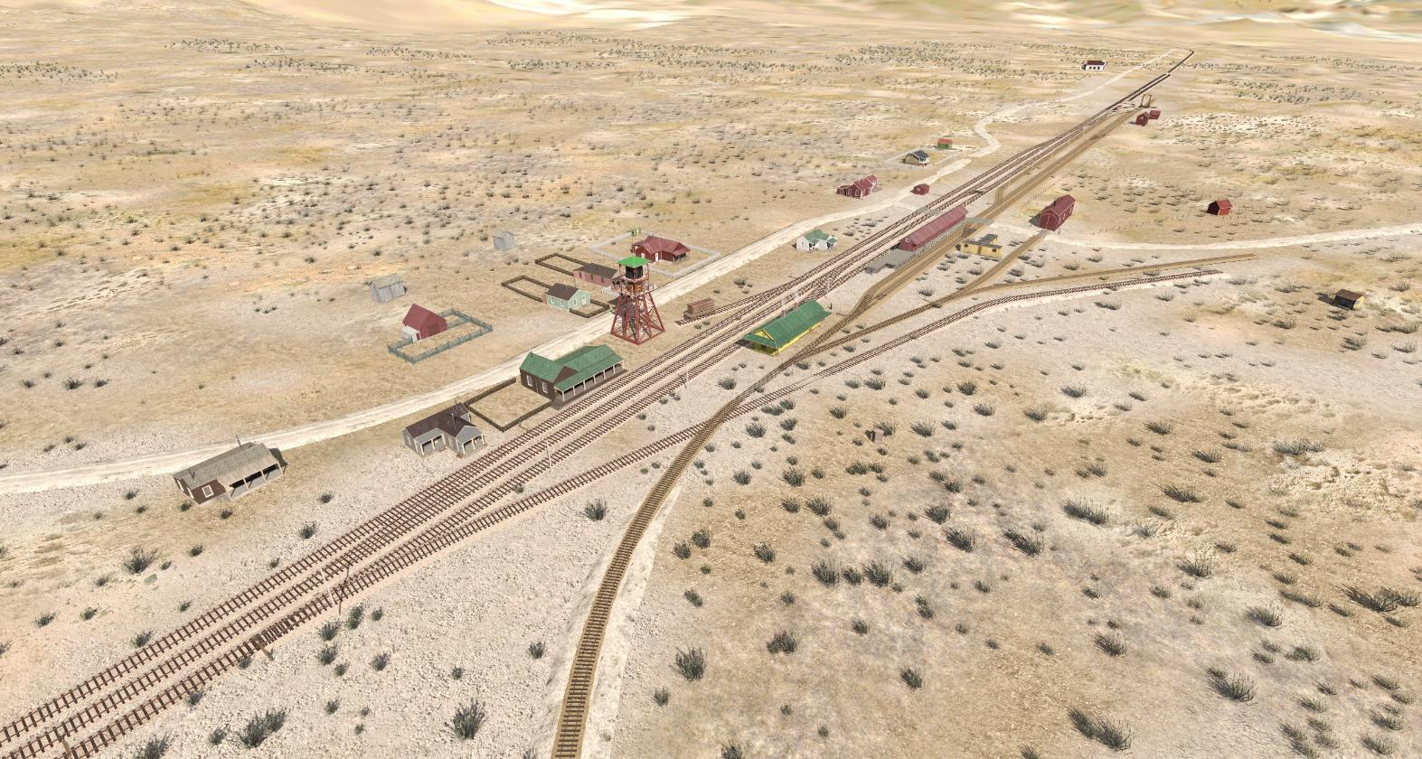
1886
Feb: Engine house burns down; car shed taken over for locomotives.

Slide 13
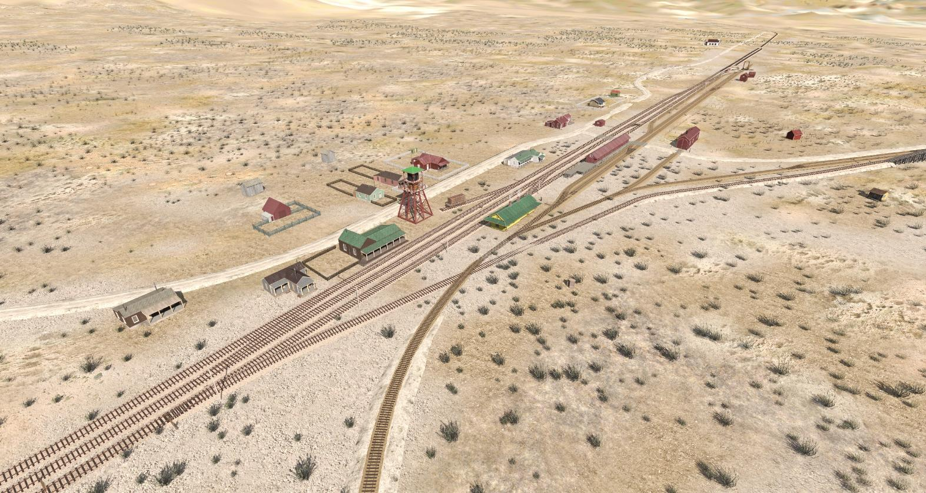
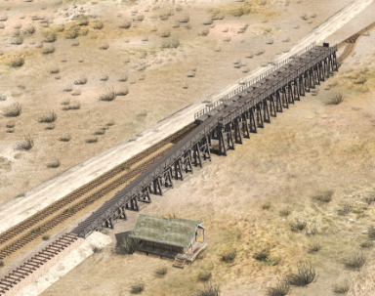
1888
Ore transfer trestle built
- Ore from the Savage → Rock Point Mill

Slide 14
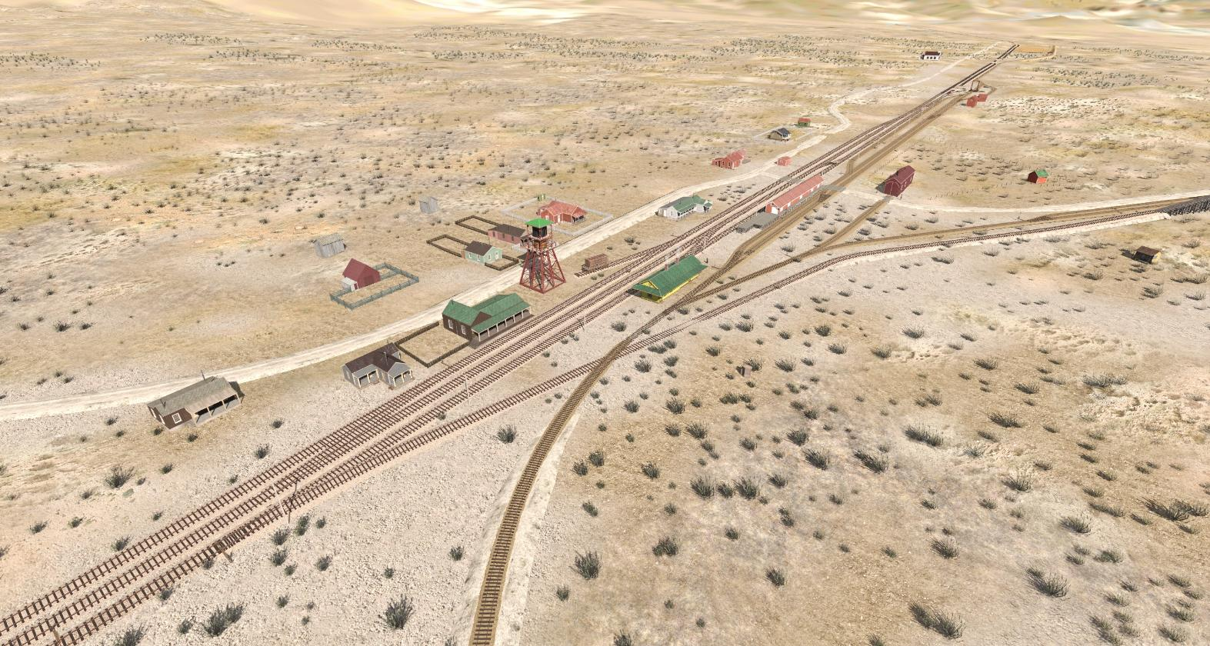
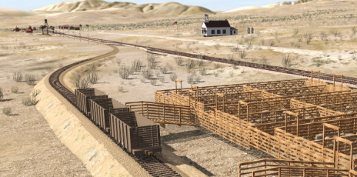
1893
Stock yards built
- Cows, pigs, and sheep from Wabusca

Slide 15
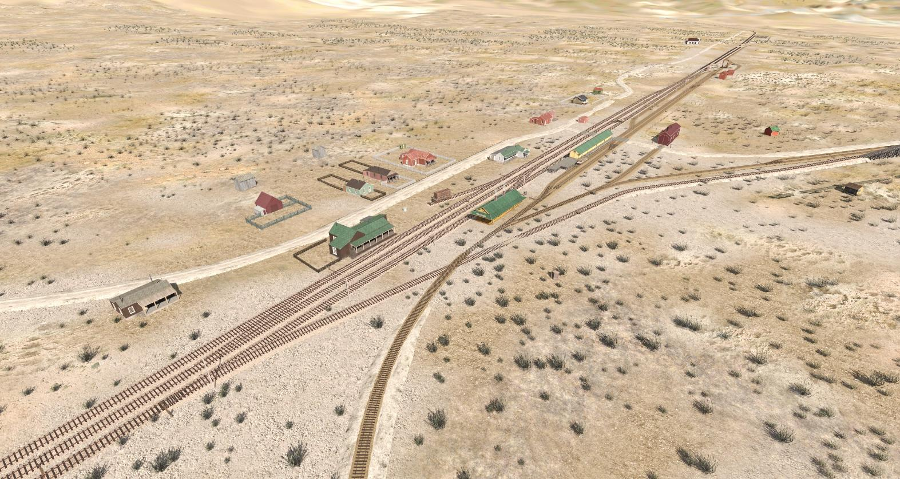
1900
Carson and Colorado sold to Southern Pacific

Slide 16
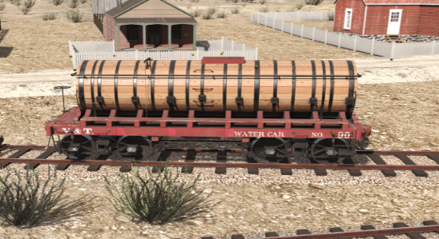
1901
Water Car No 90 replaces No. 42

Slide 17
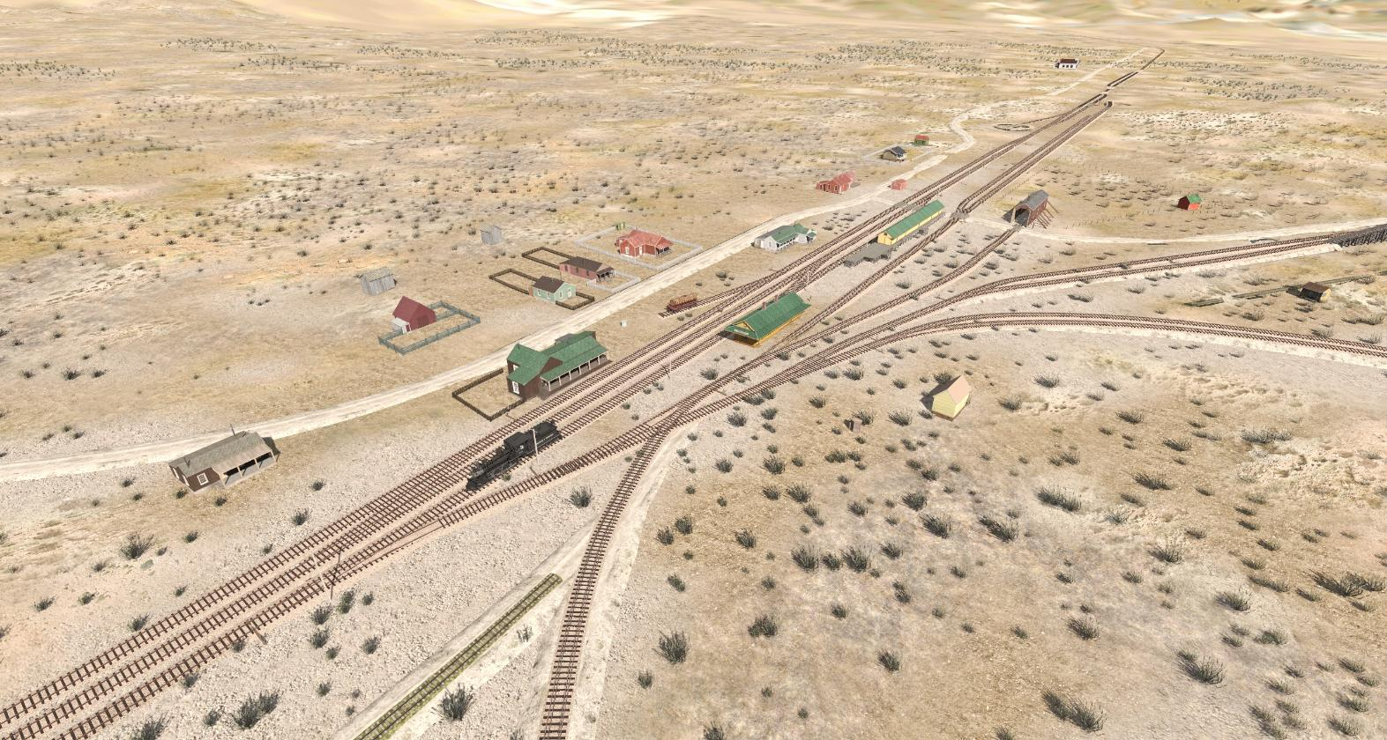
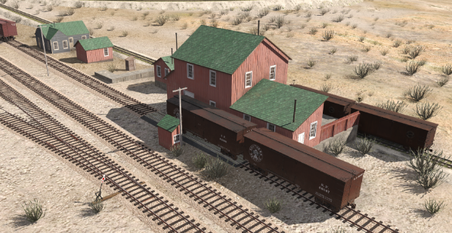
1904
Western Ore Purchasing Co is built
SP standard-gauges to Dayton

Slide 18
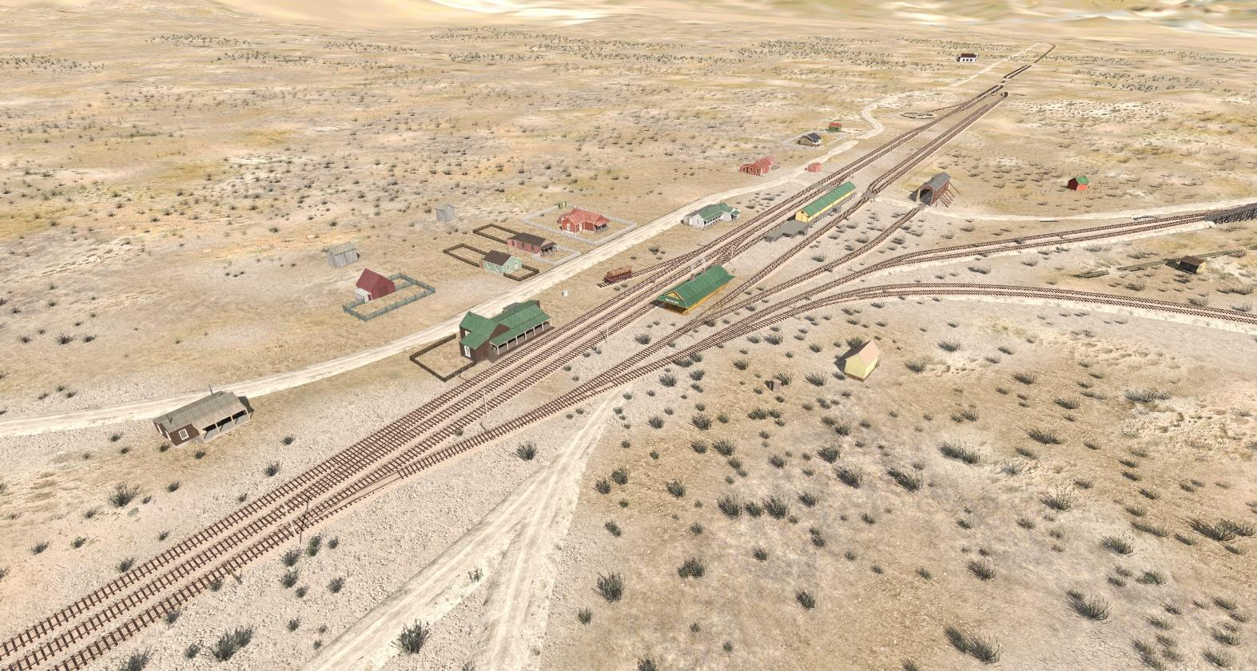
1905
Western Ore Purchasing Co moves to Tonopah

Slide 19
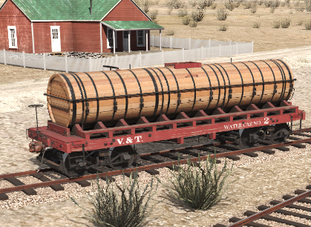
1906
January: Water Car No. 2 replaces No. 52

Slide 20
1908
August: SP now operating joint depot

Slide 21
1909
February: Nevada Gypsum mill opens

Slide 22
1914
The Lincoln Highway is built through Mound House
Graveled; one lane

Slide 23
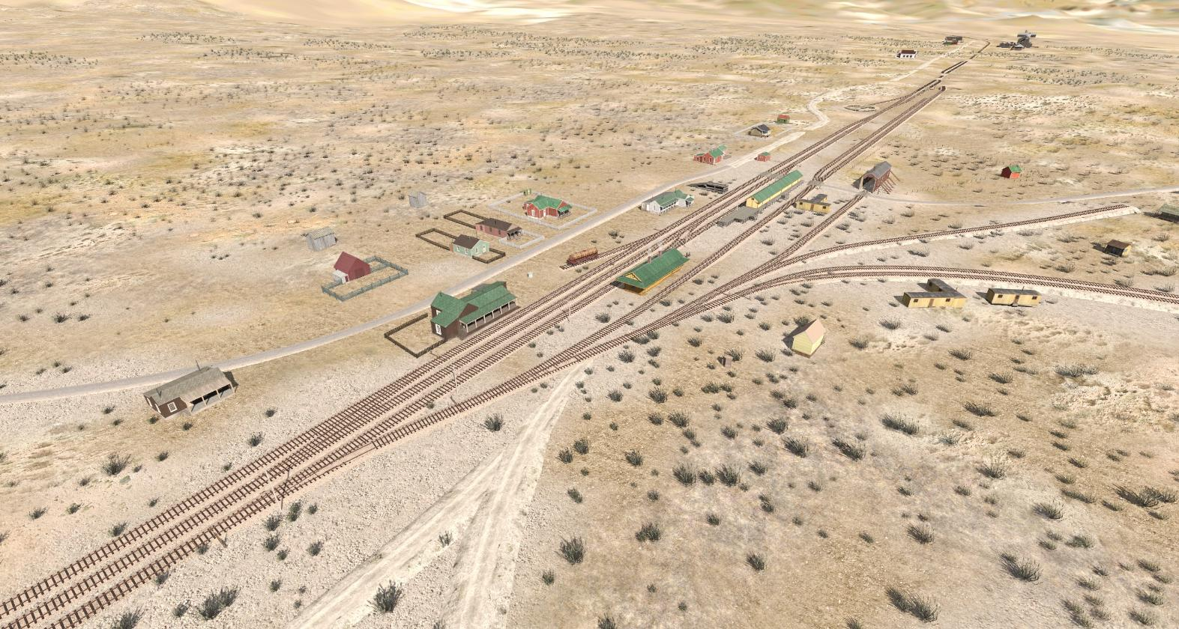
1922
Added 180’ to Pacific Portland Cement Co siding.
Replaced 1,350-feet of 56 lb. rail with 60 lb. rail.

Slide 24
1924
Pacific Portland Cement Co moved to Gerlach.
Dismantling complete by September.

Slide 25
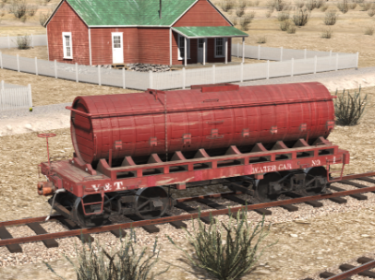
1930
Section crew consolidated with Scales crew
Water car No. 1 replaces Water Car No. 2

Slide 26
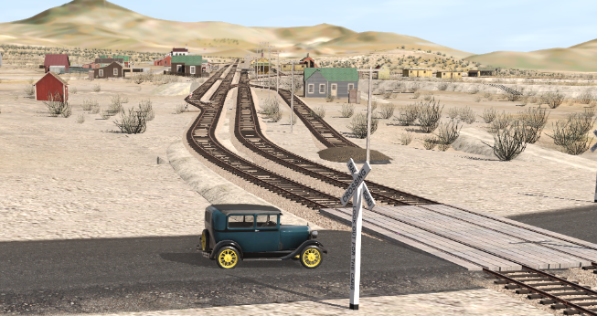
1931
Highway 50 is built; crossing the tracks just to the south

Slide 27
1932
Retired 654-foot old Scale Track “G” (Regan Track)
Retired PPC Mill tracks “J” and “K”

Slide 28
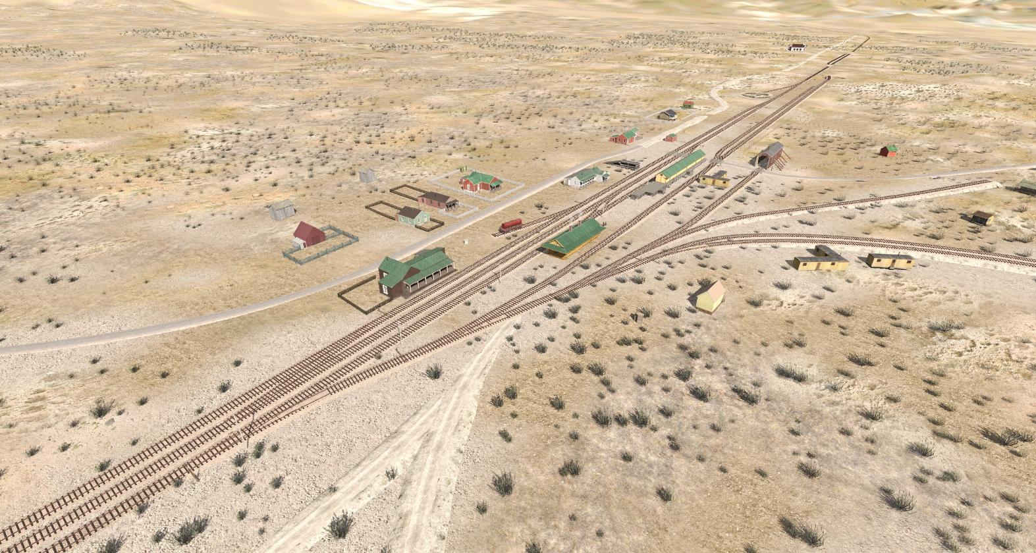
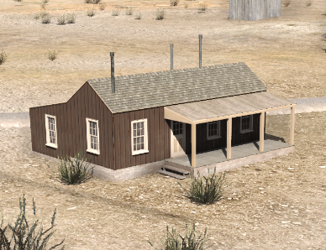
1933
Teasland House sold for $30 and removed.

Slide 29
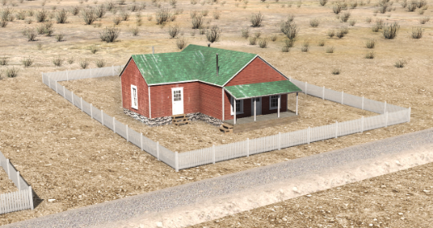
1934
Agent’s House sold and removed.
SP abandons the line between MH and Dayton

Slide 30
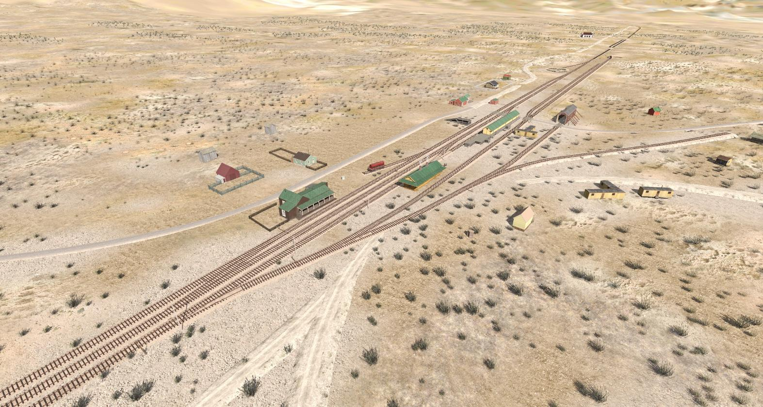
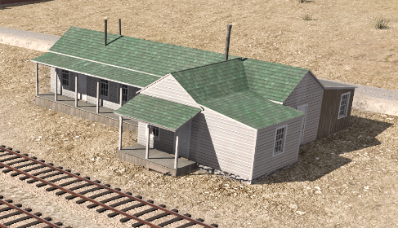
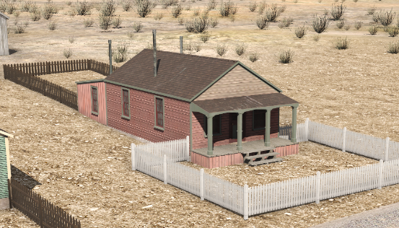
1936
SP rails removed to Dayton.
Boarding House and Fireman’s House sold ($50 ea.)

Slide 31
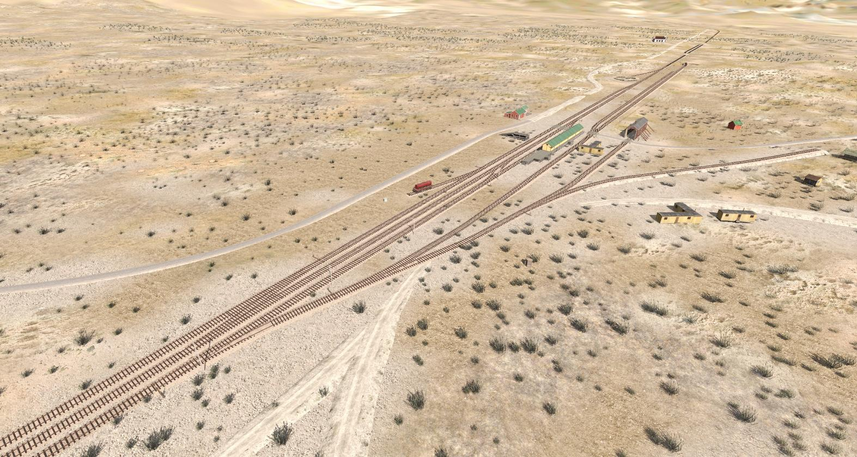
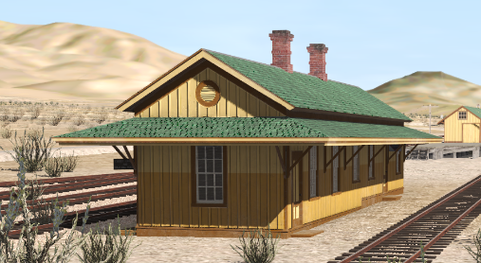
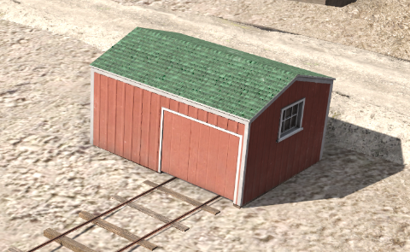
1938
Virginia City branch abandoned.
Passenger depot sold and moved to Carson
Section Tool House sold for $125

Slide 32
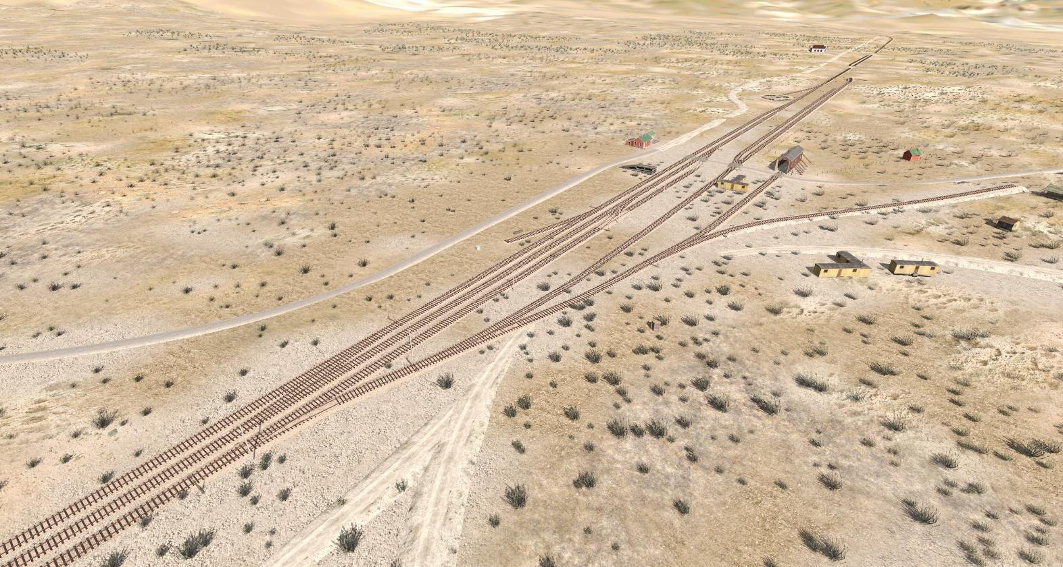
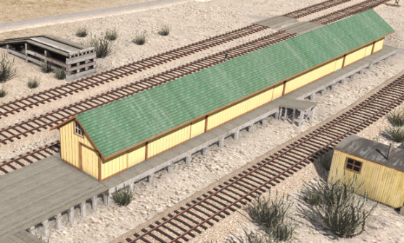
1939
Freight depot sold

Slide 33
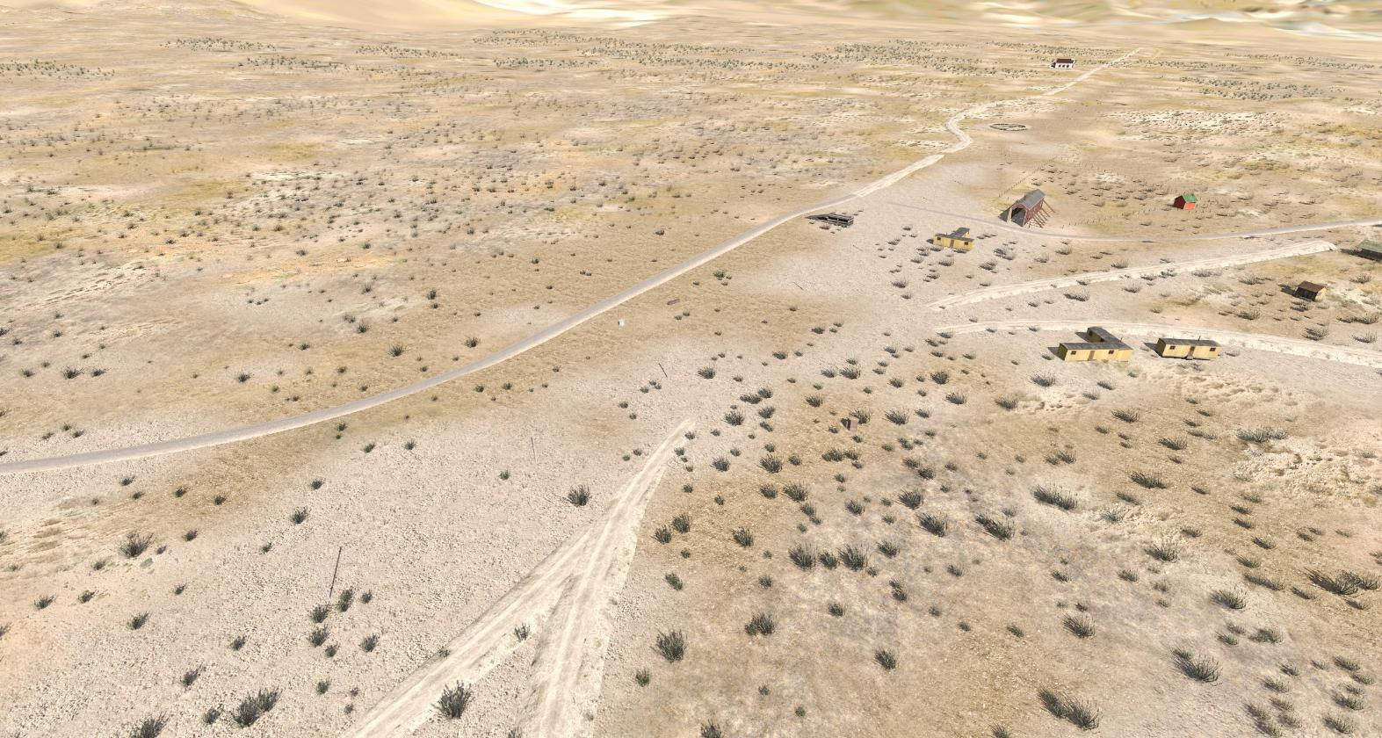
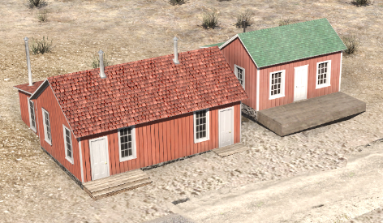
1941
Rails removed
Section House; Bunk House sold for $45

Slide 34
Other shots...

Slide 35
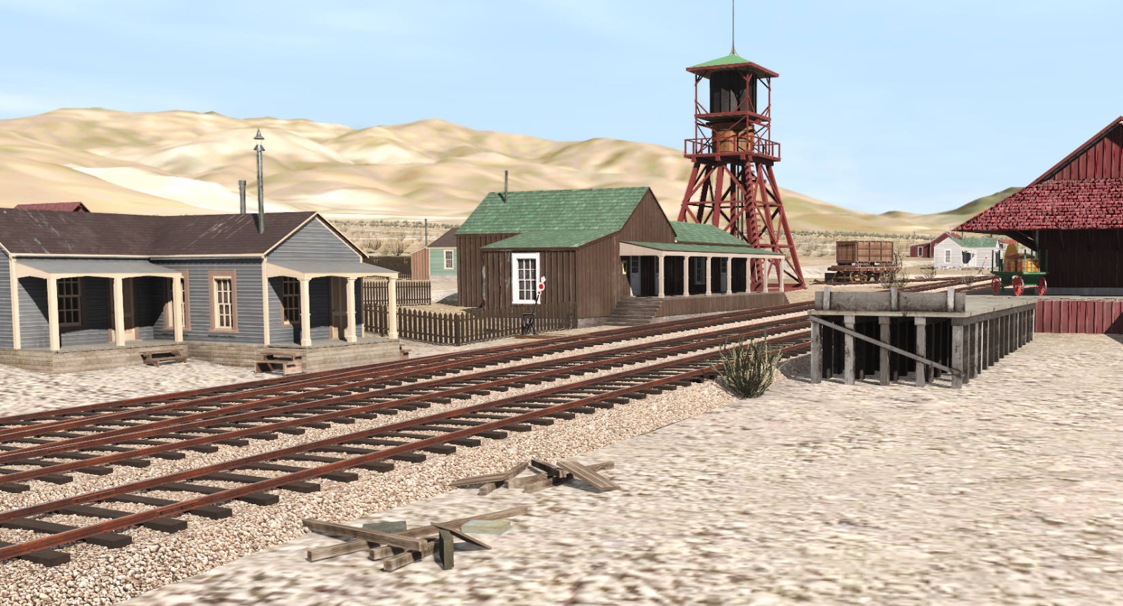
Late 1870s:

Slide 36
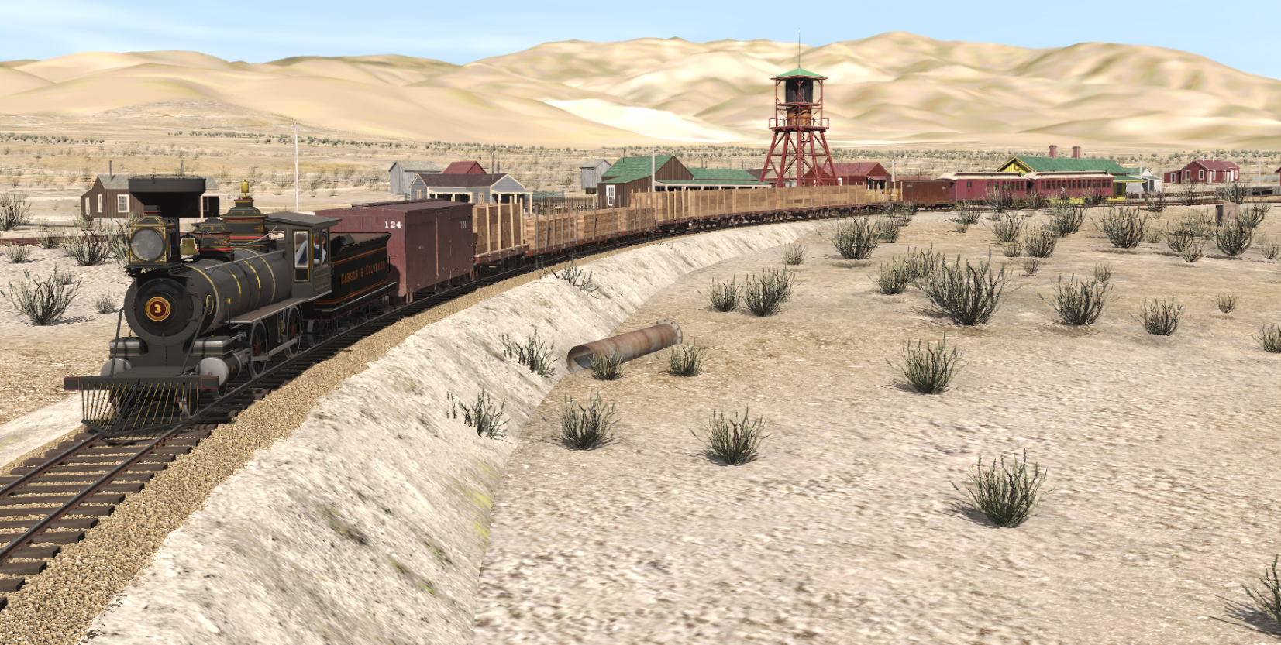
Ca 1888

Slide 37
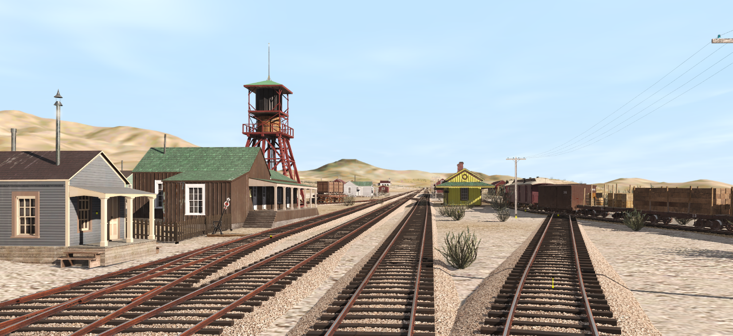
Ca 1888?

Slide 38
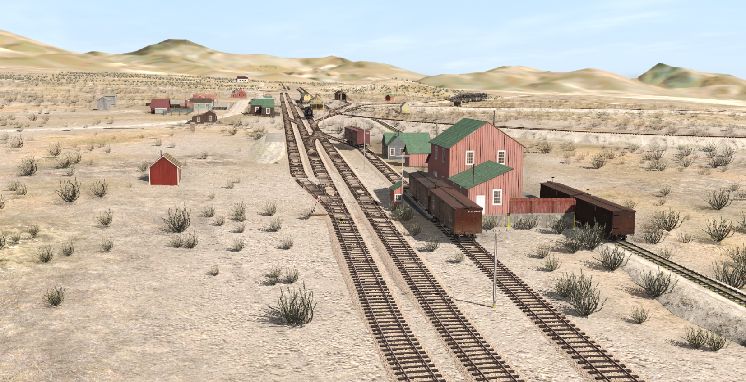
Ca 1905

Slide 39
Thanks to:
Andrew Brandon for data and coloring assistance
Mike Collins for structure diagrams and data
Stephen Drew for data, documents, review, all those Telegraph articles, and more
Dan Gollery for models
Cliff Jennings for Dexter / Turbine Windmill information

