Slide 1
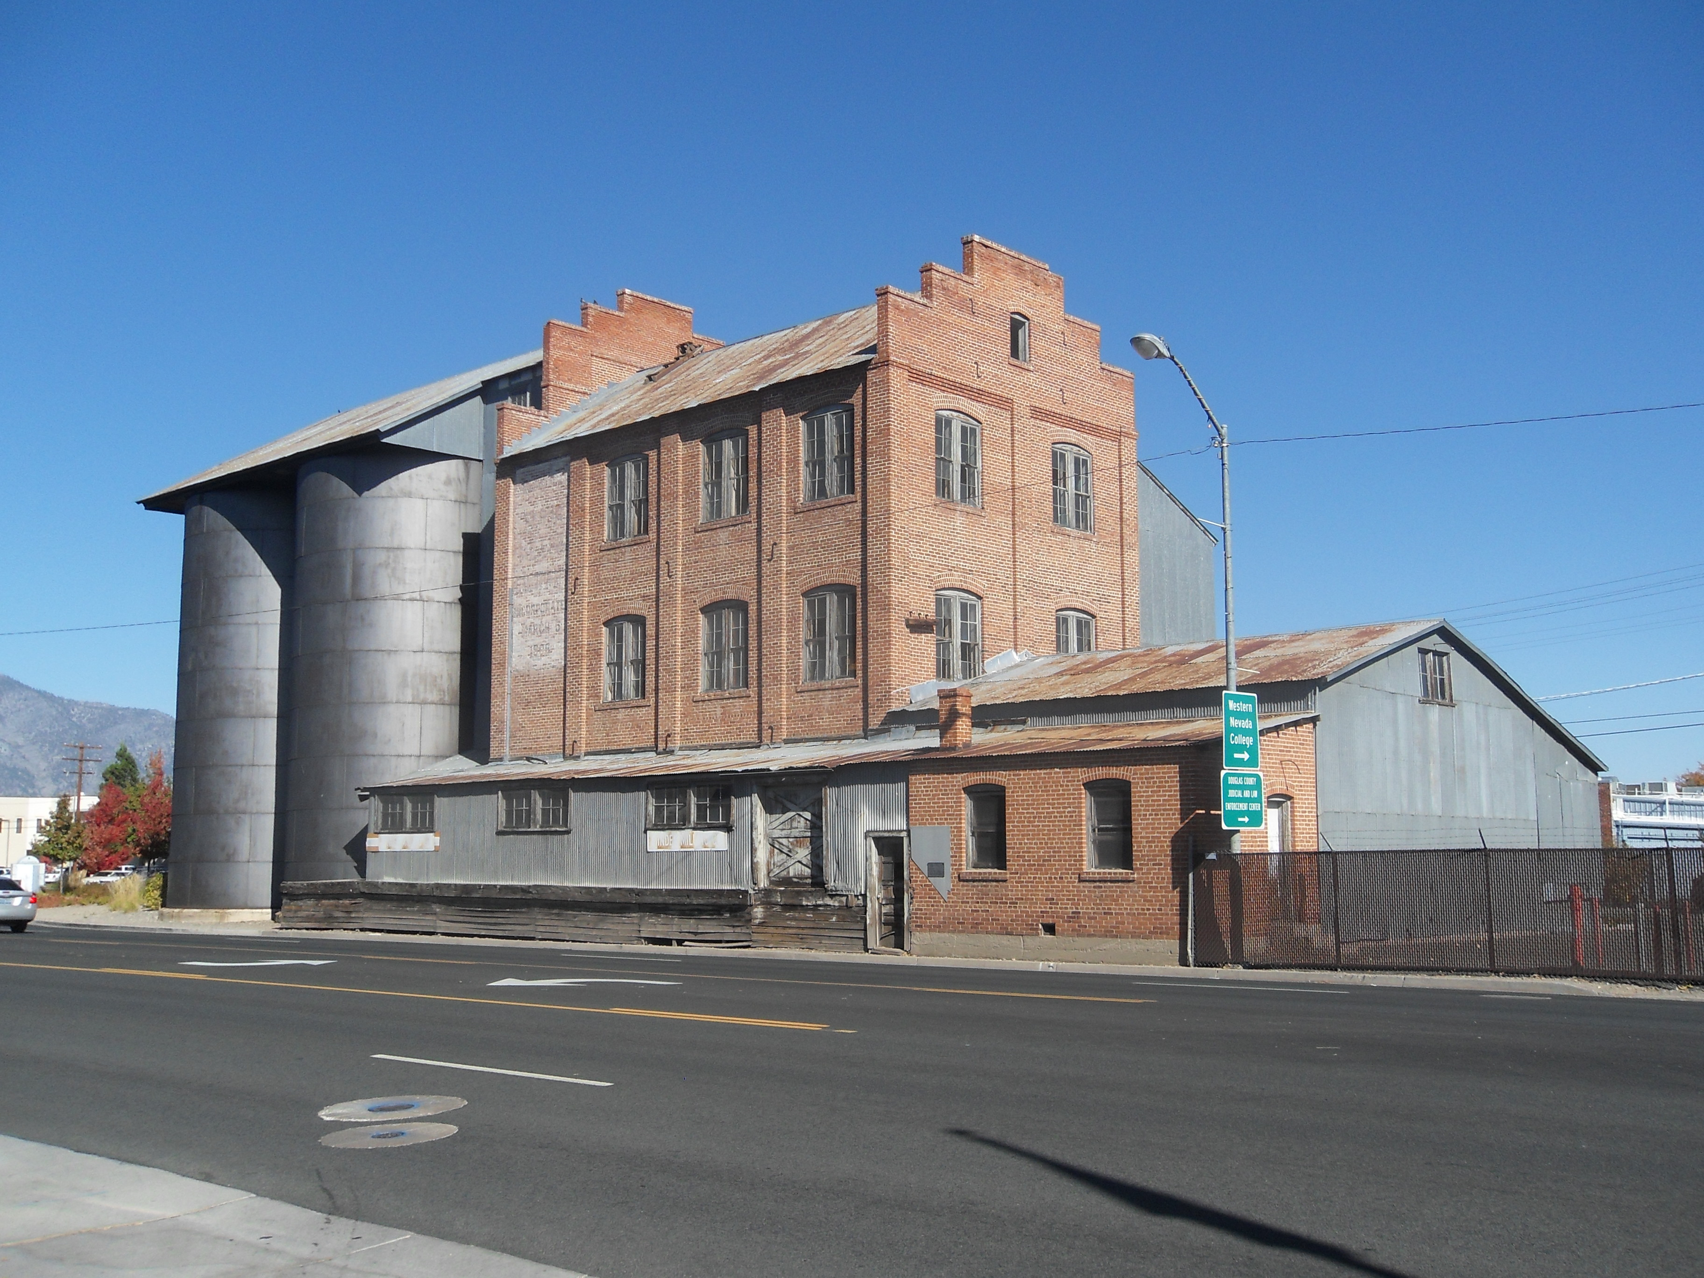
The Minden Flour Mill: 1906-1950
Stephen Drew
photo
Presented at the 2014 Virginia and Truckee Railroad History Conference
By Curtis Reid

Slide 2
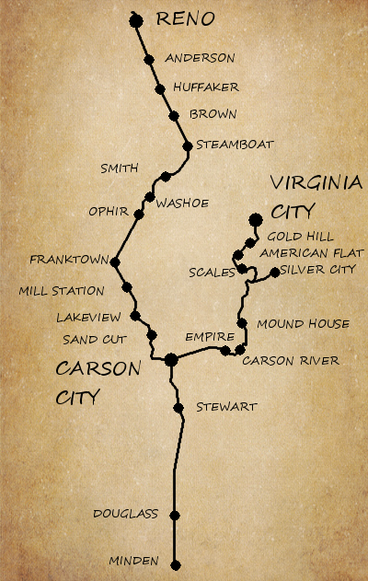
Location:
Minden; the farthest point south on the V&T
Road map image provided by Bing maps

Slide 3
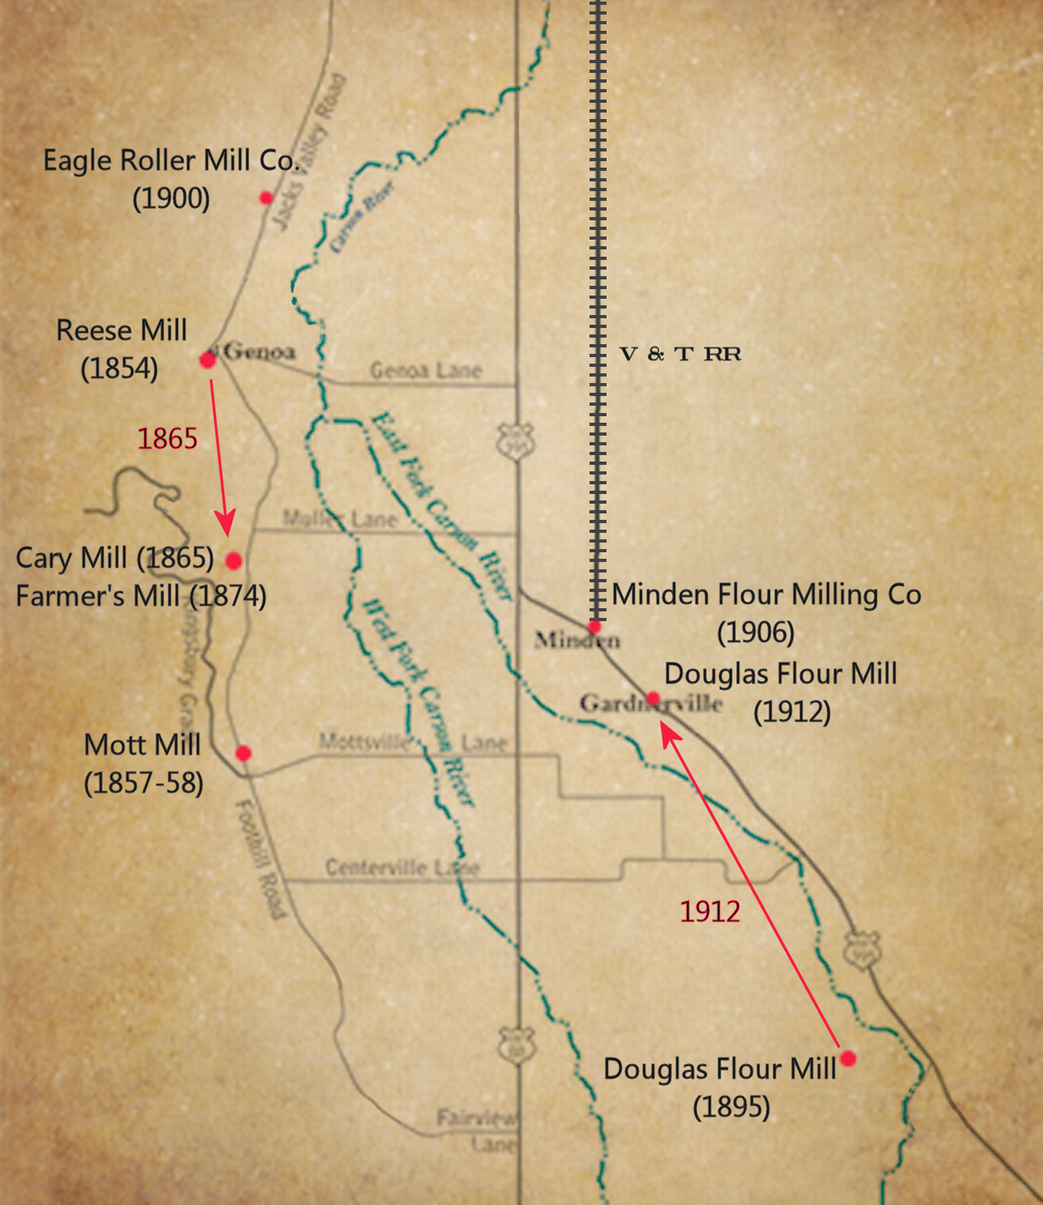
Flour Mills in the Carson Valley
5 mills total
First mill built in 1854
Last mill built in 1907

Slide 4
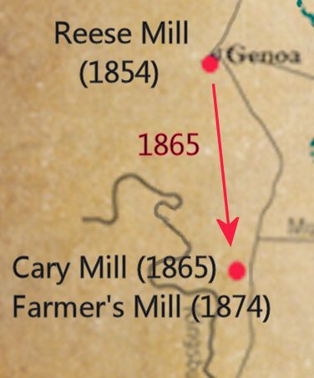
Flour Mills in the Carson Valley
Number 1 (Reese Mill):
Started operation 1854
Built by Thomas J. Knott for Colonel John Reese
On Mill St in Genoa
1865; moved to the foot of Kingsbury Grade; becomes the 'Cary Mill'
1874; becomes the Farmer's Mill; still in operation in the early 1900s.

Slide 5
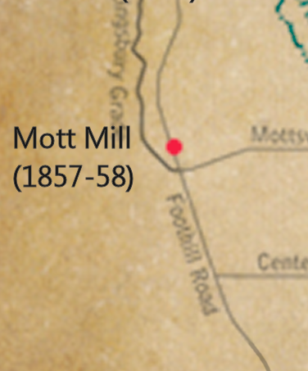
Flour Mills in the Carson Valley
The second flour mill in the valley:
Started operation 1857 or 1858
Built by Sam Silliman for Hiram Mott
On Mill Creek just north of Mottsville

Slide 6
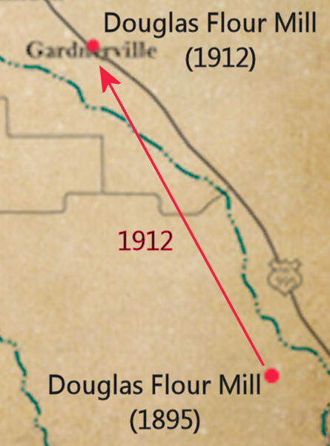
Flour Mills in the Carson Valley
Number 3 (Douglas Flour Mill):
Built on Long Valley Creek in 1895
Machinery delivered by the V&T to Carson,
then carried by wagon
Capacity: 50 barrels per day
1912; machinery moved to Gardnerville
and a new building was built
Grace Dangberg

Slide 7
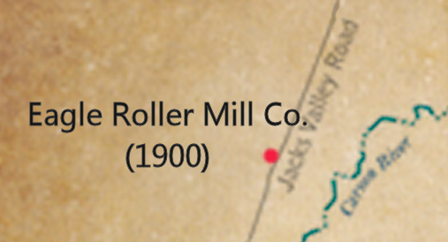
Flour Mills in the Carson Valley
Number 4 (Eagle Roller Mill Company):
Started operation 1900
North of Genoa on Adams Creek

Slide 8
Flour Mills in the Carson Valley
Number 5 (Minden Flour Milling Company):
Construction started March 1906
Started operation October 1907; after a 6 month wait for electricity
Silos held 65,000 bushels of grain
Capacity listed as 100 barrels / day
1942 – converted to a feed mill; 'Minden Milling Company'
Closed in the late 1960's
The only mill served by the V & T (or any railroad)
The only mill still standing

Slide 9
Minden Flour Mill
Physical History

Slide 10
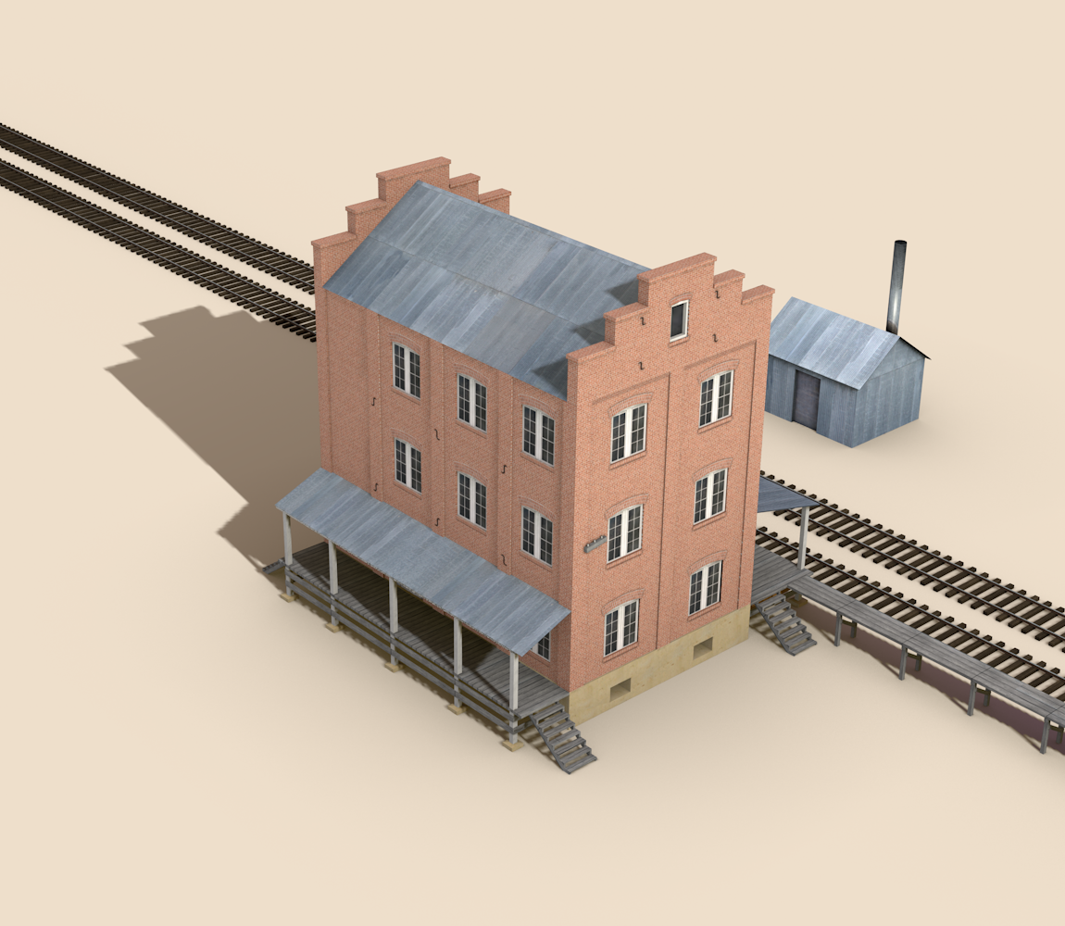
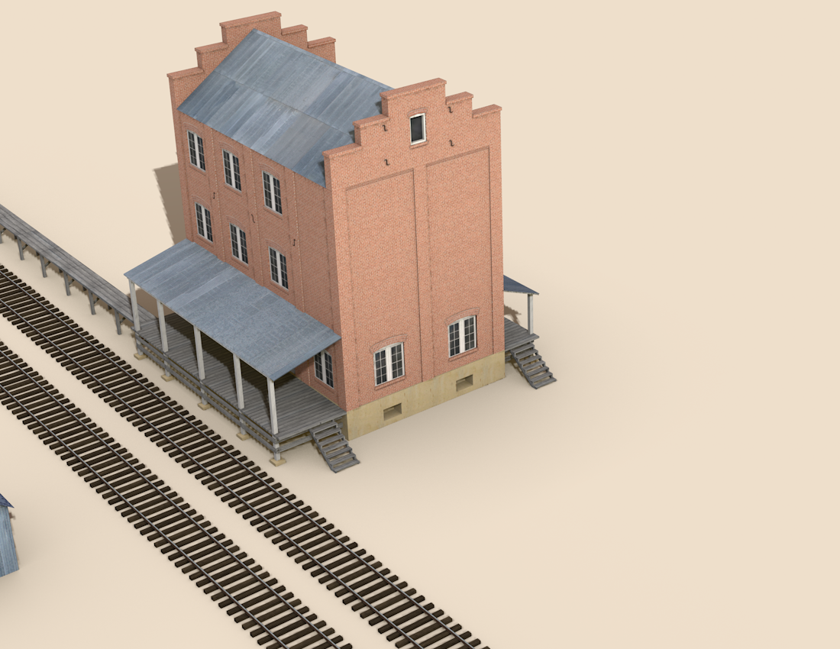
April 1907
The initial building is completed

Slide 11
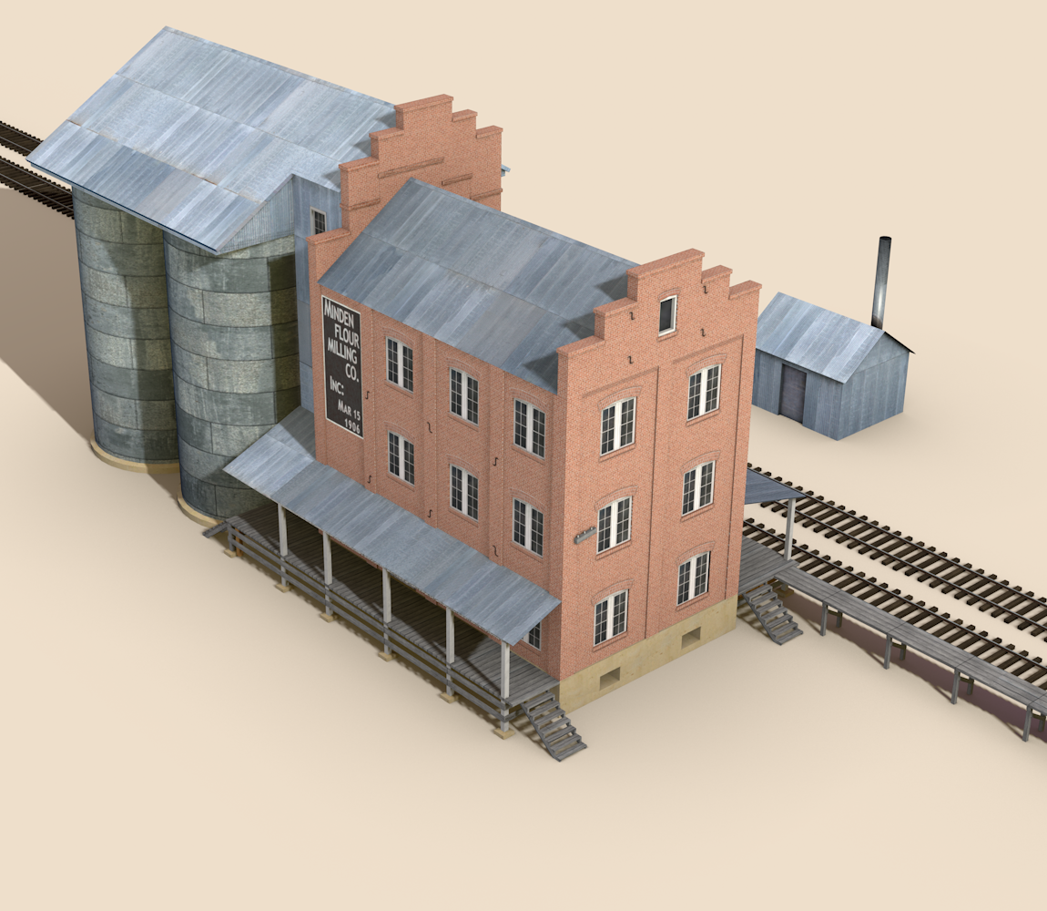
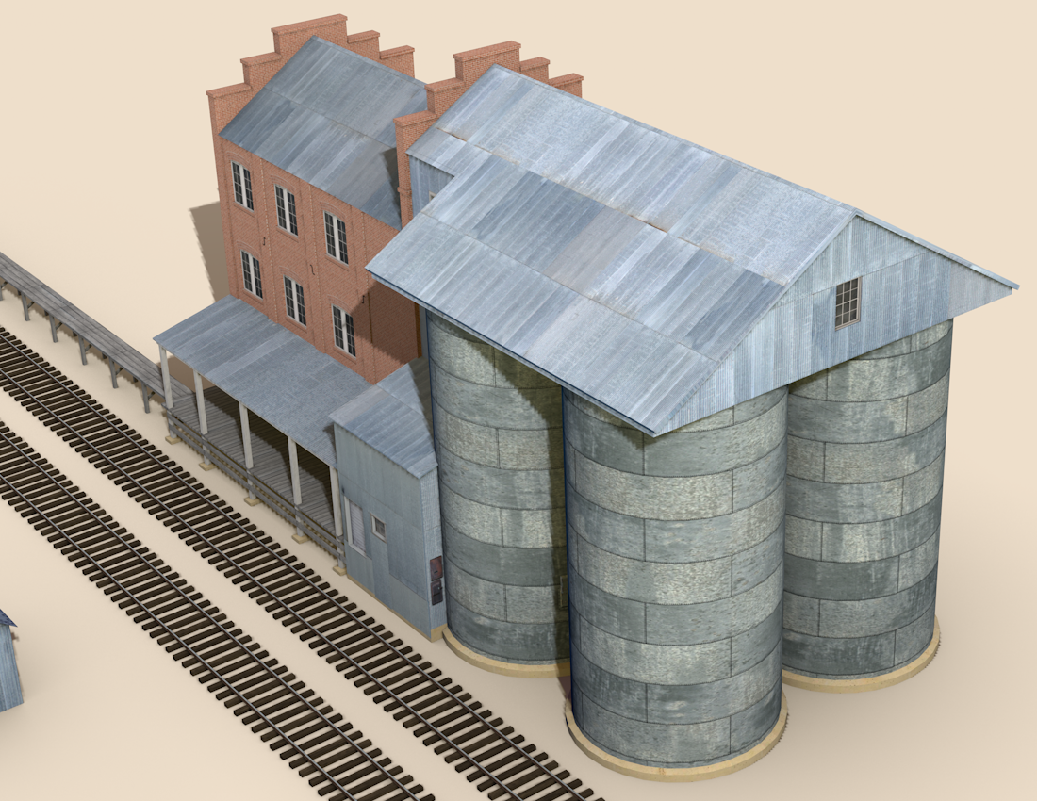
September 1908
Silos added

Slide 12
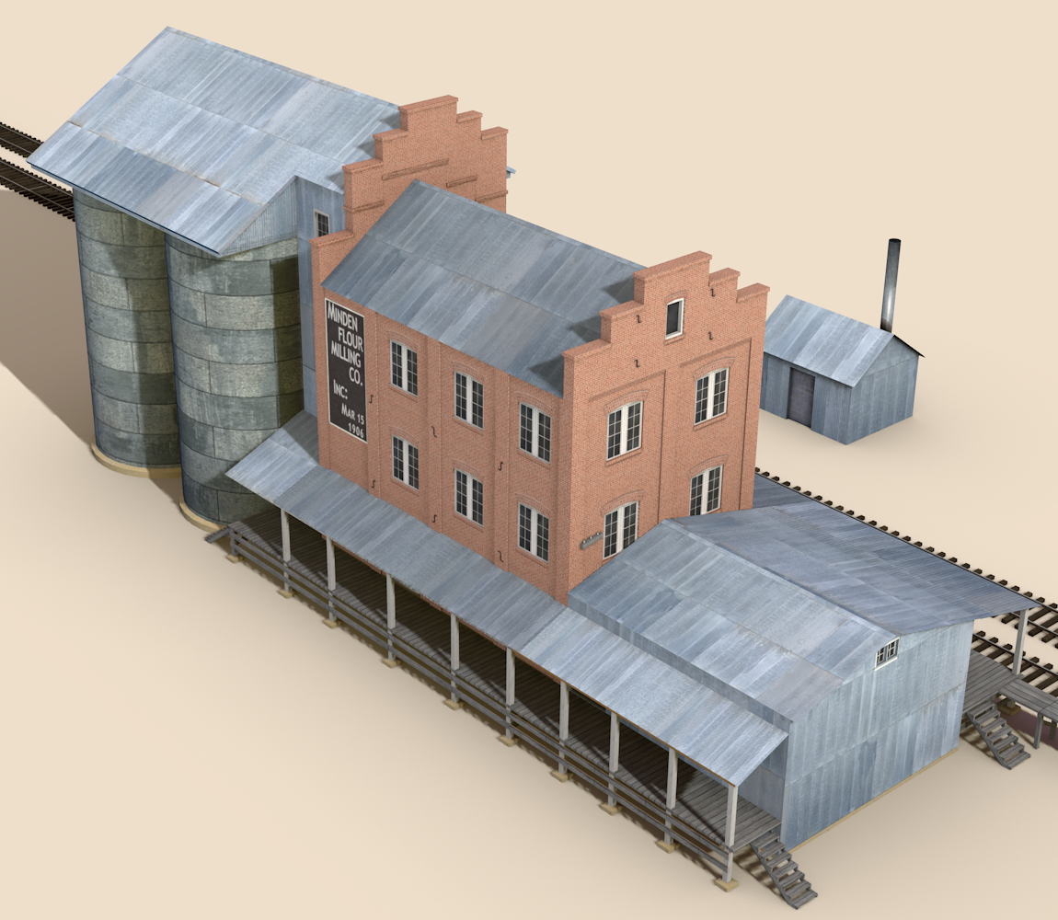
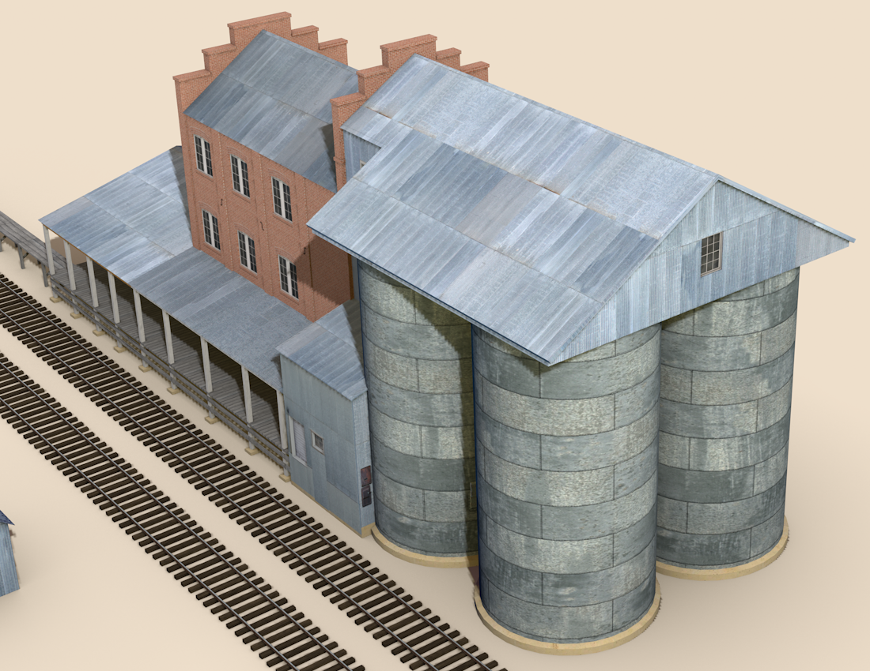
November 1908
Warehouse added

Slide 13
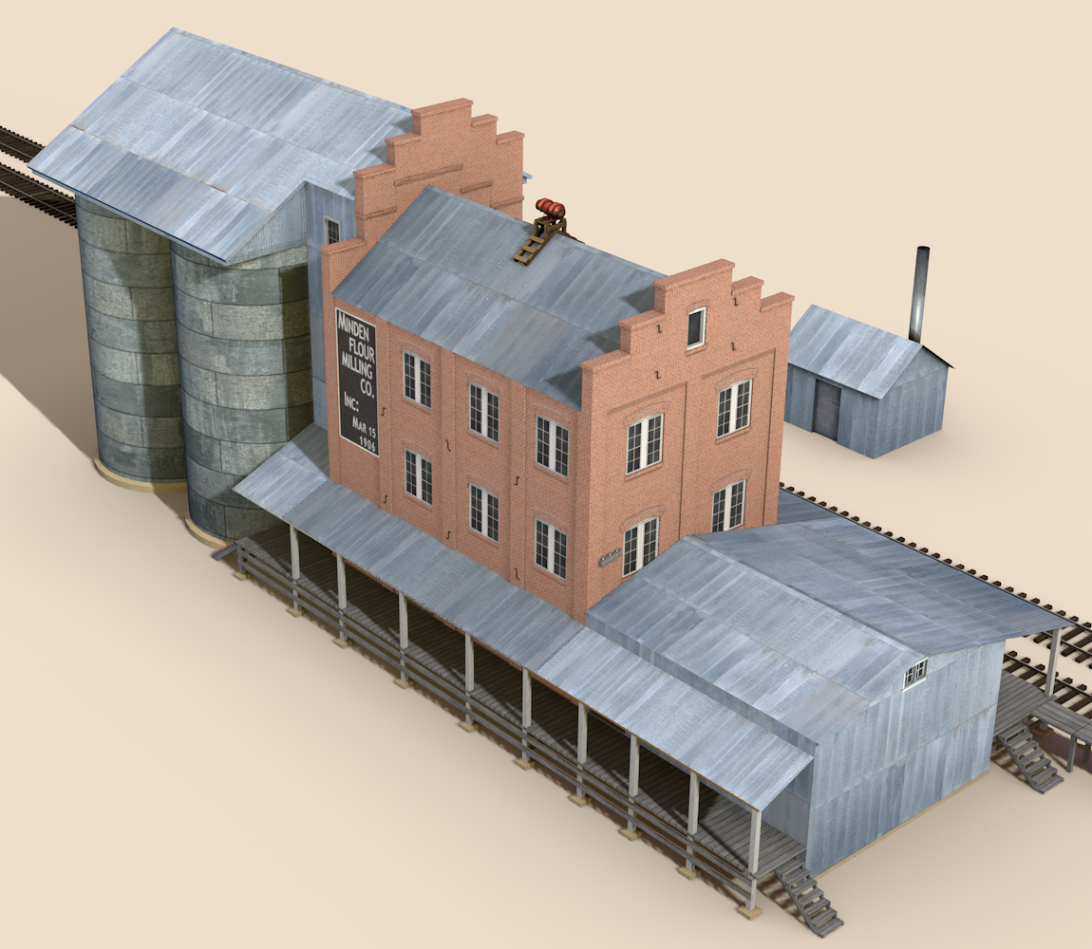
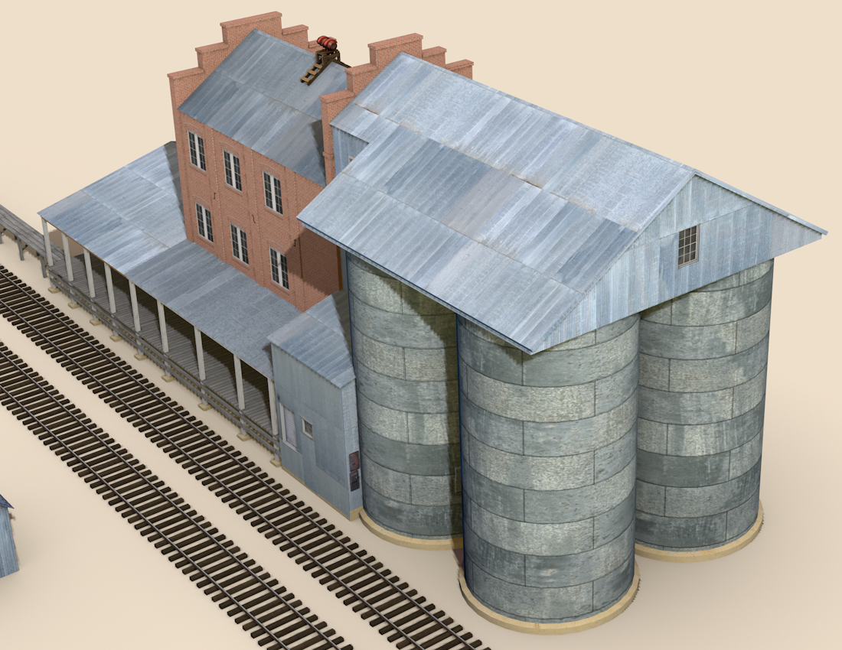
1921+
Fire siren added

Slide 14
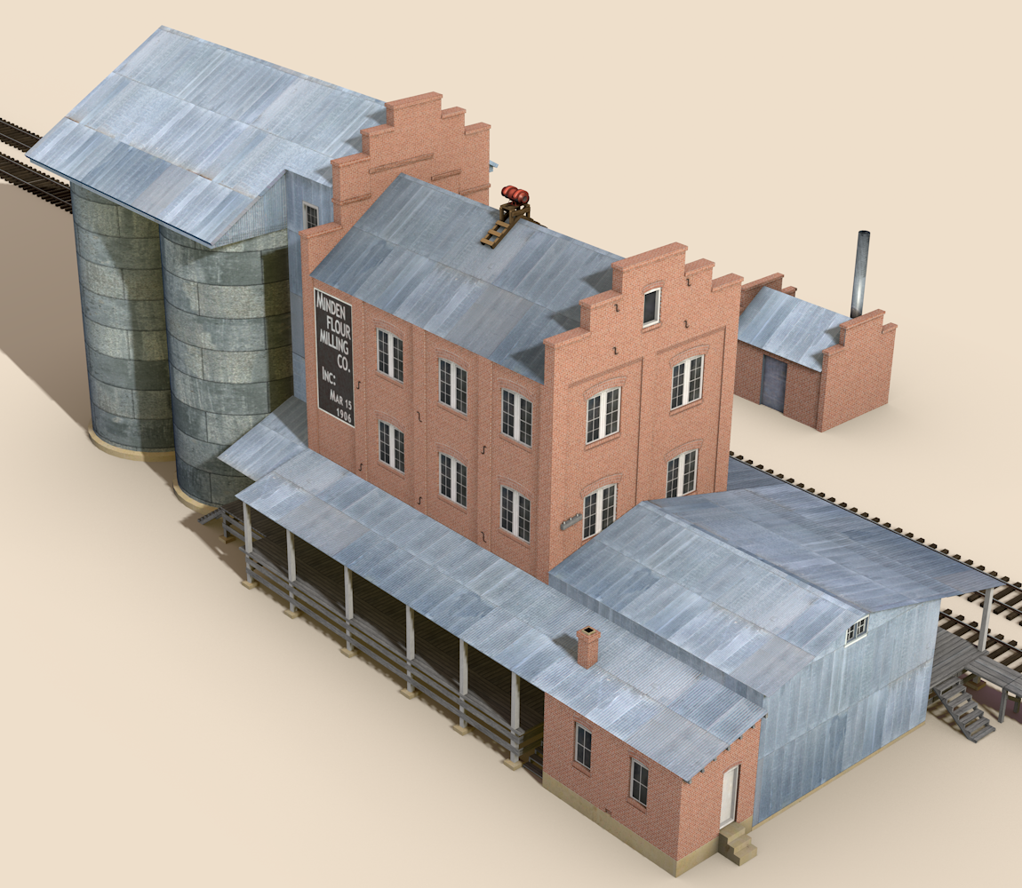
September 1924
Brick office added

Slide 15
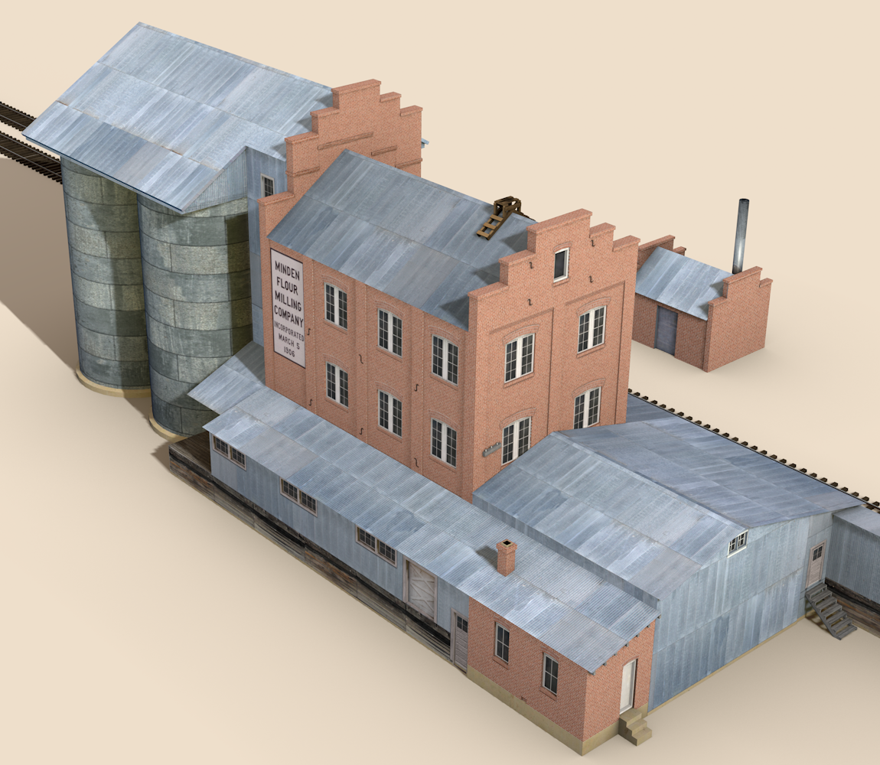
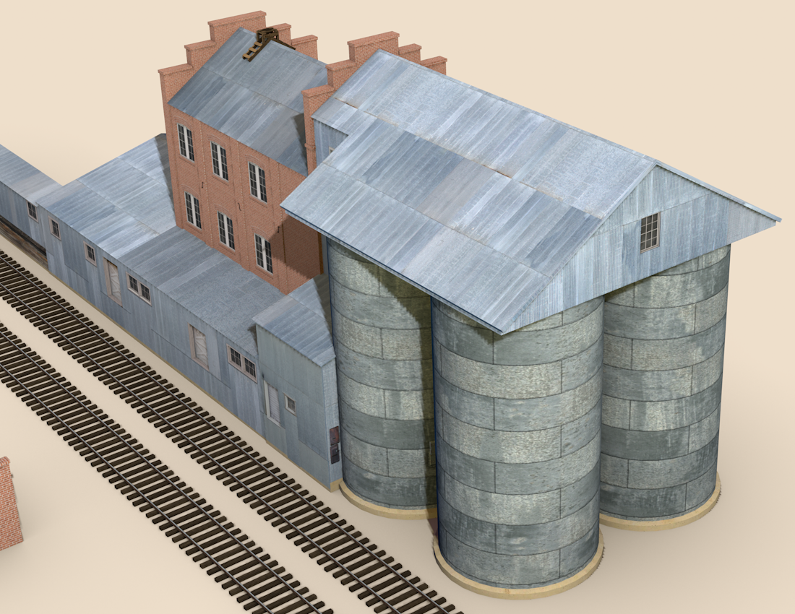
Unknown
Platforms enclosed

Slide 16
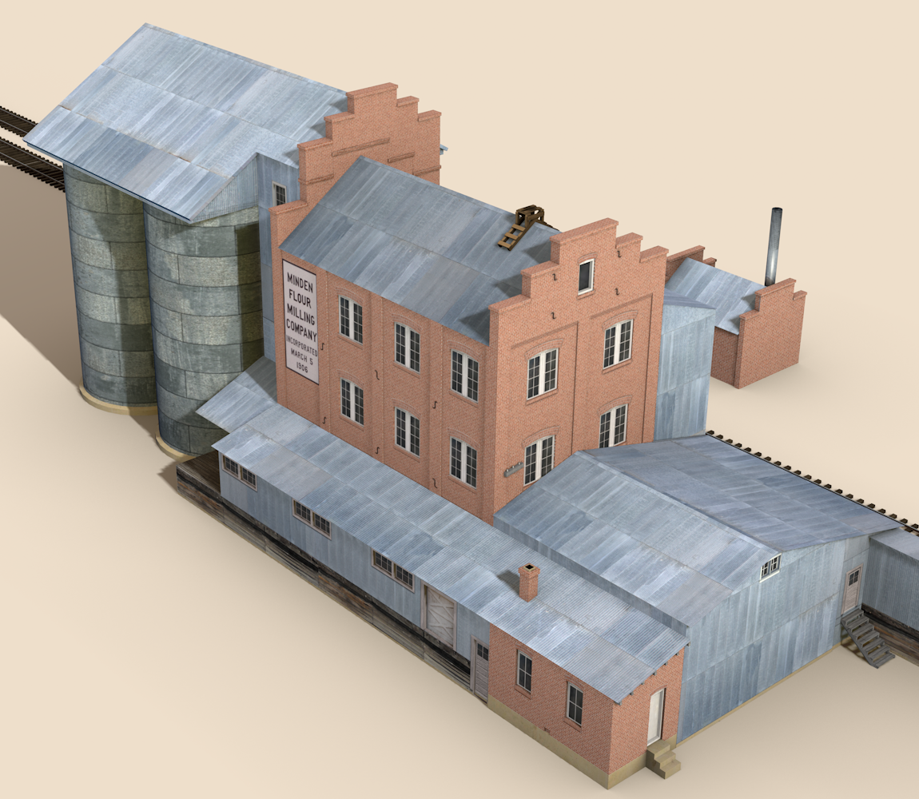
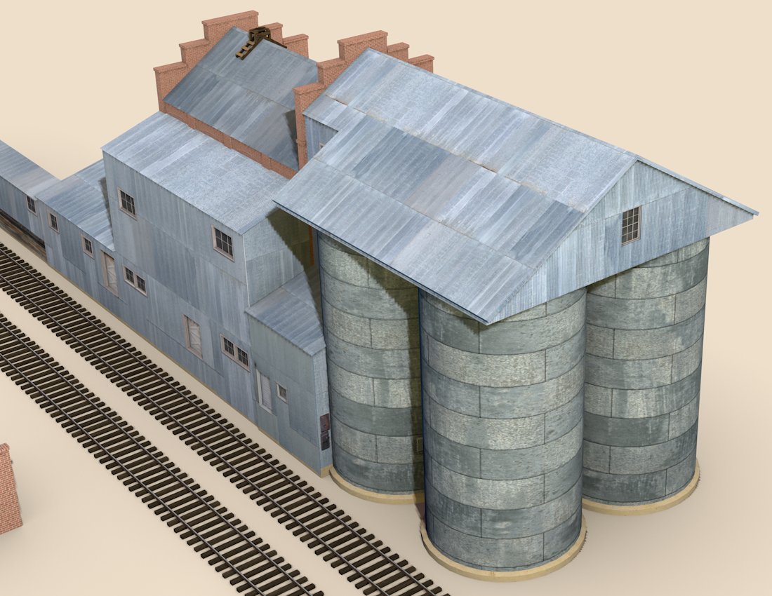
Post 1940 (1943?)
Large enclosure built on the north side

Slide 17
Historical Images

Slide 18
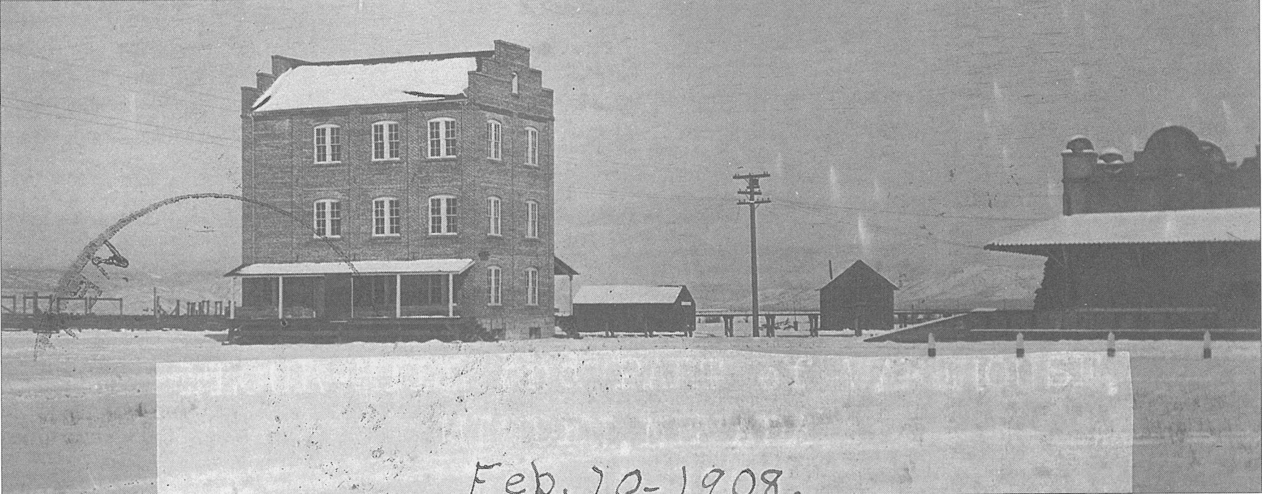
1908
Stephen Drew
Before the silos were added.

Slide 19
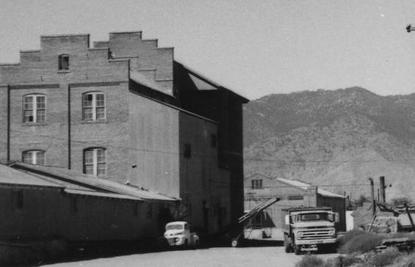
Late 1960s
Stephen Drew
North side of covered platforms

Slide 20
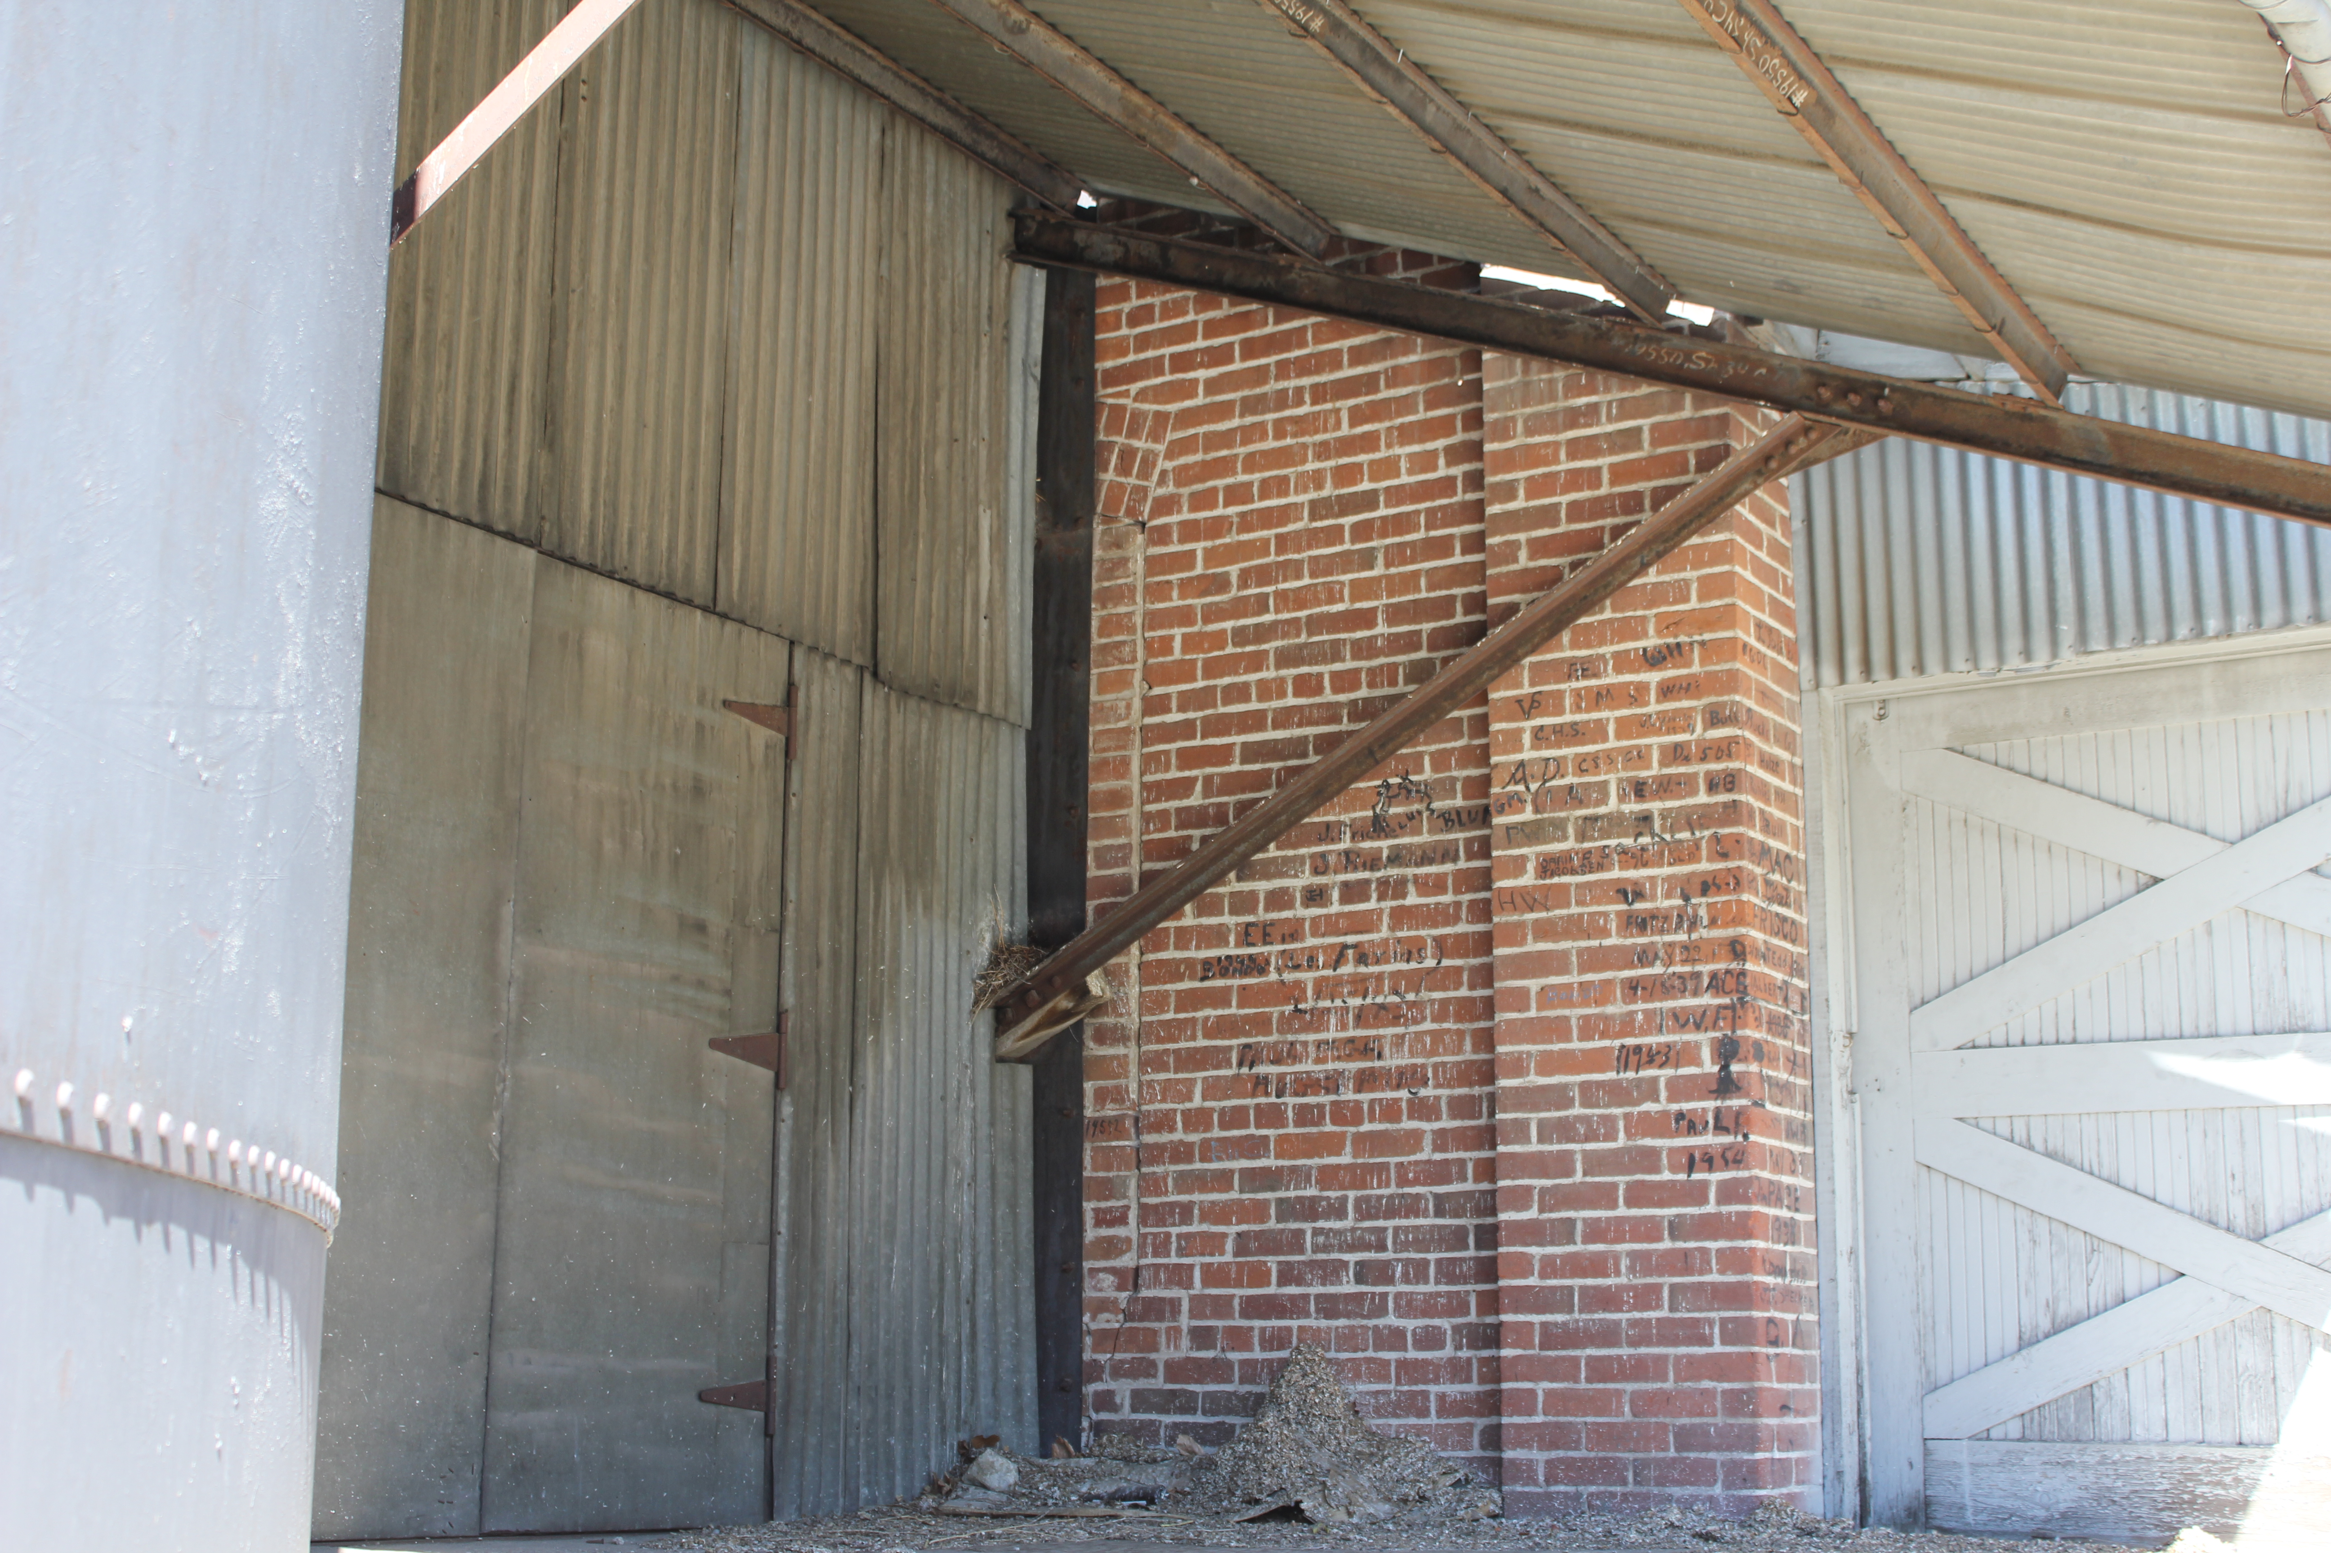
Evidence of 1st story west window

Slide 21
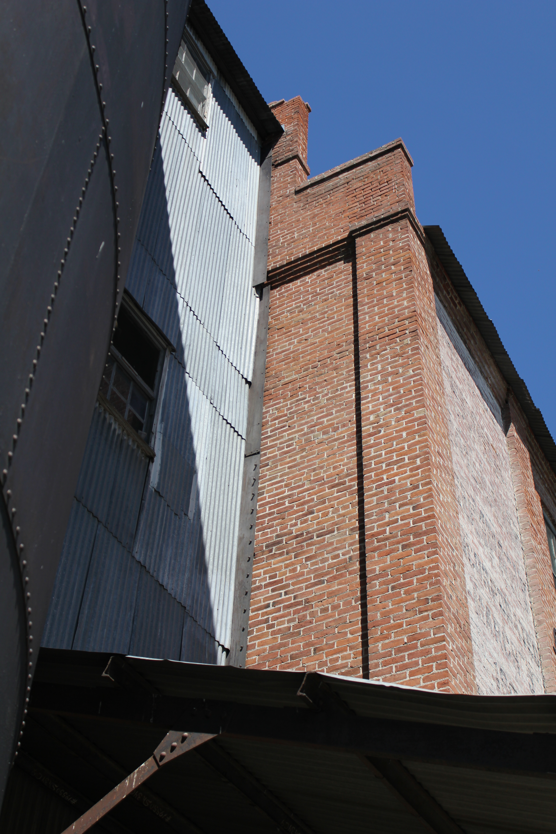
But no windows on the 2nd and 3rd stories?

Slide 22
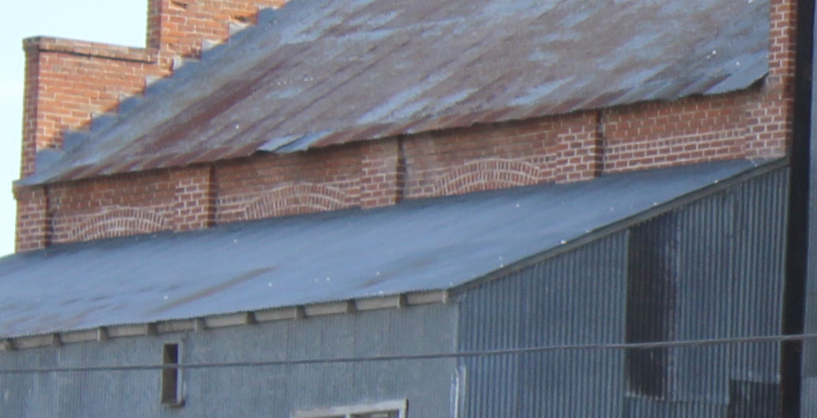
Only three rows of windows on the north side

Slide 23
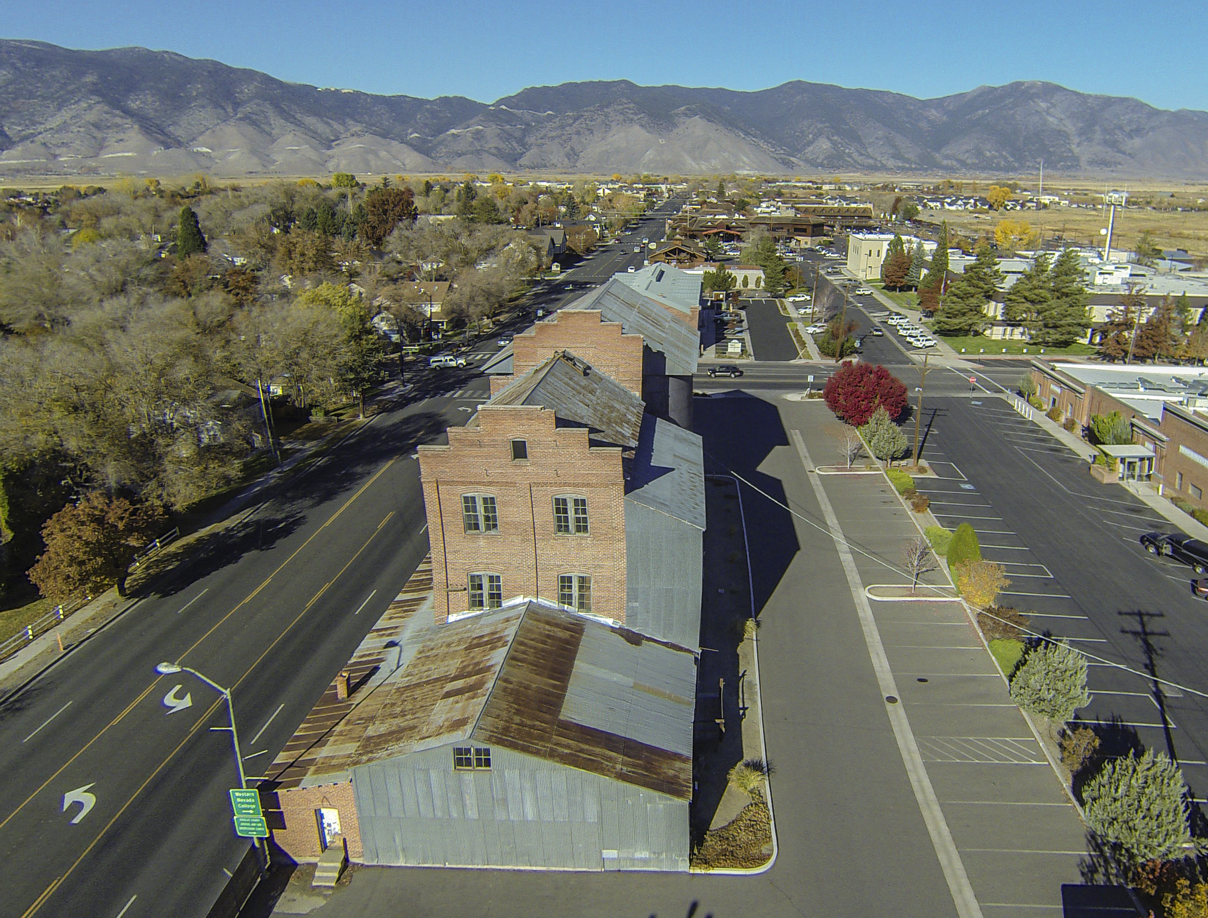
Jack Freer
Good view of offset silos

Slide 24
References
Print:
Crow, C.C. “The Minden Flour Mill”. Mainline Modeler October 1988.
Dangberg, Grace. Carson Valley: Historical Sketches of Nevada's First Settlement. Reno: The Carson Valley Historical Society, 1972.
Ferrell, Mallory Hope. Virginia & Truckee: The Bonanza Road. Hong Kong: Hundman Publishing, 1999.
Maule, Wynne M. Minden, Nevada: The Story of a Unique Town 1906-1992. The Carson Valley Historical Society, 1993.
The Record-Courier. Carson Valley: Historic Photo Album: The Early Years ~ 1860 – 1940. Pediment Publishing, 2000.
Web:
Bently Heritage (Current owners of the mill). Location: http://bentlyheritage.com/index.php
Historical Carson Valley Flickr photostream: https://www.flickr.com/photos/carsonvalleynevada/sets/72157632885918979
Jack Freer (Overland Photography): http://www.overlandphotography.us/
National Register of Historic Places Inventory – Nomination Form. United States Department of the Interior; National Park Service. 1978. Location: text: http://pdfhost.focus.nps.gov/docs/NRHP/Text/78001721.pdf photos: http://pdfhost.focus.nps.gov/docs/NRHP/Photos/78001721.pdf
University of Nevada, Reno Maps Online: http://contentdm.library.unr.edu/explore/NVMapsExplore/nvmaps/nvmaps-home.html

