Slide 1
Modeling the V&T Virtually
Curtis Reid
2010 V&T History Conference
V & T RR Historical Society

Slide 2
Agenda
Intro to virtual railroading
Overview
Pros / cons (virtual / physical)
Simulator overview
V&T in Trainz
Why Trainz?
Content
What’s already available
How do you make new models?
Route
How do you make a new route
V & T Route screenshots
Demo

Slide 3
Introduction to Virtual Railroading

Slide 4
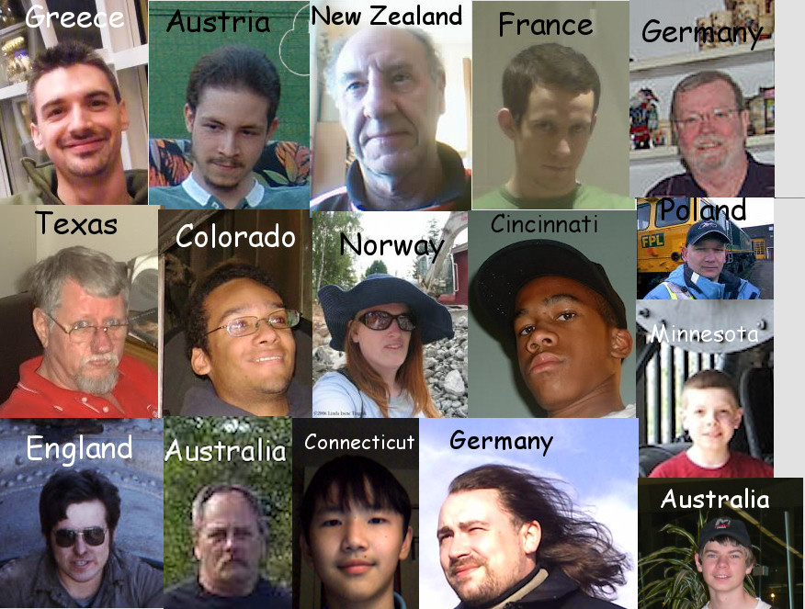
What is it?
Basically, model railroading on your computer
Is not ‘either-or’ – many people enjoy both traditional and virtual modeling
Enjoyed by people all over the world

Slide 5
Pros and cons
Pros
Cab view is an option
Minimal physical constraints
Space; derailing; dirty track; where to put the motor, finicky couplers
Can model large areas at 1:1 scale
Can have multiple layouts simultaneously
Can share / duplicate content trivially
Say you need 100 ore cars….
Can send a copy of what you’ve made to a friend across the country (or world)
Cons
No physical models to touch / own
Must look at items ‘through the computer’
Backups required to avoid accidental erasure of content
Cannot easily modify models you do not create (limited ‘kitbashing’ or repainting)

Slide 6
Simulator Overviews

Slide 7
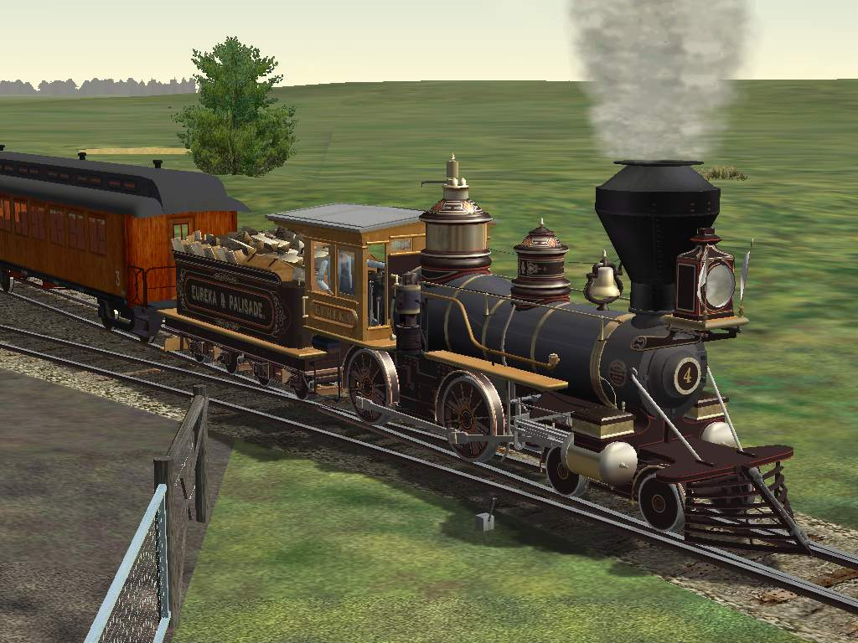
Microsoft Train Simulator (MSTS)
Released in July 2001 ;
Can occasionally still be found in ‘bargain bins’
Notes:
Pros
Excellent driving simulation
Good community support (unofficial patches, etc)
Cons
Difficult to build your own routes
Non-functioning turntables
No longer officially supported
No narrow gauge
Unstable (frequent crashes)

Slide 8
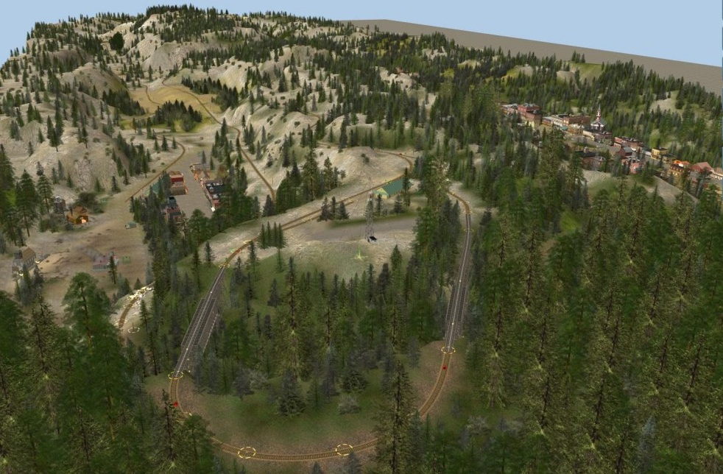
Trainz Simulator
Initial release in December 2001
Current version is TS 2010 (December, 2009)
Notes:
Started as a model railroad simulator; has expanded past that
Pros
Easy route creation
Large number of assets
Continual development / support from the company
Ability to script assets expands the capabilities beyond what the designers provide animated locomotive bells; door animation
Functioning cargo / passenger capabilities
Cons
Average graphics
Average simulation
Many older assets require fixing / updating to work in the newer versions

Slide 9
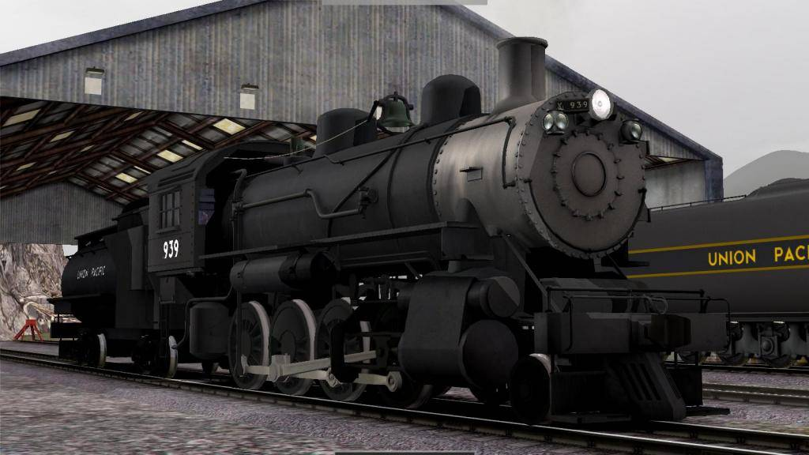
Kuju Rail Simulator
Released in October 2007
By the same team that wrote MSTS
Current version is RailWorks (June, 2009)
Notes:
Pros
Excellent graphics
Excellent driving simulation
Good community support
Cons
Limited free 3rd-party content
Limited AI

Slide 10
Modeling the V&T in Trainz

Slide 11
Why Trainz?
Started back in 2006 – only MSTS or Trainz were available
MSTS had been out of support for 4 years or so – didn’t see any resolution to the various bugs & lack of features
Preferred the easier route creation
A Trainz user asked for help!

Slide 12
What is already available for Trainz?

Slide 13
Generic Old West

Slide 14
Notes:
Wagons, horses, ‘Old West’ buildings

Slide 15
V & T Rolling Stock

Slide 16
Locomotives
Notes:
Locomotives 4-14; 21 & 22
Three basic models here, with slight variations on details and textures – 2-4-0, Baldwin 4-4-0, and early Baldwin 2-6-0.

Slide 17
Passenger Cars
Notes:
Coaches 1-6; 9 & 10

Slide 18
Freight Cars

Slide 19
V& T Structures

Slide 20
Virginia City
Notes:
Roundhouse (several configurations)
Wood fuel shed
Water tank (several configurations)
Passenger depot
Freight depot (under construction)
Passenger car shed
Sand house
Blacksmith shed
Ophir mill trestle #1

Slide 21
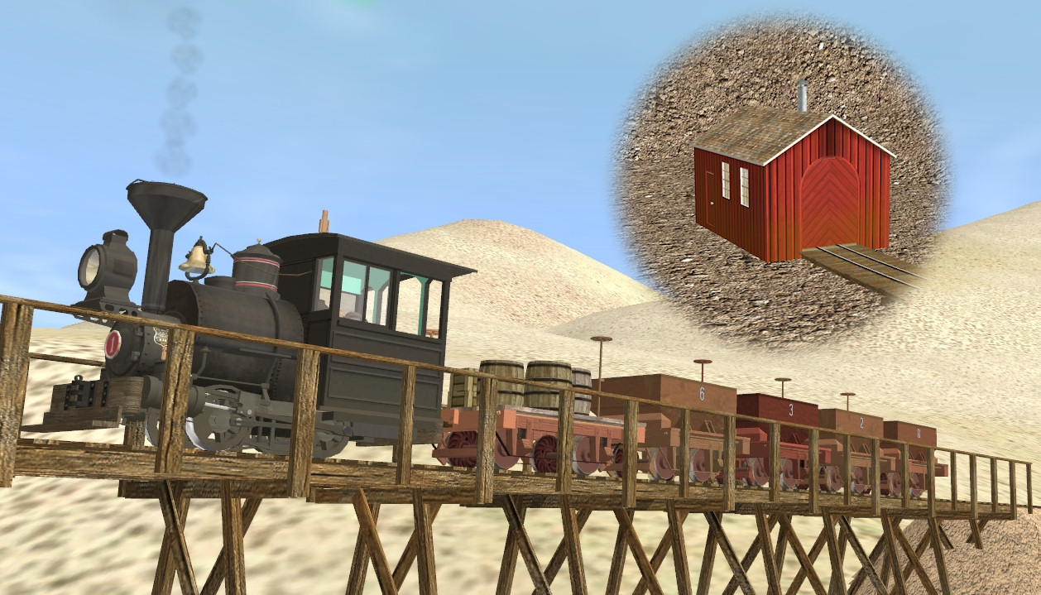
Gold Hill – Carson River
Notes:
Gold hill
Depot (under construction)
Miner’s Union Hall
Scales
Water tank
Carson River
Empire Mill 30” tracks, train, trestles, engine house

Slide 22
V&T Content: Carson City
Notes:
Carson City
Enginehouse (under construction)
Turntable (under construction)
Oil tank
Boxcar 1005 shed
Oil house

Slide 23
Steamboat & Reno
Notes:
Passenger depot (under construction)
Water tank
Truckee River bridge (2 versions)
Turntable
Engine house
Section house
Tool shed
Blacksmith shop
Reno Mill (under construction)
Overland Hotel (under construction)
Virginia St. bridge (old) & other bridge;

Slide 24
Making New Models

Slide 25
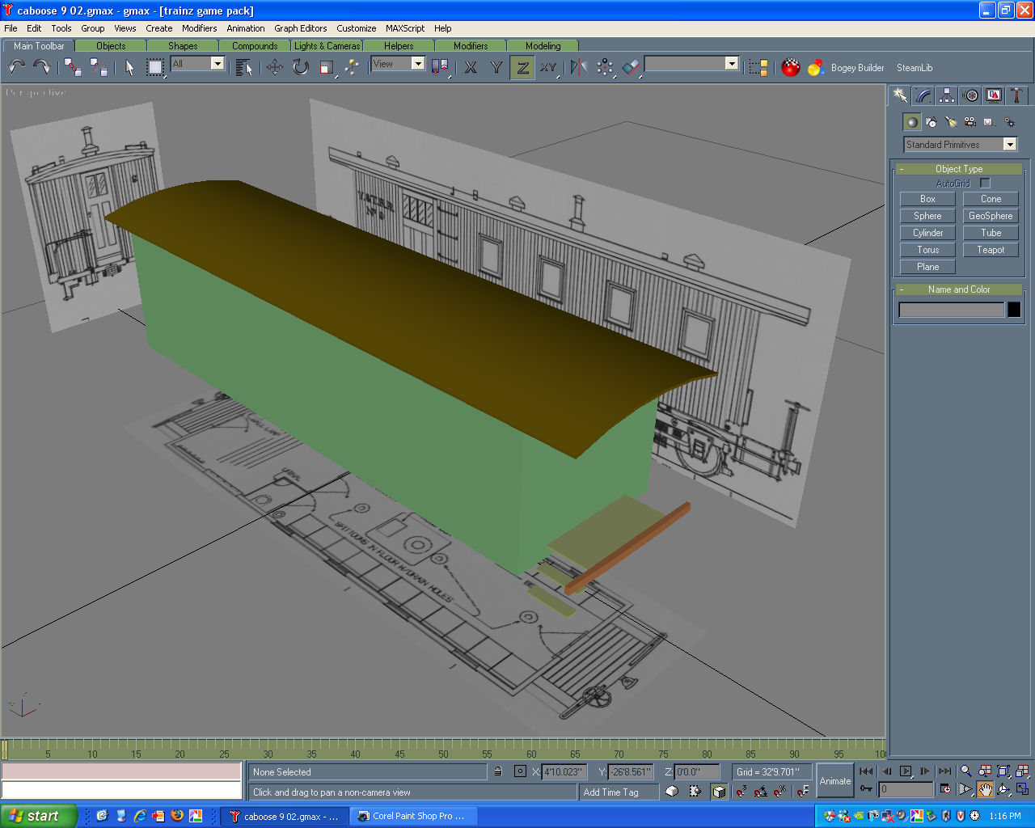
Create the model in a 3D program
Notes:
Blender or GMAX are free; 3DS max is also used
Start with simple primitives (cubes, planes, etc)

Slide 26
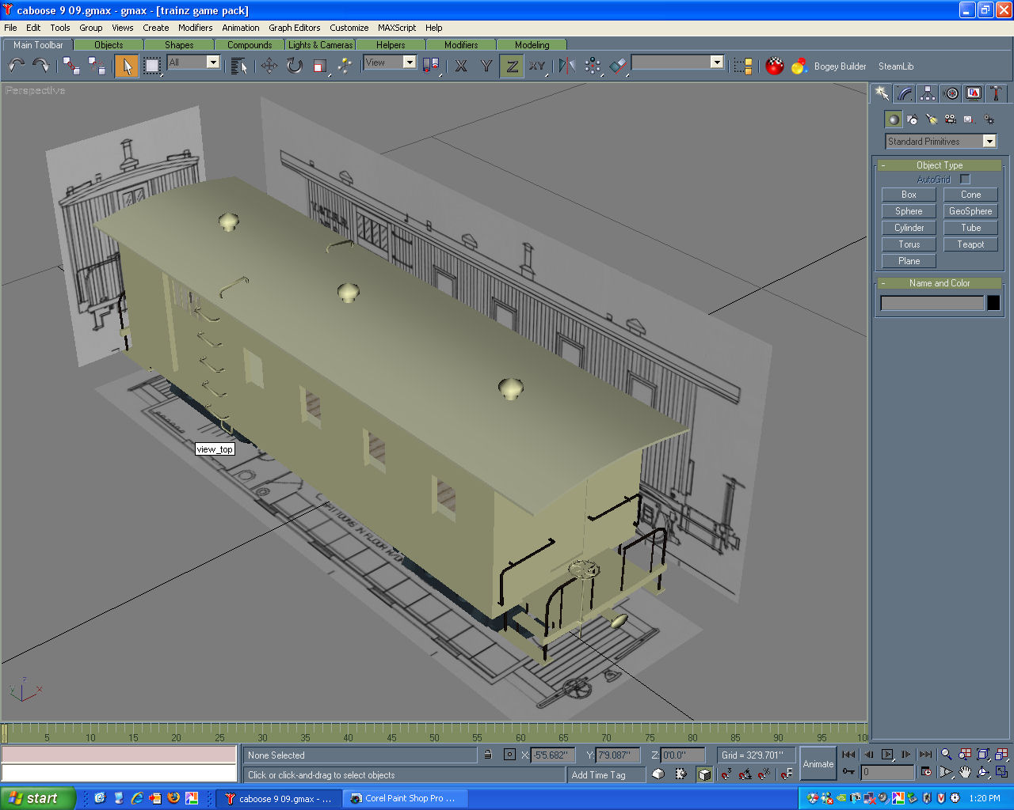
Create the model in a 3D program
Notes:
Add details

Slide 27
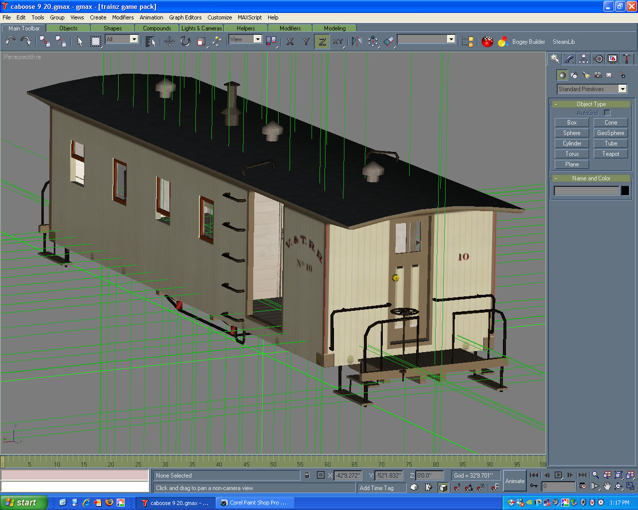
Create the model in a 3D program
Notes:
Finalize details; add texture and attachment points

Slide 28
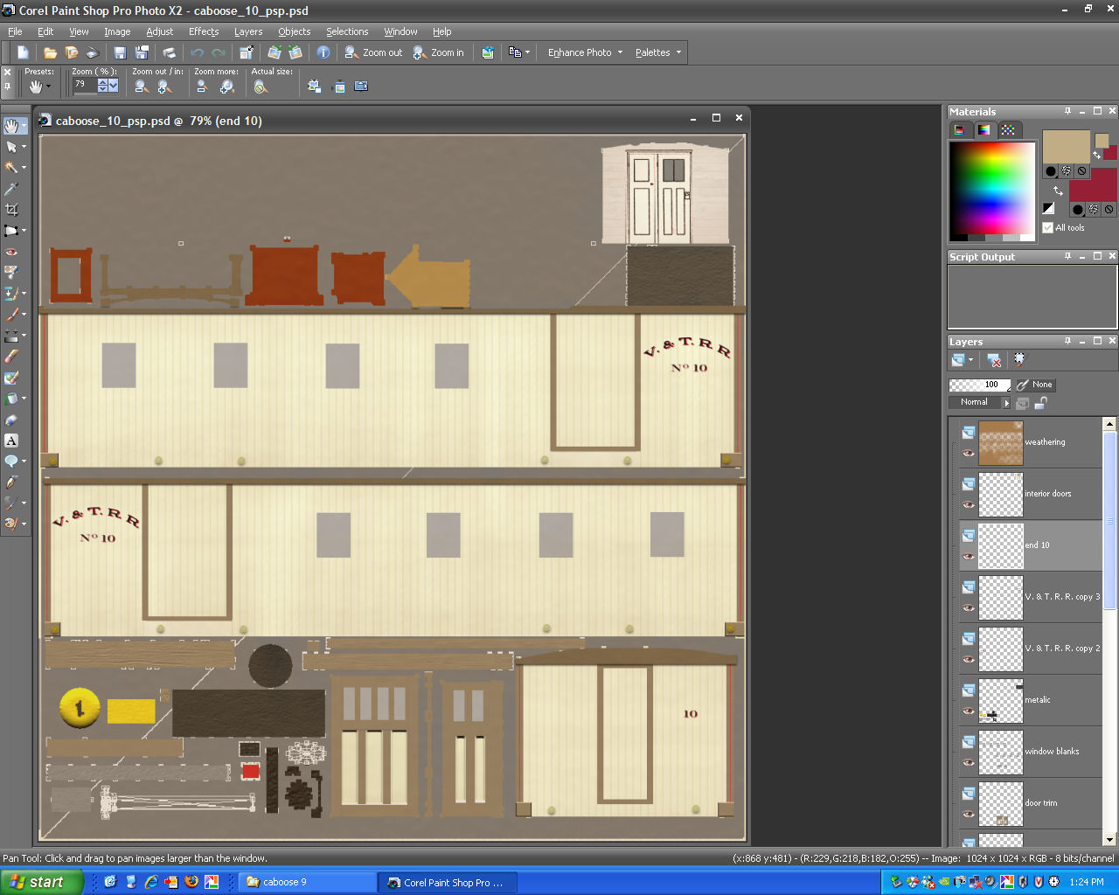
Use a paint program to ‘texture’ it
Notes:
Paint.Net; Gimp; Paint Shop Pro; Photoshop

Slide 29
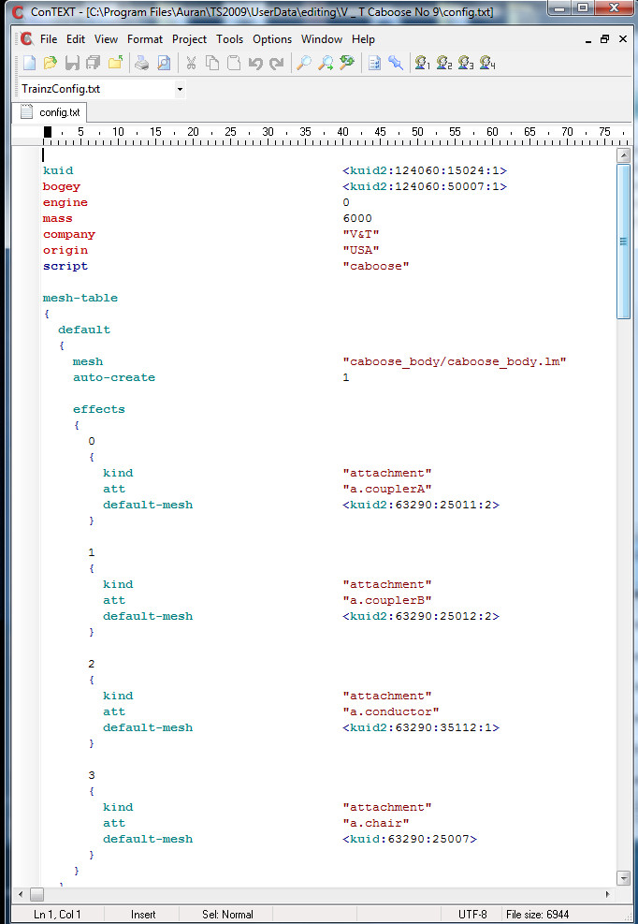
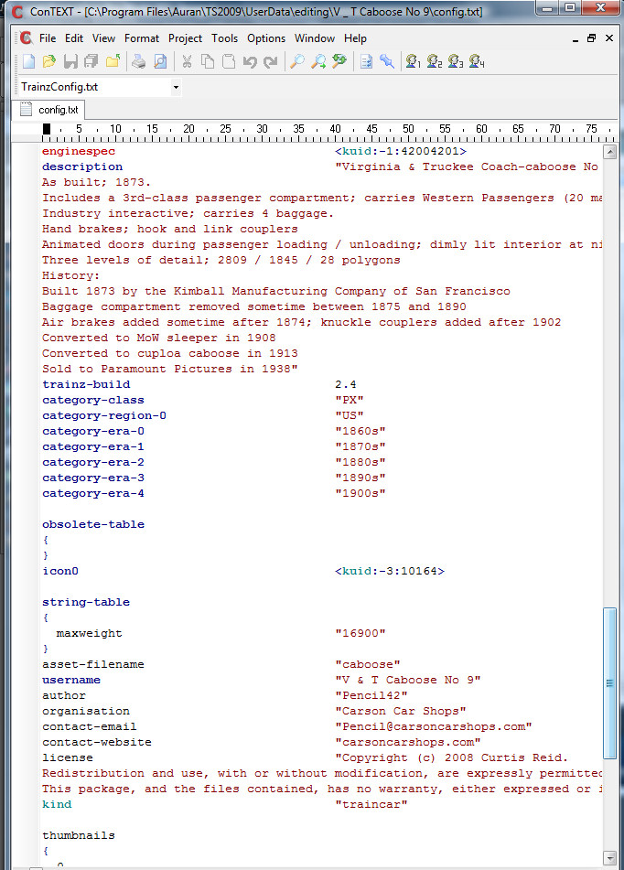
Add a config file
Notes:
Tells the game how to use the model
which parts to use and where (trucks & other attachments)

Slide 30
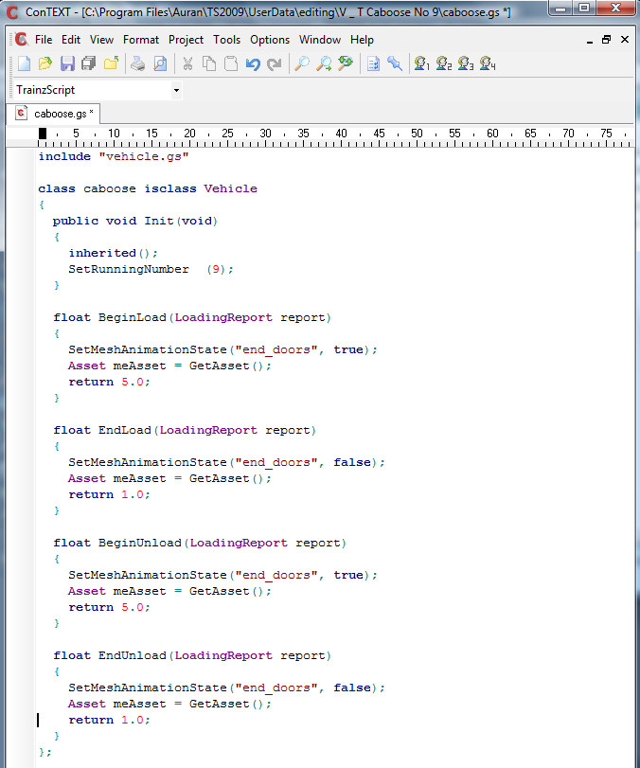
Add scripting (optional)
Notes:
C-like syntax
Used to add any animation effects
In this case, animates end doors to open when loading or unloading.

Slide 31
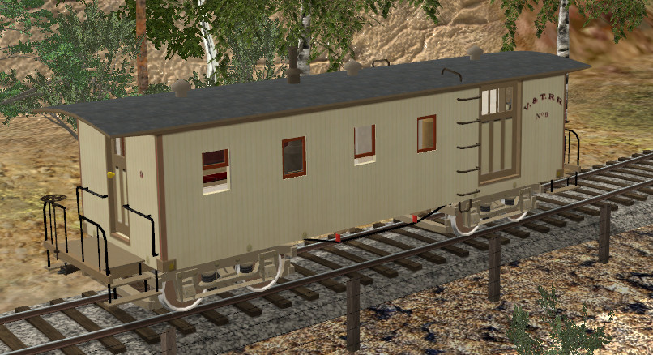
And, you are done!

Slide 32
Making a New (Prototypical) Route

Slide 33
Research
Railroad
Where did the track go?
What did the track look like?
Where were the rail joiners – staggered, or flush?
Were tie plates used? Rail chairs?
What rolling stock was used
What did the bridges look like?
Right of way protection?
Fences; grade crossings; signs
Surrounding area:
What material(s) were used in road construction?
What did signs look like?
What landmarks & features have changed?
Airport was once at the golf course, Virginia Lake was built by the CC in the 1930’s, entire VC topography has changed over the years
Road alignments have changed
Entire towns are gone now – Ophir, Jumbo, Empire…

Slide 34
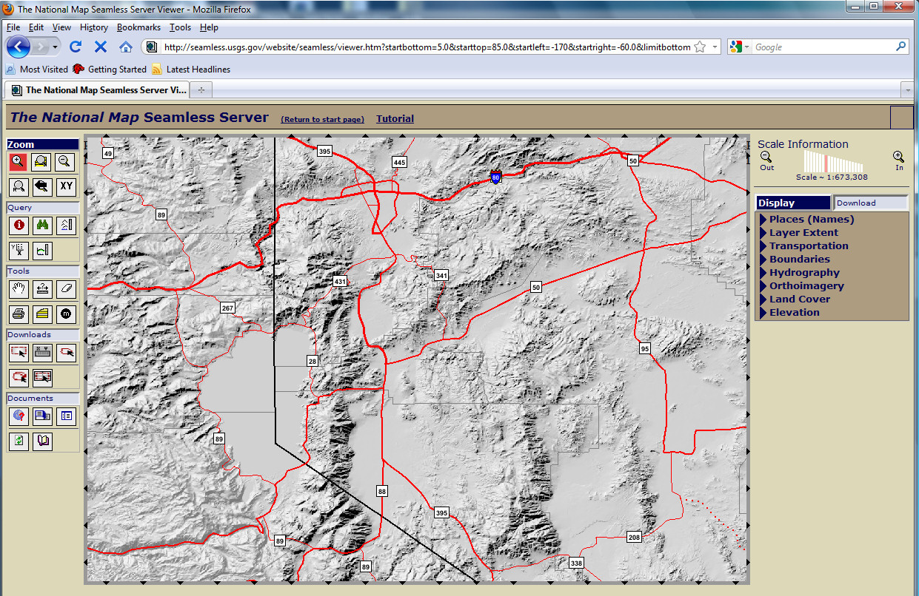
Create the terrain
Download DEMs (Digital Elevation Maps) for the appropriate area.
Notes:
Free data from USGS
Available in both 30m and 10m resolution
Some 3m data is available, but not yet for Nevada
(Trainz native resolution is 10m or 5m)

Slide 35
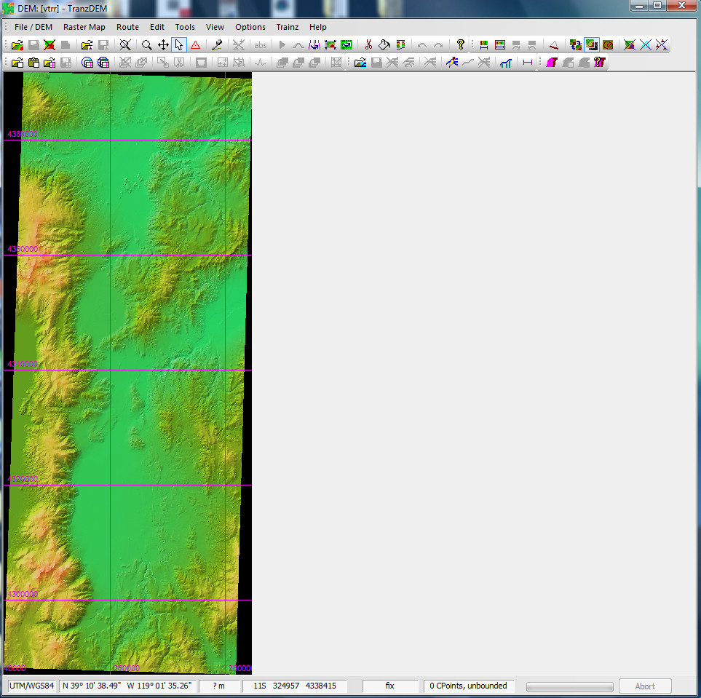
Create the terrain
Use TransDEM (separate program) to convert to Trainz format, add lines for tracks, and add basemaps

Slide 36
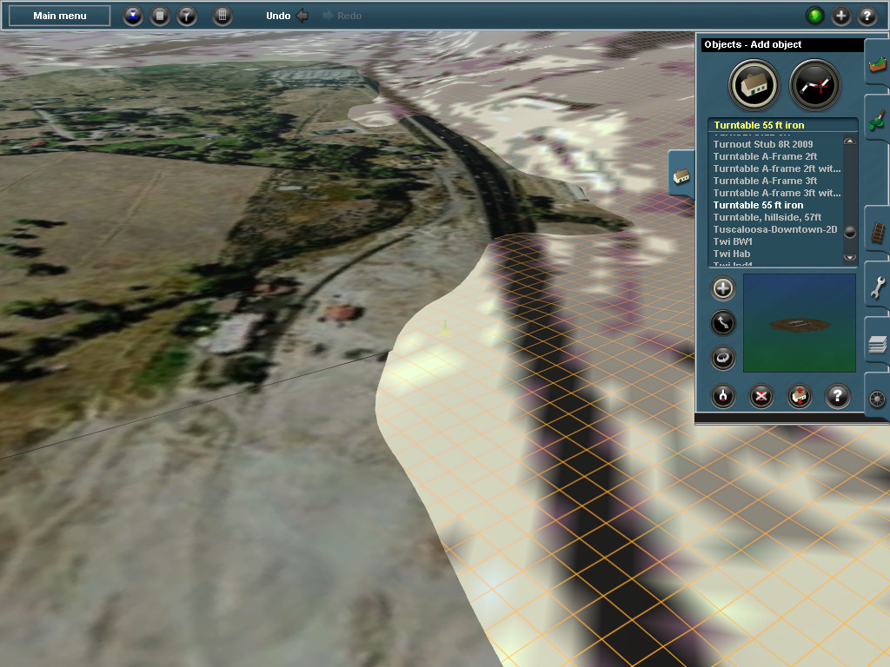
Create the terrain
This is what it looks like ingame:
Notes:
Steamboat location, looking South-ish
Basemap is on the left – it’s a flat plane with a detailed texture applied
Can be moved up and down to match elevation of a particular point, or to get it out of the way
Useful for precise placement of items
Default ground texture resolution is pretty low; it can give a rough idea of location of large items
Ground texture will be painted over with detailed textures (next)

Slide 37
After a little bit of work:
Notes:
Similar location as previous picture a couple slides back – Steamboat, looking South

Slide 38
Some ‘work in progress’ shots

Slide 39
Reno

Slide 40
Reno

Slide 41
Steamboat

Slide 42
Carson City Yards

Slide 43
Vivian Cut

Slide 44
Virginia City Yards

Slide 45
Virginia City

